Slide 1
Te Poipoia Tūkino o Hauraki
matauranga Maori, social norms and community mobilisation as a primary prevention strategy for violence in Hauraki
Notes:
Our deepest condolences to the families who have recently lost loved ones to domestic violence here in the NT – we are so sorry your personal grief was sprawled across the newspapers like that - you need to know that Australia is not alone in this

Slide 2
Notes:
In NZ
40% of all homocides are caused by family violence
1 in 4 women experience intimate partner violence, and
55% of the children who witness family violence are Maori
It is estimated FV costs the NZ taxpayer between $4 to $7bn per annum with a projected increase to $10bn by 2018 (Glenn Inquiry, 2014)
NZ has done the crises summits and the inter-agency protocols and the national publicity campaigns and the policy frameworks and the Taskforces but the rates of family violence continue to rise, something has to change
Our organisation is trying a new direction which involves a model that has been developed in Uganda and an amalgamation of knowledge from Maori research methodologies, western epistemologies and other indigenous disciplines

Slide 3
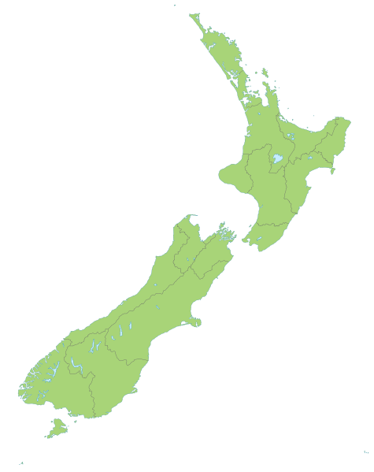


some background info
Hauraki is a tribal area in Aotearoa, NZ
small towns, rugged isolated terrain
high density Māori populations
Te Poipoia Tūkino o Hauraki (Te Poipoia)
a local collective of indigenous NGOs
a 10 year strategic plan
the name of our research project
Te Whāriki Manawāhine o Hauraki
a member of Te Poipoia
violence prevention & support services
host organisation for the research
Notes:
Hauraki is a territory or region, that is defined by tribal boundaries … it is characterised by small towns, rugged terrain, coastal villages and some very high density Māori populations …
Te Poipoia Tūkino o Hauraki is
a local collective of indigenous NGOs
the name of a 10 year strategic plan for the transformation of whānau violence
and the title of a research project that Im about to describe
Te Whariki Manawāhine is
The name of our organisation
We are an indigenous provider of violence prevention and support services in Hauraki, and
one of the NGOs in Te Poipoia
and the host organisation for this research

Slide 4
research scope
explore the community mobilisation model of violence prevention
informed by SASA!, www.raisingvoices.com
track progress/change over time
Māori cultural imperatives (Dobbs & Eruera, 2014)
reduce the risk of violence
Notes:
In March 2014, Te Whariki started an 18-month project that is funded by the Health Research Council of NZ under their Māori health stream
broadly speaking, the HRC gave us an opportunity to explore the relevance of a sociological theory called community mobilisation as a violence prevention strategy for Maori
We set it up so the methodologies were informed by an internationally acclaimed initiative called SASA! that was established by Lori Michau and her colleagues at Raising Voices in Uganda
Alongside reducing the impacts of family violence in Hauraki, our research wants to
establish capacity for tracking progress or change over time, and
Our methodologies must be firmly underpinned by Maori cultural imperatives

Slide 5
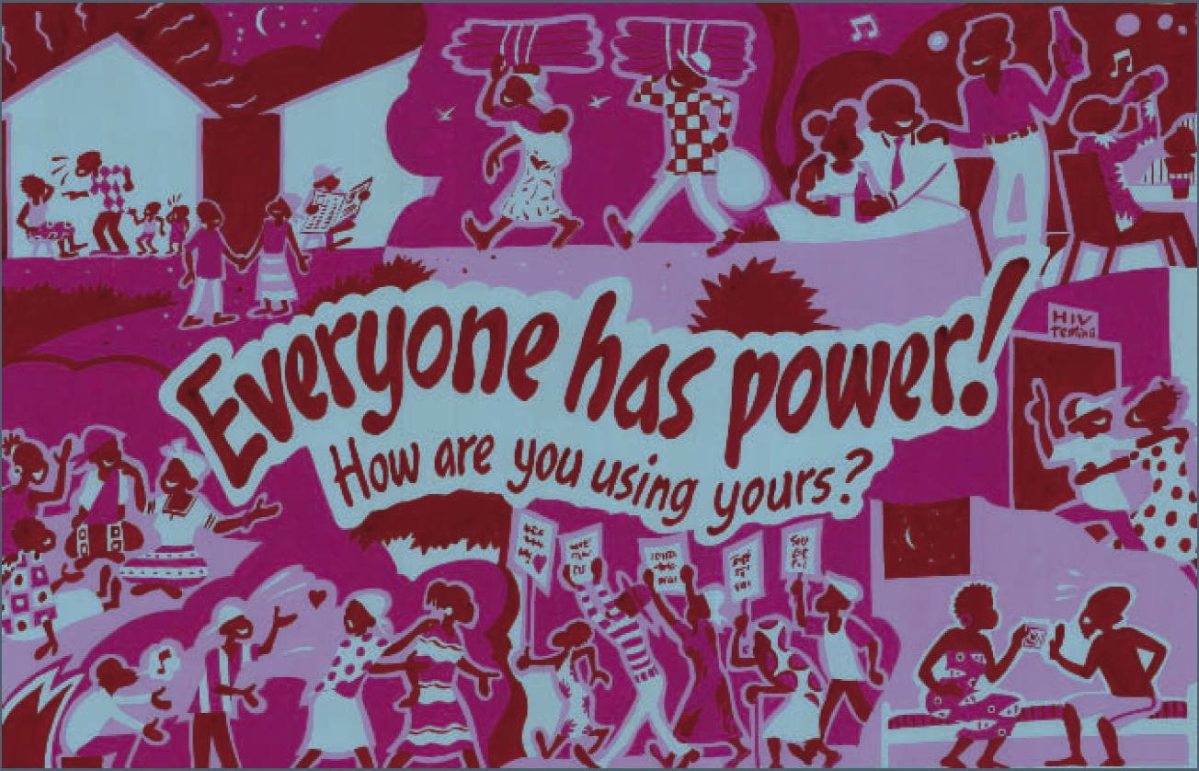
principle 1: violence is about POWER
SASA! design logic
violence is caused by an imbalance of power
strategies for the prevention of violence must address this underlying cause
Notes:
The way in which Raising Voices have utilised community mobilisation theory to create SASA! is innovative and inspirational as an exemplar for indigenous groups working in violence prevention and the general area of social change.
In a nutshell, the SASA! model of violence prevention is derived from a logic matrix that is mainly based on 4 theoretical principles
First and foremost, Raising Voices have fully embraced the literature which shows that Violence is always about POWER
as a logic statement for SASA!, this translates into something like
violence is caused by an imbalance of power, therefore
strategies for the prevention of violence must address this underlying cause

Slide 6
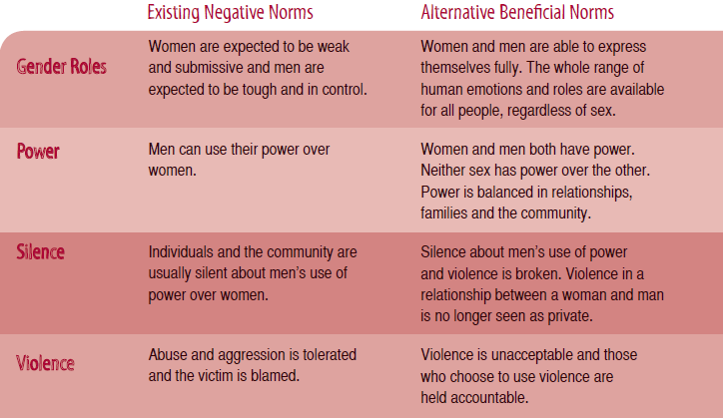
principle 2: power is a social construct
a social norm is a personal belief about the things that other people do and think
descriptive norm (I do it because other people do it)
injunctive norm (I do it because other people think I should do it)
social norms are held in place by the expectations of people in our reference group (whānau, community, friends, workmates, society)
Bicchieri, C. & Mercier, H. (2014). Norms and Beliefs: How Change Occurs. The Jerusalem Philosophical Quarterly, 63 (January): 60-82.
SASA! design logic
violence is upheld by normalised beliefs about power
violence is upheld by social norms
violence prevention strategies have to target harmful social norms
Notes:
Principle 2: Power perceptions are normalised by social processes
Secondly, Raising Voices have remembered that
human beings are not born with predetermined perceptions about power
this is something that we learn from our family and friends and neighbours and environments and society
power perceptions are an attitude, a belief, a stereotype an expectation that is socialised and normalised by other people in our lives
As a logic statement for a violence prevention strategy, this has translated into something like …
violence is upheld by normalised beliefs about power, therefore
violence is upheld by social norms, which means that
violence prevention strategies must target harmful social norms

Slide 7
principle 3: social norms can be changed
establish team
create resources
gather baseline data
complete surveys
distribute resources
participate in discussion
engage with community
participate in discussion
participate in discussion
participate in discussion
participate in discussion
Notes:
Principle 3: Social Norms can be Changed
On any one day, throughout the world, billions of dollars are invested in public health campaigns that are based on Prochaska’s trans-theoretical process for attitude and behaviour change
Raising Voices used the language of power to reframe Prochaska’s model into a community mobilisation strategy for transformation of the social norms that underpin violence
Within SASA!, the 4 stages of change are aligned with corresponding phases, and symbols, and power concepts and a number of expected outcomes for not only the kaimahi, or NGO team that leads the delivery of these strategies but also the Community itself

Slide 8
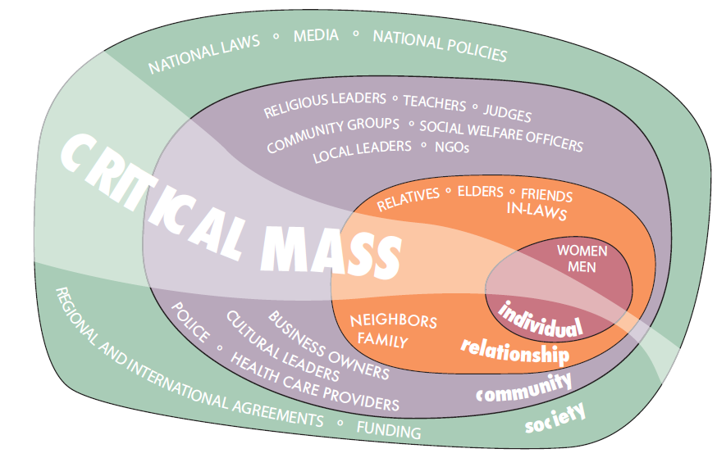
principle 4: critical mass
Systems Theory (Bronfenbrenner, 1979)
the simultaneous use of diverse strategies, within and across our Circles of Influence, will eventually generate the critical mass that will change social norms and sustain long-term behaviour change
Notes:
The 4th logic statement comes from Systems Theory also called Ecological Theory which talks about the connectedness between ourselves as individuals and our family, then our community and wider society … and the capacity that exists for this connectedness to become an agent of change … this, of course, is referring that familiar notion of … a small change in one person being able to trigger a sea of change in others
SASA! have called this our Circles of Influence and the logic statement says …
“the simultaneous use of diverse strategies, within and across our Circles of Influence, will eventually generate a critical mass that will change social norms and sustain long term behaviour change”

Slide 9
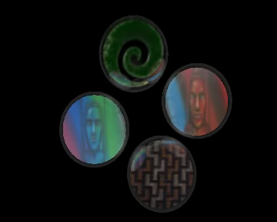

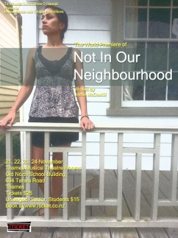
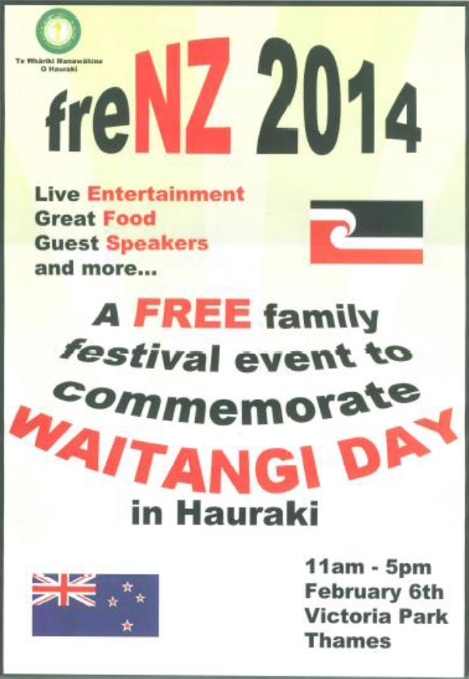




POUTAMA MAURI ORA MAURI TU:
a programme for healing and recovery from violence
Notes:
Hearing about SASA! immediately struck a chord with Te Whariki because it gives value and meaning to the diverse strategies that we have been using for the prevention of violence within our community for decades

Slide 10
Start phase
will a social norms approach work in Hauraki?
produce evidence that social norms are operating and associated with family violence (demonstrate feasibility)
how will we know the community mobilisation model works?
collect baseline data for monitoring change over time
can a Māori cultural imperative become a social norm?
develop/deliver a programme that teaches transformative cultural imperatives
pre/post test outcomes
Notes:
Our Start Phase has involved three data collection methodologies, two of which I am going to quickly describe.
I am going to show you some evidence which suggests a social norms approach to the prevention of family violence is going to be successful in Hauraki
And I am going to show you some data which suggests that a Maori cultural imperative has the capacity to become a social norm that generates critical mass

Slide 11
Will a social norms approach work?
how to identify a social norm (Christina Bicchieri)
what I do?
what I think other people do?
what do other people think it is appropriate to do?
masculinity theory (Raewyn Connell, Australian sociologist)
gender perceptions are associated with power asymmetries that underpin intimate partner violence
can be measured/identified through simple word quiz?
Notes:
to test the feasibility of a social norms approach we turned to the literature on
how to identify a social norm, and
Masculinity theory

Slide 12
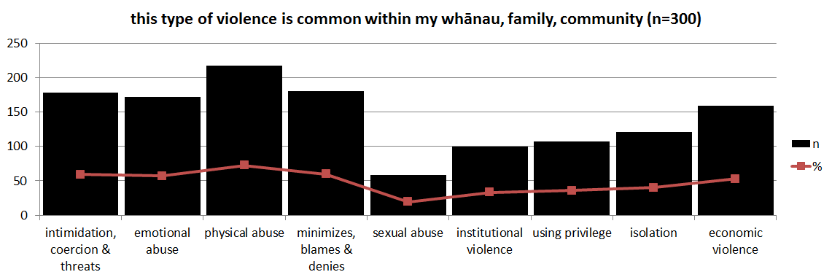
Is violence a social norm?
what I do?
what I think other people do?
what do other people think it is appropriate to do?
Notes:
To identify a social norm, experts say you have to show that people either
Do it, or
Think other people do it, or
Think other people think it is appropriate to do it
So we ran a prevalence survey which asked our people whether various types of violence were common within their family and friends … 50 to 70 % of our sample said most types of violence were common
In other words, most of our people thought most types of violence were quite normal within their families and communities

Slide 13
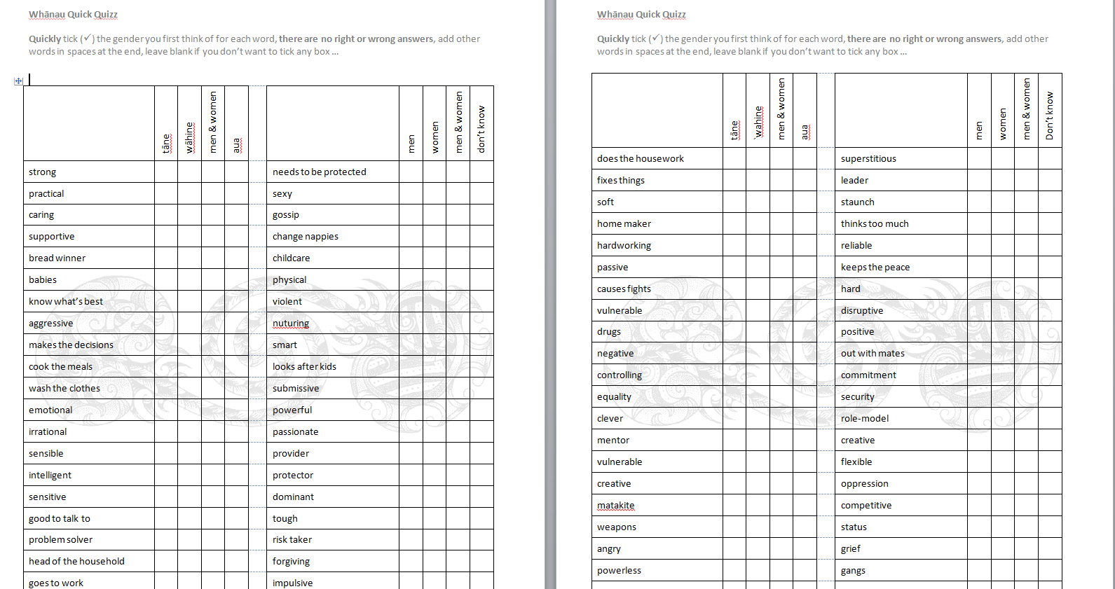
Evidence that social norms are operating
Notes:
Based on masculinity theory, and the notion that intimate partner violence is often underpinned by gender inequity perceptions, we ran a survey which asked people whether everyday words and expressions were associated with a particular gender …. this simple, theoretically informed, technique has produced an amazingly rich dataset that could certainly help to explain the prevalence of violence in our community and it has also identified a brand new direction for the development of primary prevention strategies

Slide 14
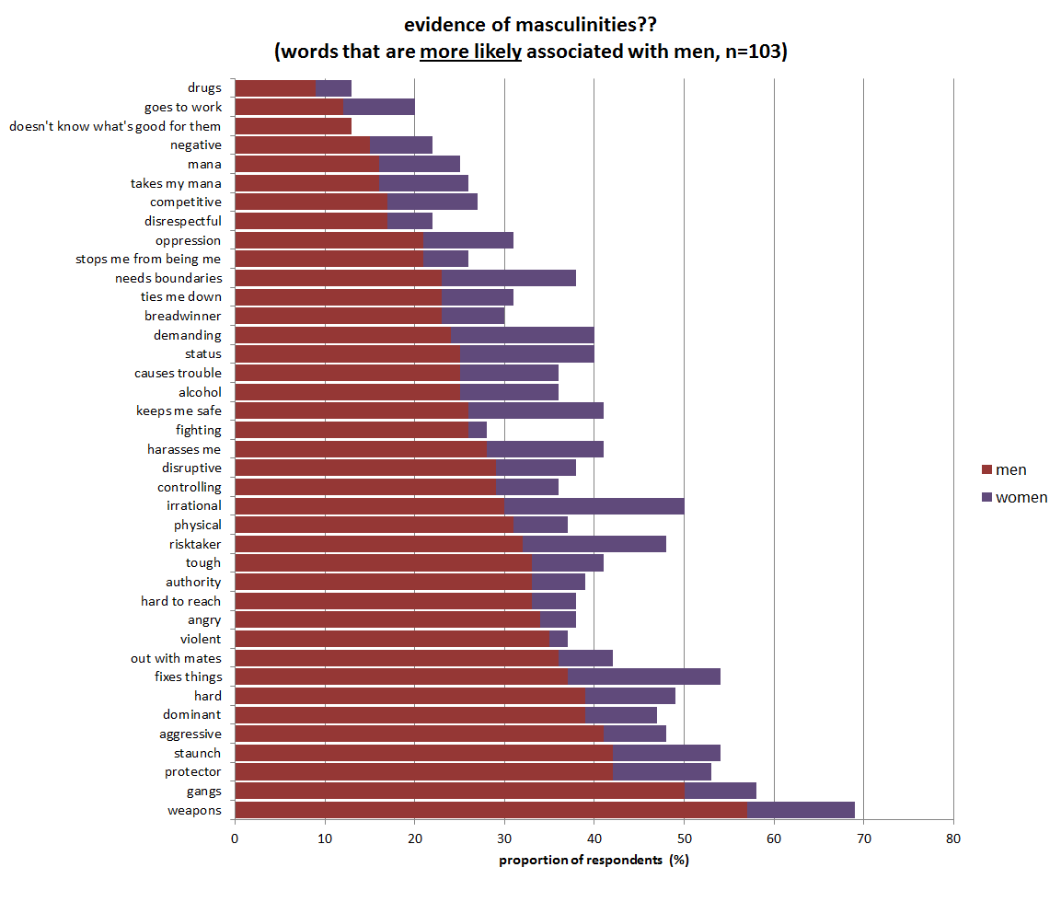
Notes:
In brief, 39 of the 150 items in our quiz, were associated with men, for example, words like
weapons
protector
staunch
authority
angry, and
hard to reach
were clearly associated with men

Slide 15
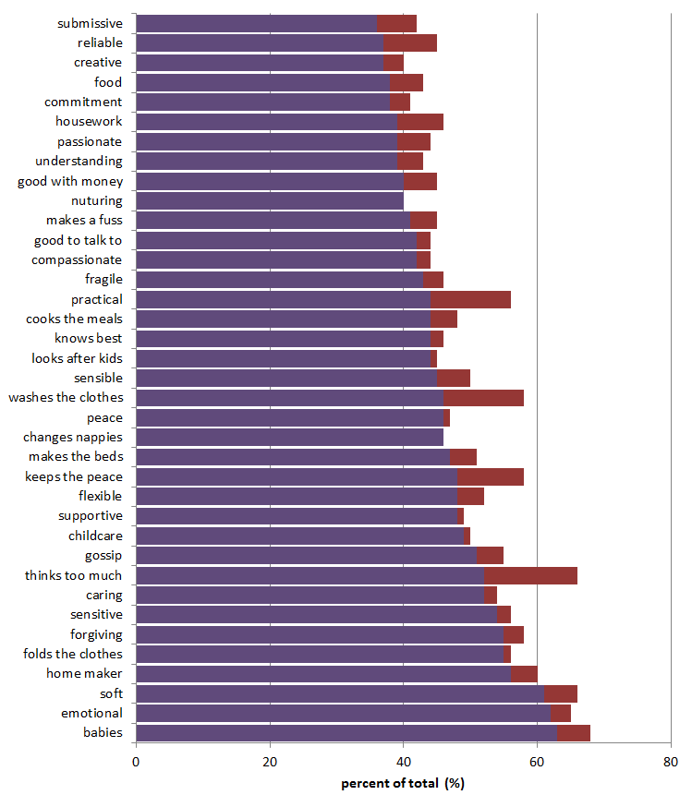
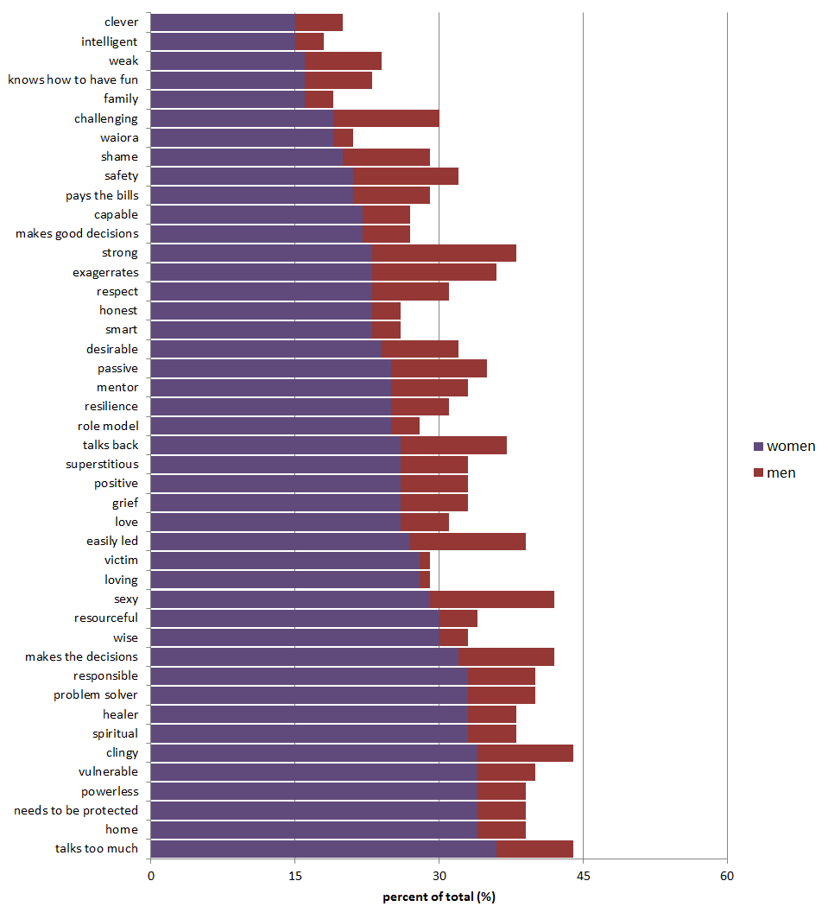
evidence of feminities (words that are more likely associated with women, n=103)
Notes:
In addition, over 80 items were associated with women including
needs to be protected
talks too much
soft
emotional, and
powerless

Slide 16
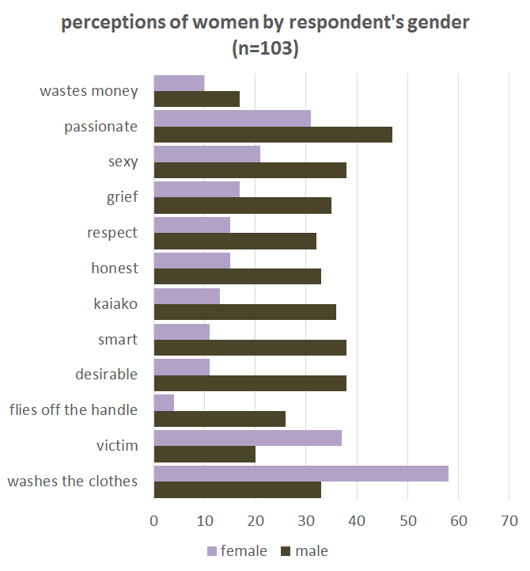
Notes:
We found significant differences by gender

Slide 17
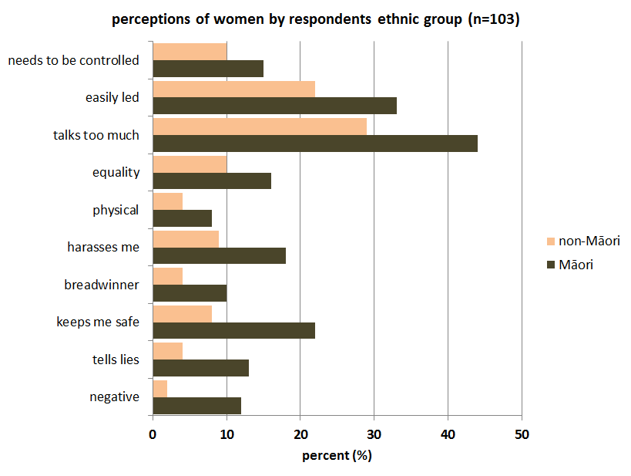
Notes:
And ethnic group …. and as you may have realised by now …. this dataset has shown that masculinities are alive and well in Hauraki and the development of resources that promote gender equality would be a really good place to start as a violence prevention strategy in our community

Slide 18
can a Maori cultural imperative be a social norm?
Mauri
life principle, the sneeze of life, unifying element, sacred and divine origins, taonga tuku iho
dynamic, resilient, flexible, can wax and wane, feeds on collective energy, interacts with mana and tapu, reflects vitality – mauri tu, mauri ora, mauri noho, mauri mate
impacted by violence and abuse
1 of 6 cultural imperatives in the Mauri Ora Framework for family violence prevention (Dobbs & Eruera, 2014)
Notes:
To test whether a Maori cultural imperative could be a social norm, we delivered a programme that uses Maori cultural imperatives to help people recover from violence. One of the concepts this programme discusses is “Mauri” which is generally said to be “the life force or the sneeze of life”, of course its true meaning for our people is much, much deeper than that and we know one thing for sure …. mauri is definitely impacted by experience of violence and abuse

Slide 19
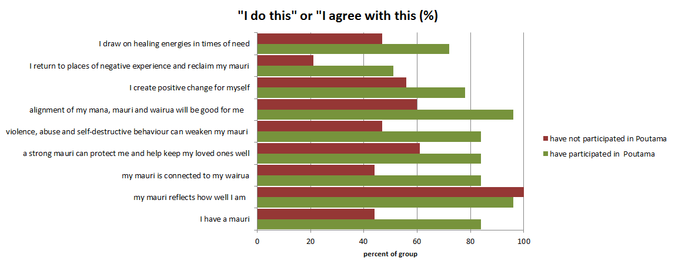
Pre/post test of Poutama outcomes
Poutama Mauri Tu, Mauri Ora – a programme for healing and recovery from whanau violence (Denise Messiter, 1995)
Notes:
Using the theory on how to identify a social norm, we wrapped a pre/post survey around the Poutama programme – and the findings showed that participation increased the likelihood of agreement with mauri statements and willingness to take personal actions that are good for our mauri …. this is an empirical finding that has informed our next research hypothesis ….

Slide 20

a mauri-ora revolution is a community mobilisation strategy that could generate critical mass and displace the negative social norms that underpin family violence in Hauraki
Notes:
over the next 3 or 4 years, and for as long as we possibly can …. Te Whariki is going to heavily invest in the development and use of diverse strategies to normalise mauri across our circles of influence …. Tihei Mauri Ora!

Slide 21
Te Whariki Manawahine o Hauraki
Maree Tukukino mareet@hauraki.refuge.co.nz
Stephanie Palmer stephanie@tumana.maori.nz

