Slide 1
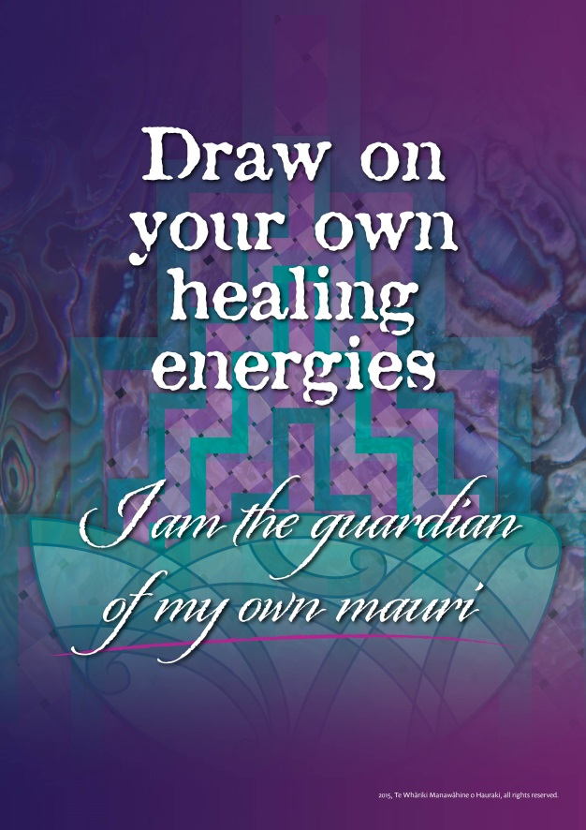
Te Whāriki Manawāhine
transforming & healing violence in Hauraki
preliminary findings from an
exploratory research project
Notes:
This research builds on a body of work that Denise Messiter was implementing during her time as the Manager of Te Whāriki,
this type of research is part of a vision that was identified in
2008 when Māori Service providers launched Te Poipoia Tukino o Hauraki Collective a 10 year strategy for transforming and healing whānau violence in Hauraki
And again, in 2012 during a Formative evaluation of Kaupapa Māori Violence Prevention Services in Hauraki

Slide 2
research aims
develop a tool which measures the social norms that are associated with whānau violence in Hauraki
mātauranga Māori content and aspirations
aligns with Poutama Mauri Ora Mauri Tū!
builds on strengths
able to monitor change over time
progress towards an evidence base
actively engage in primary prevention strategies
Notes:
Towards the end of 2013, Te Whariki received an 18-month Health Research Council research grant that has given us the opportunity to

Slide 3
why social norms?
consistent with the Mauri Ora Framework of Violence Prevention (2nd Māori Taskforce on Whānau Violence, 2004)
dispel the illusion that violence is normal and acceptable
remove opportunities for violence to be perpetuated
transformative practice based on Māori cultural imperatives
inspired by the community mobilisation model of violence prevention (Raising Voices, 2012)
targets the underlying cause
primary prevention technique
diverse programmes and strategies
systematic approach to attitude and behaviour change
tracking outcomes
evidence base
Notes:
Te Whāriki’s decision to use social norms is …
consistent with goals identified by the 2nd Māori Taskforce on Whānau Violence in 2004, their Mauri Ora Framework of Violence Prevention urges the need for strategies which
dispel the illusion that violence is normal and acceptable
remove opportunities for violence to be perpetuated
teach transformative practices that are based on Māori cultural imperatives
Inspired by the community mobilisation model of violence prevention that has largely been developed by Raising Voices in Uganda.
Raising Voices have identified the normalisation of socially defined power inequities as the underlying cause of violence within their families and communities
social norms are targeted as a primary prevention technique to change every day attitudes and behaviours
a diverse platform of programmes and strategies can reduce, and even eliminate, violence in local communities
each programme, or strategy, is wrapped around a data collection process for tracking outcomes and reporting on their evidence-base

Slide 4
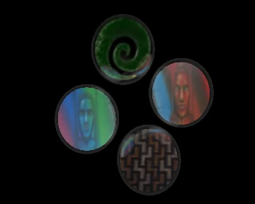
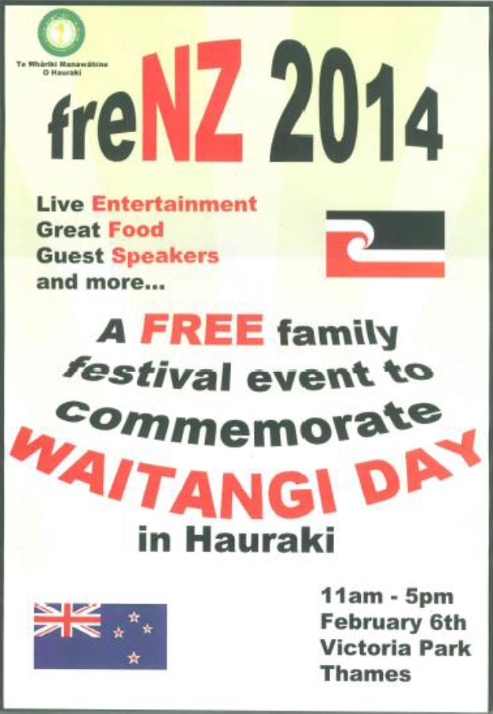
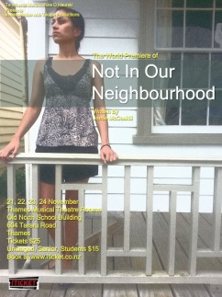
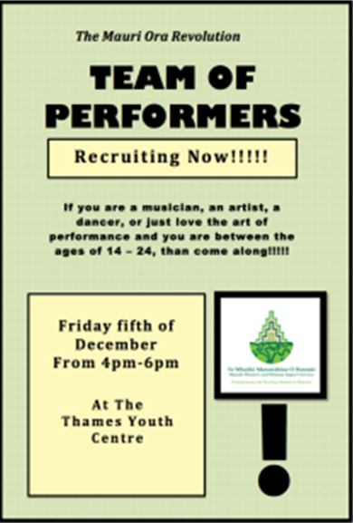
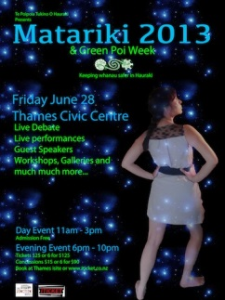


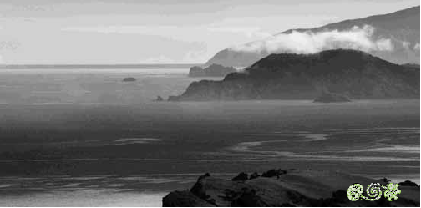
Notes:
the Community Mobilisation model struck a chord with Te Whāriki because it recognizes the value of investments in local events, programmes and activities, which Te Whāriki has been doing for many years, as a strategy for the prevention of whānau violence

Slide 5
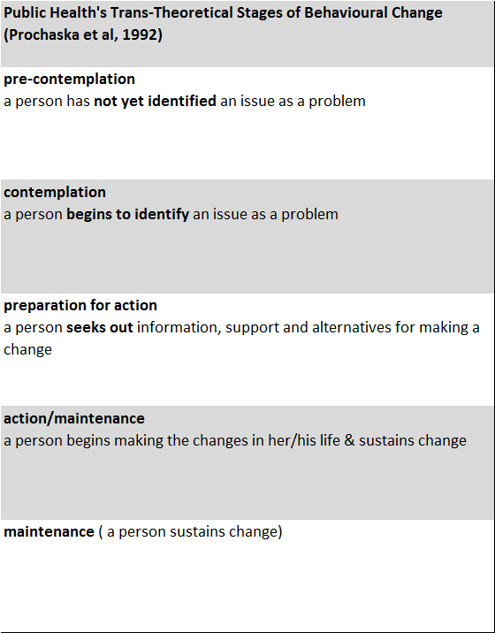
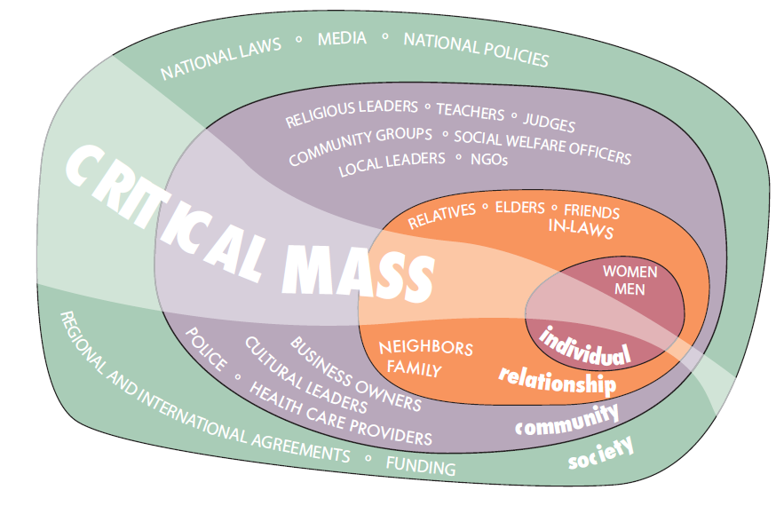
community mobilisation: theoretical base
Systems Theory (Bronfenbrenner, 1979)
the simultaneous use of diverse strategies, within and across the Circles of Influence, will engage the critical mass that is needed to sustain long term behaviour change
Notes:
Community mobilisation is also underpinned by a theoretical paradigm that gives meaning and shape to the work that Te Whāriki has been doing, as well as a platform for engagement in the collation of evidence:
Firstly, community mobilisation is grounded in Public health’s trans-theoretical model of behaviour change which reminds us that people can be at varying stages along a continuum of change - ie pre-contemplation, contemplation, preparation for action, action & maintenance
community mobilisation is also informed by Ecology Theory which builds on the notion of ripple effects, wherein small initial inputs, like one person attending a workshop or Matariki dinner, can trigger changes within their family, community and even the whole of society (Beutement & Broenner, 2010)

Slide 6
what is a social norm?
personal beliefs about the things that other people do and think
descriptive norm (I do it because other people do it)
injunctive norm (I do it because other people think I should do it)
social norms are held in place by the expectations of people in our reference group (whānau, community, society)
Notes:
Social norms are ….
There are different types of social norms, for example …
In general, it is important to know social norms are ….

Slide 7
need to know …
how many of the people in Hauraki have violence in their lives and what types of violence are experienced? (baseline prevalence data for monitoring change over time)
How do we know a social norms methodology will work in Hauraki? is it even relevant? (feasibility of using social norms)
what social norms are based on Māori cultural imperatives? (items in the pilot tool)
Notes:
3 need to knows were identified early in our research journey
We felt the prevalence survey was needed because national and local datasets, like FVCH summaries are presenting the information that comes through the system, eg Police apprehensions, court records, CYFs referrals etc. As many of you will know, the violence that people actually experience is grossly under-reported in these types of statistics.

Slide 8
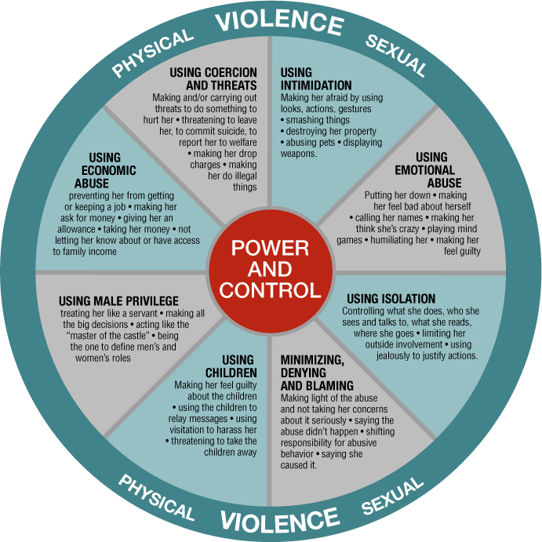
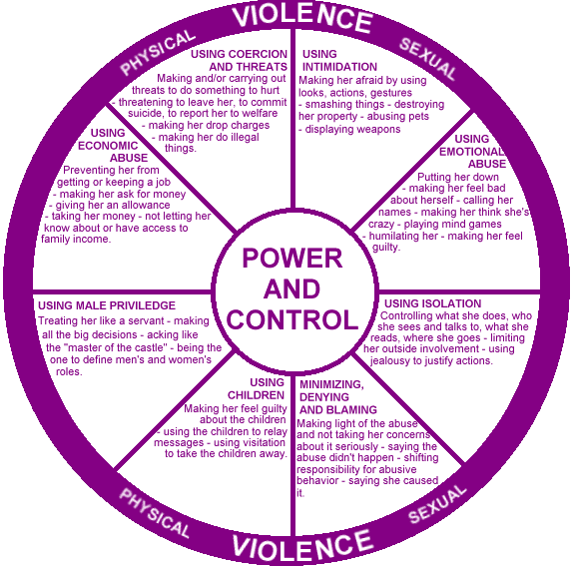
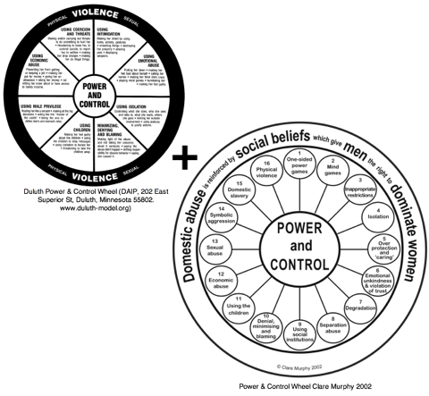
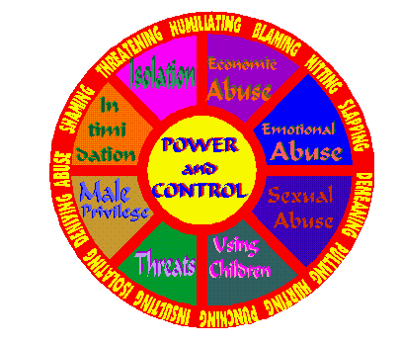
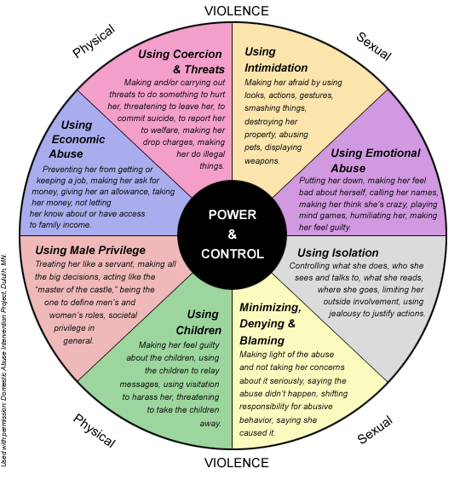
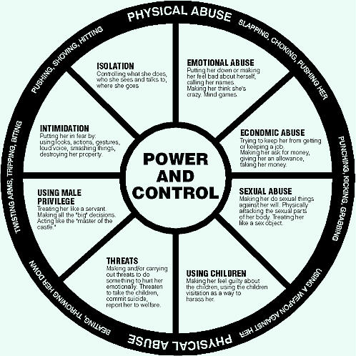
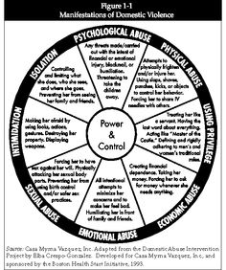
the prevalence survey
Notes:
Preparation for the prevalence survey led us to the hundreds of violence wheels, that have been created, throughout the world, to describe and define the types of violence that people can experience
Read out some

Slide 9
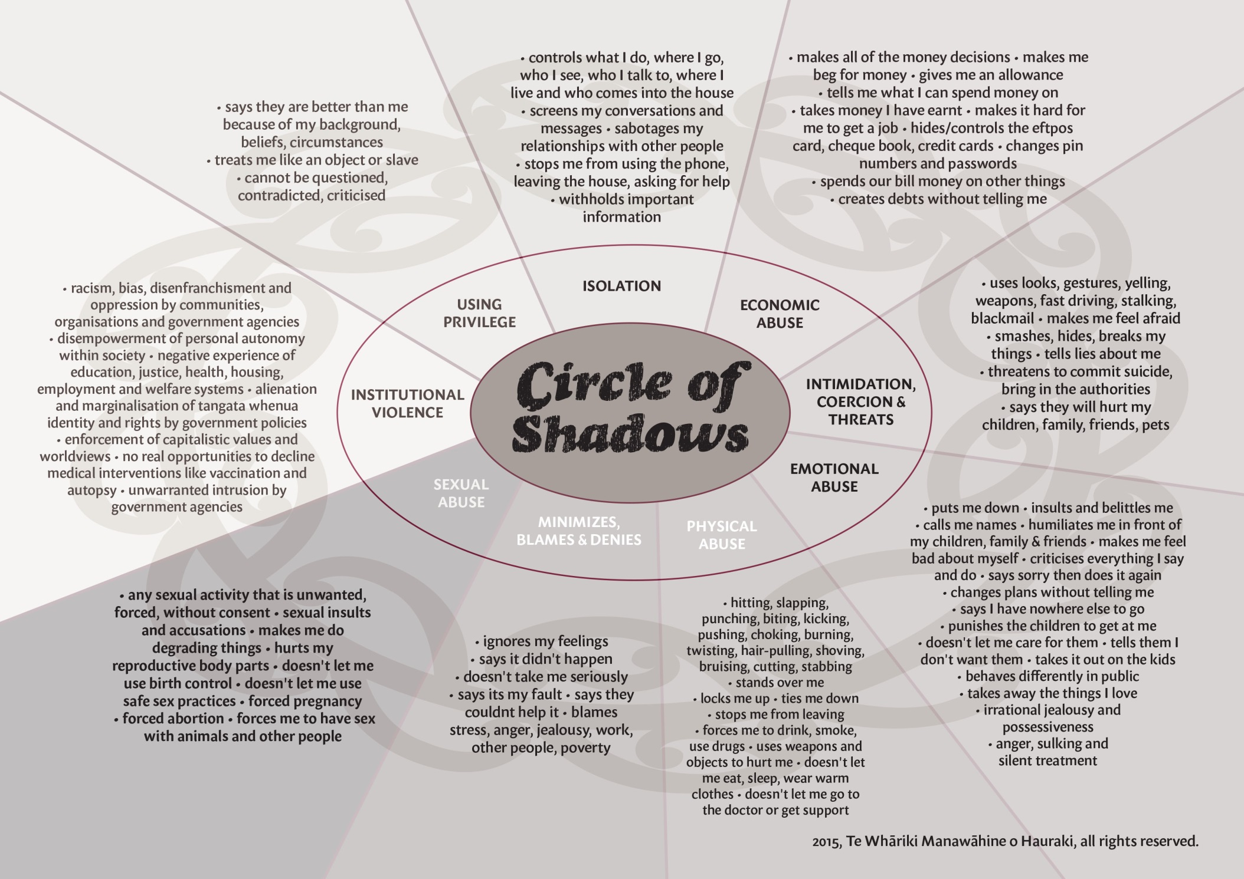
Notes:
At the end of the day, we created our own image to describe the types of violence people because we knew many of our people had experience of institutional violence, we called this The Circle of Shadows

Slide 10
Notes:
Our prevalence survey asked people whether they had ever experienced these types of violence
At any time in the past
Over the last 12 months
And it also asked people whether they thought it was common in their community

Slide 11
Prevalence survey – sample

Slide 12
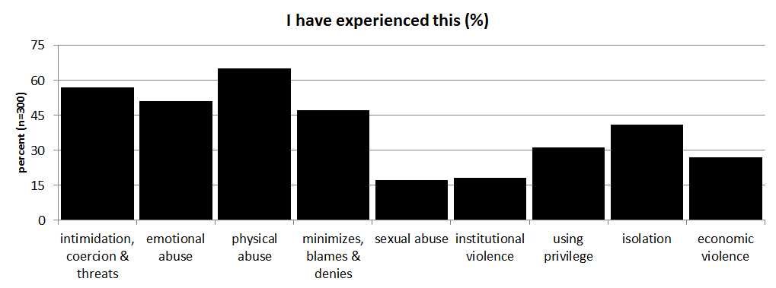
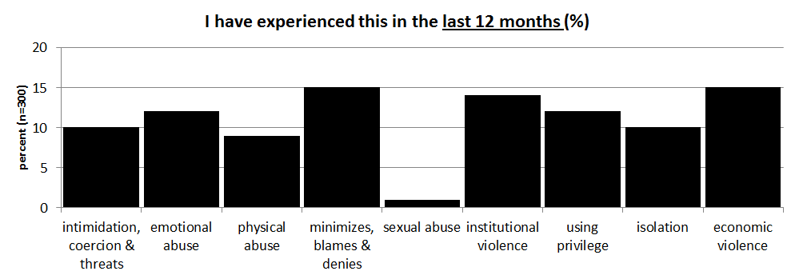

Slide 13
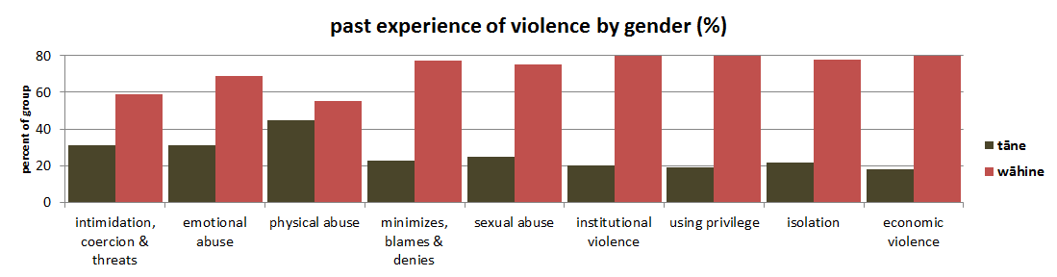
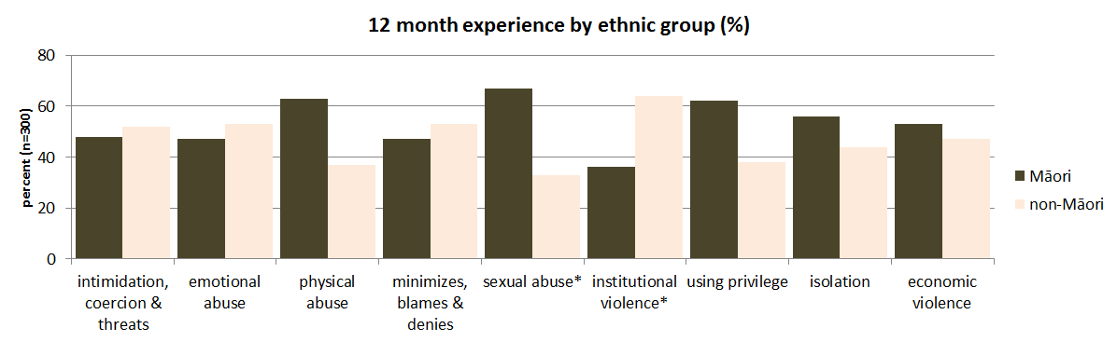
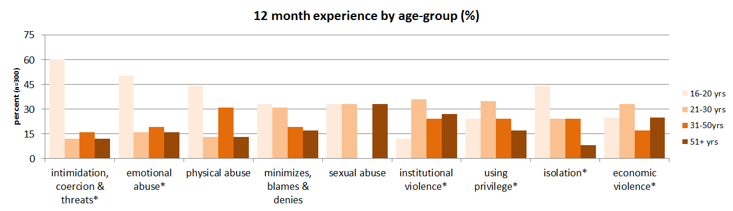

Slide 14
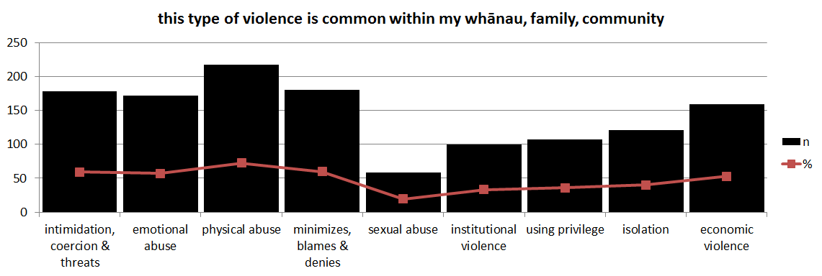

Slide 15
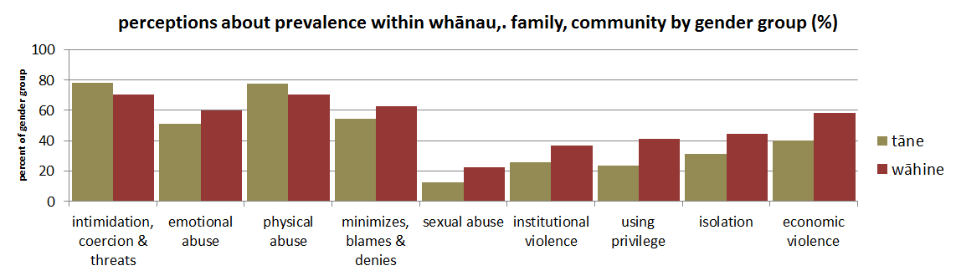
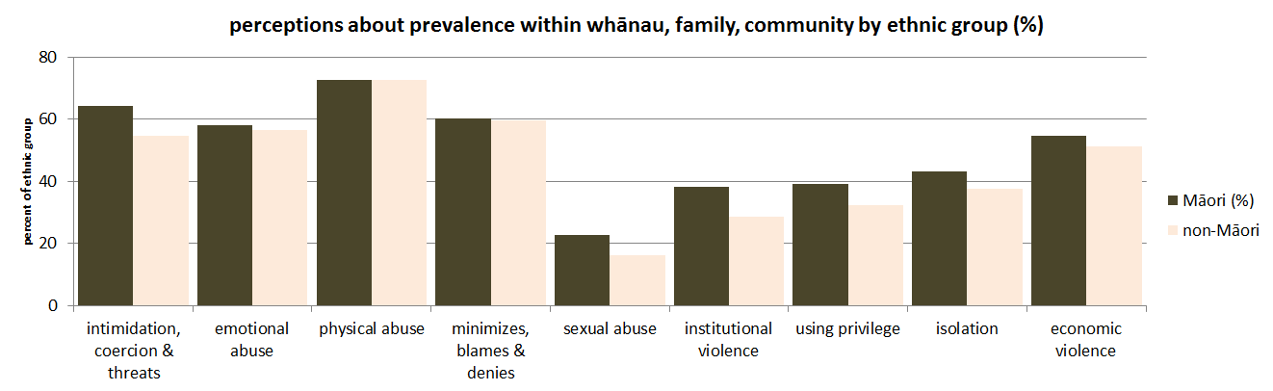

Slide 16
testing the feasibility of social norms
why use a word quiz
masculinities associated with power asymmetries that are known to underpin intimate partner violence (Connell, 2000)
promotion of gender equality as a strategy for prevention of violence against women (Fulu et al, 2013)
hegemonic, cosmopolitan and hybrid masculinities - changes over place, time and demographics (Connell & Messerschmidt, 2005)
gaps in New Zealand’s literature
characteristics of manhood (Brickell, 2012)
gender specific communication styles (Holmes & Stubbe, 1997)
the origins of Māori masculinity (Hokowhitu, 2004)
patriarchy, as a dominant ideology, in violent interactions between adolescent girls (Swift, 2014)
if are masculinities were found to be associated with everyday words, that are heard and used in Hauraki, we would have evidence of socially defined perceptions/social norms operating within our community
Notes:
Raewyn Connell

Slide 17
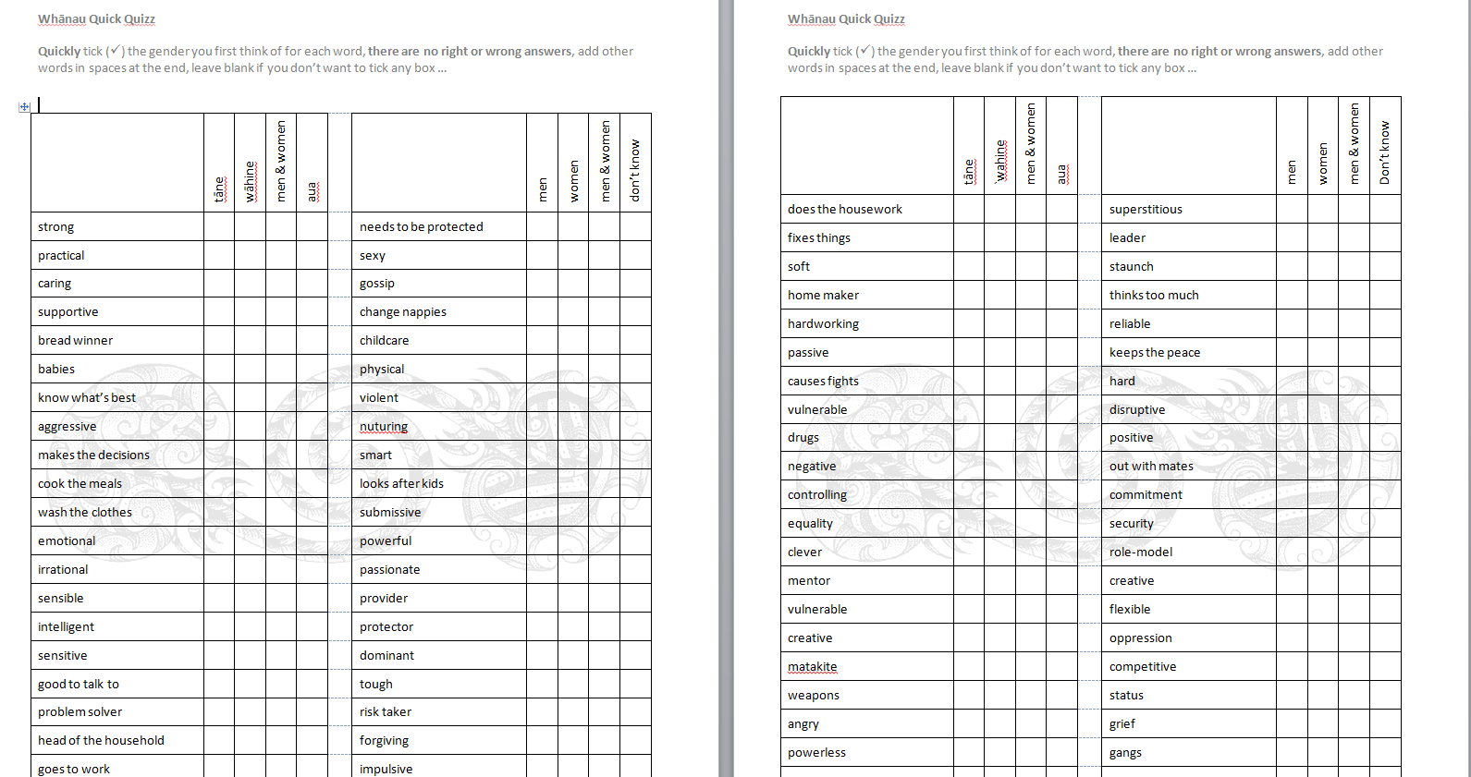
a simple word quiz

Slide 18
n=103

Slide 19
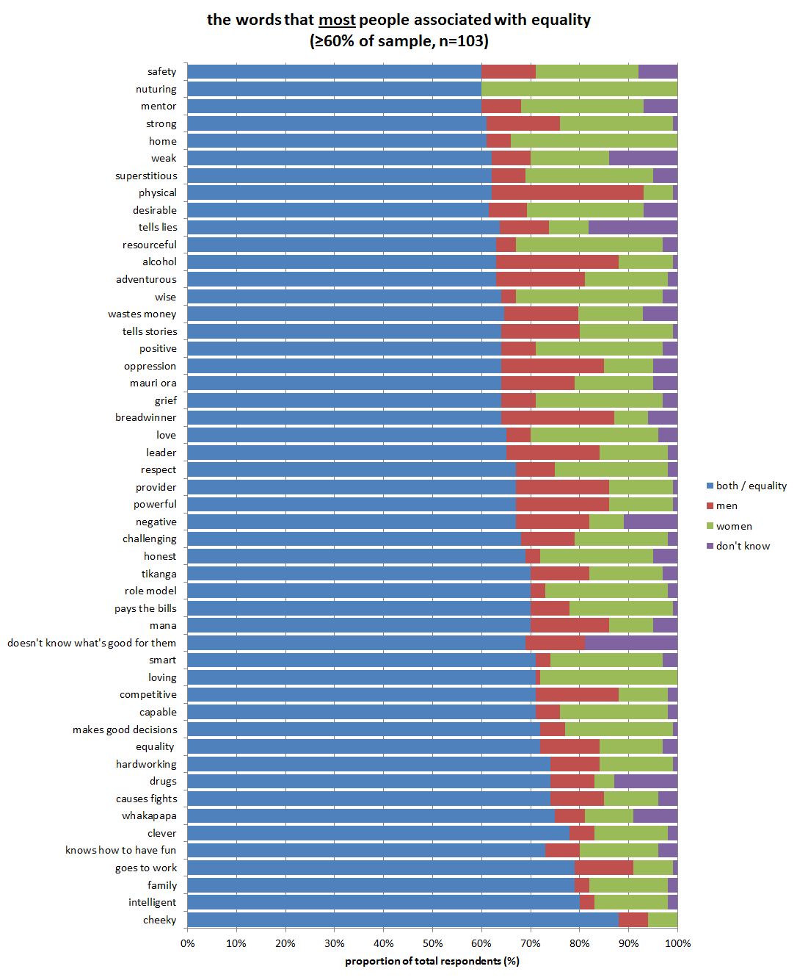
Notes:
ninety-one words (61 percent of the words in this quiz) were more likely to be associated with equality than gender-specific perception, this means the majority of respondents (over 50%) said the word was associated with equality
70-80% said cheeky, intelligent, knows how to have fun, goes to work, family, clever, whakapapa, hardworking, drugs, causes fights, makes good decisions, equality, smart, loving, competitive, capable, tikanga, role model, pays the bills, mana, doesn’t know what’s good for them

Slide 20
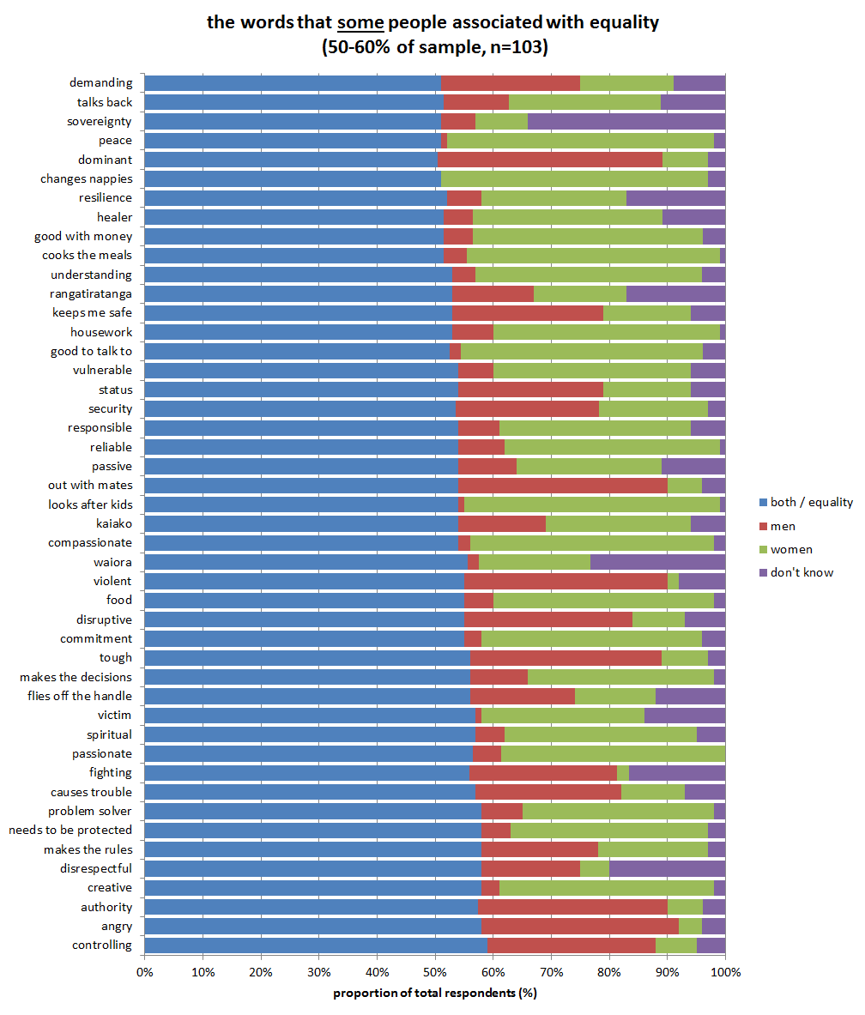

Slide 21
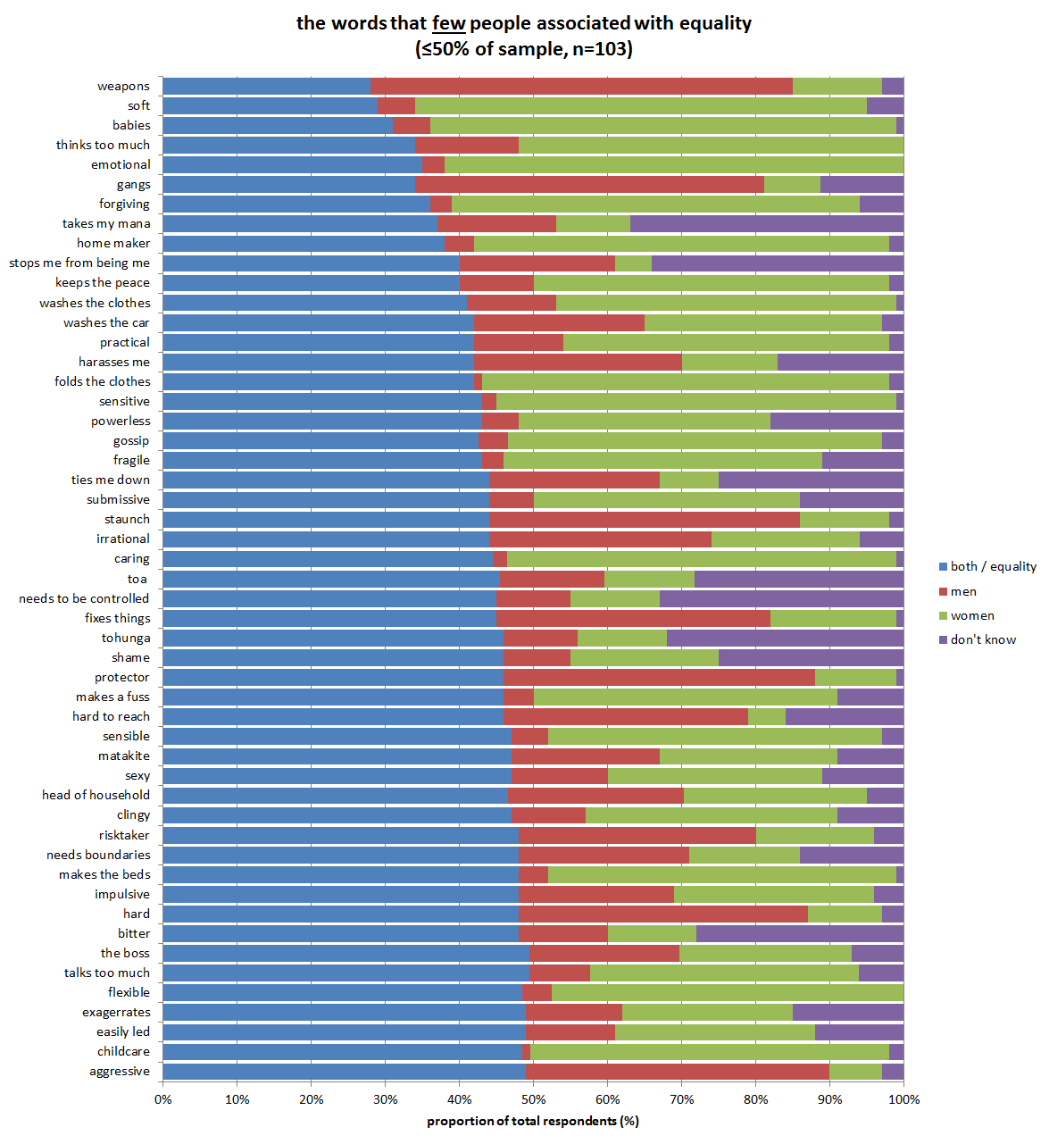

Slide 22
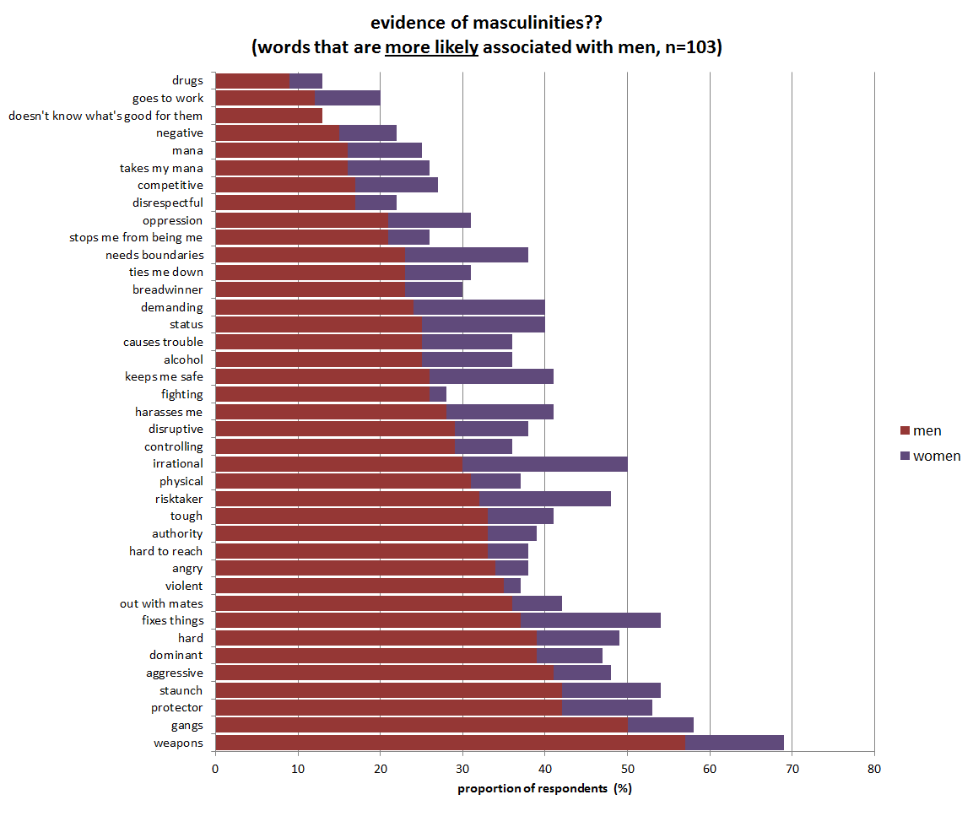

Slide 23
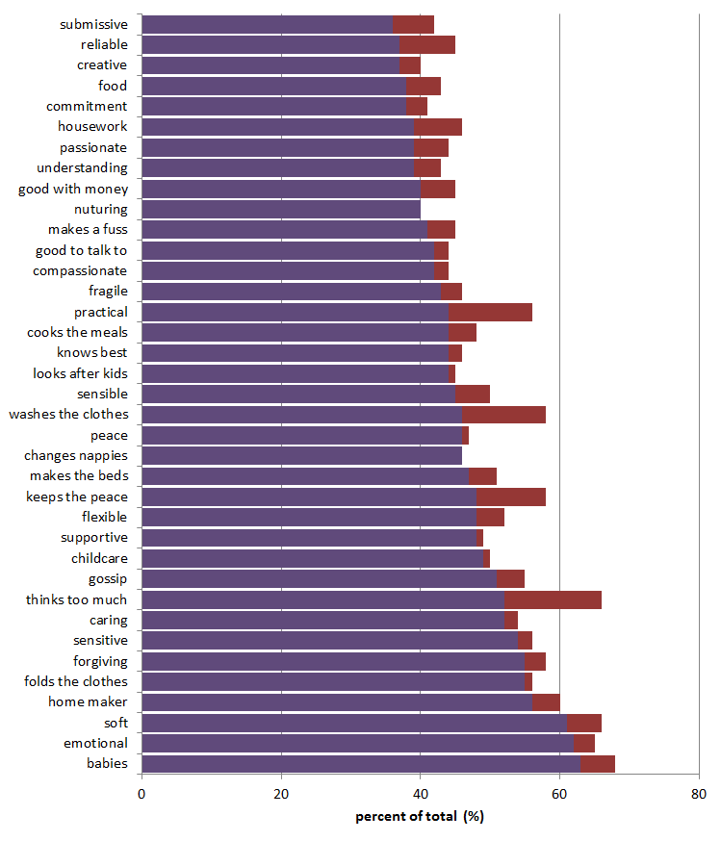
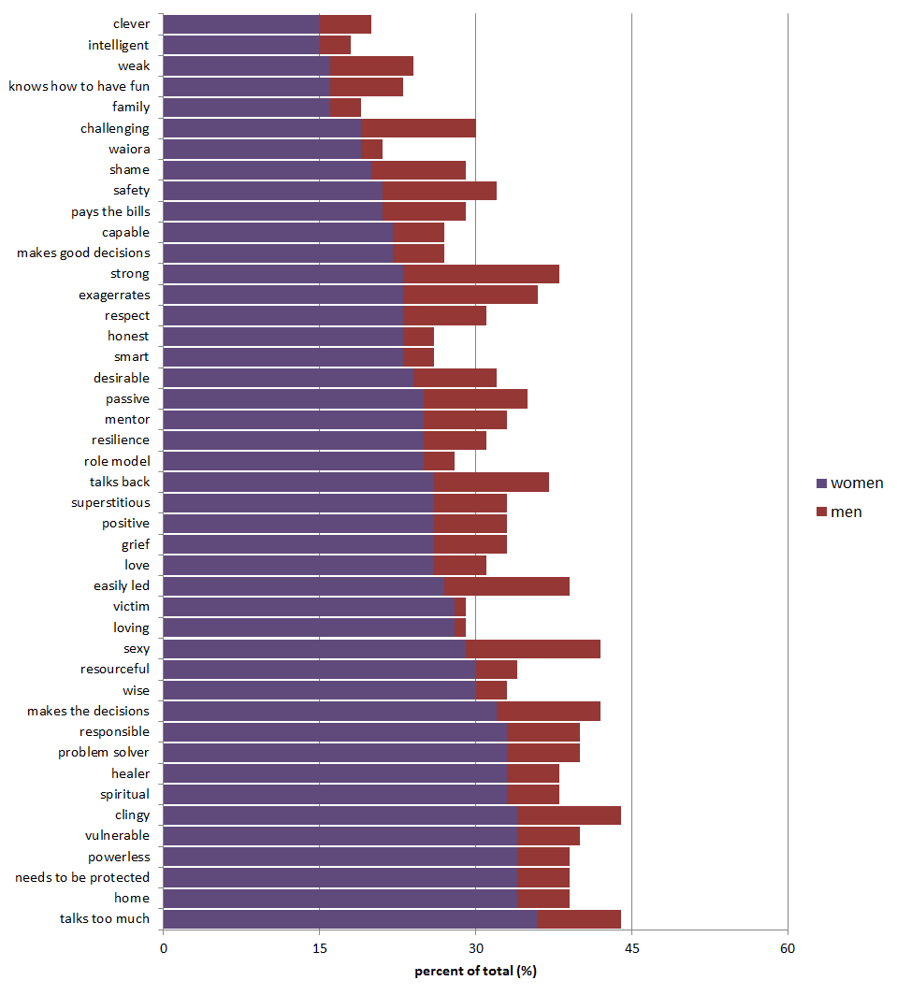
evidence of feminities?? (words that are more likely associated with women, n=103)

Slide 25
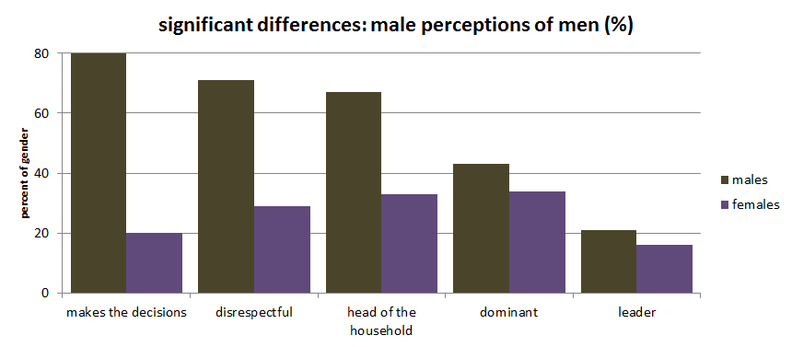
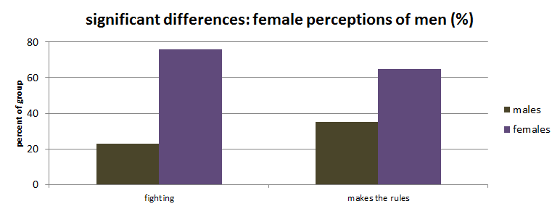

Slide 26
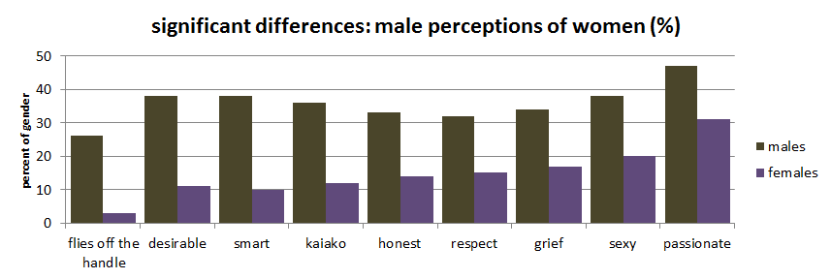
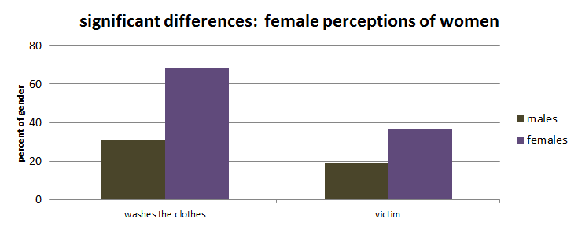

Slide 27
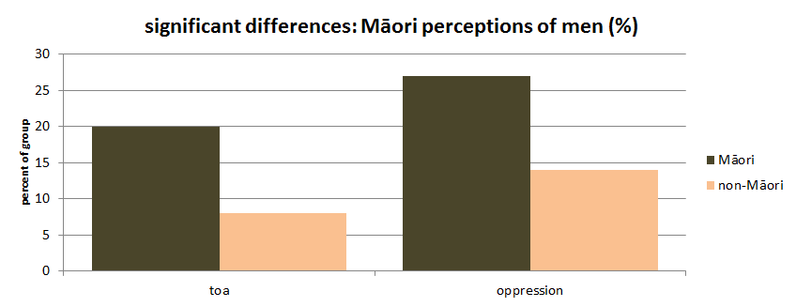

Slide 28
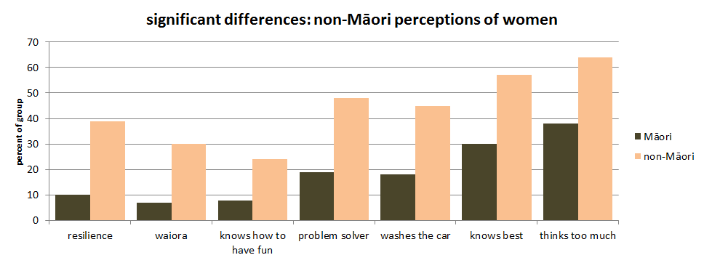

Slide 29
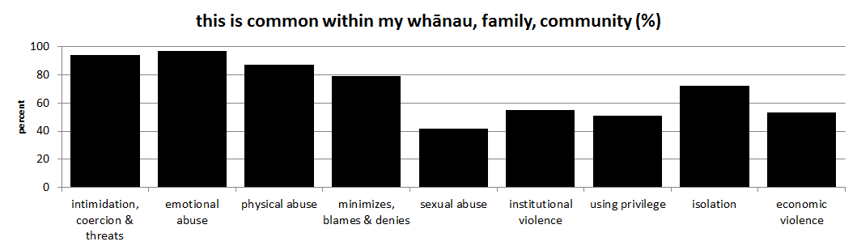
how to identify a social norm …
what do I do?
what do I think other people do?
what do other people think it is appropriate to do?
(Mackie et al, 2012)

Slide 30

need to find social norms that have the capacity to generate a critical mass that could transform the rate of violence in Hauraki and are also based on Māori cultural imperatives?
Poutama programme teaches strategies for recovery and healing from violence that are based on Māori cultural imperatives?
32 strategies/messages identified
could these be social norms?
are Poutama participants more likely to do / agree with these messages than the general public?

Slide 31
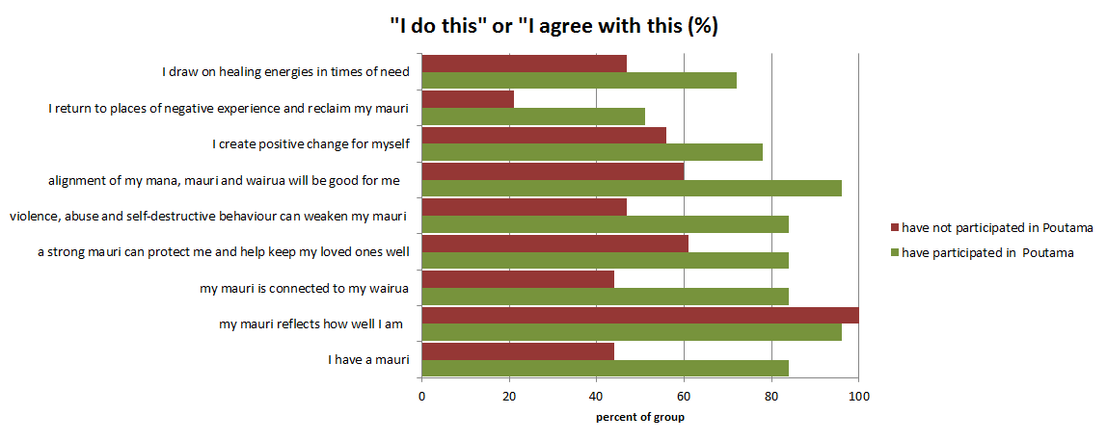
Is mauri a social norm that has the capacity for transformation?

Slide 32
we are starting a mauri-ora revolution Whakaohoho i te mauri

Slide 34
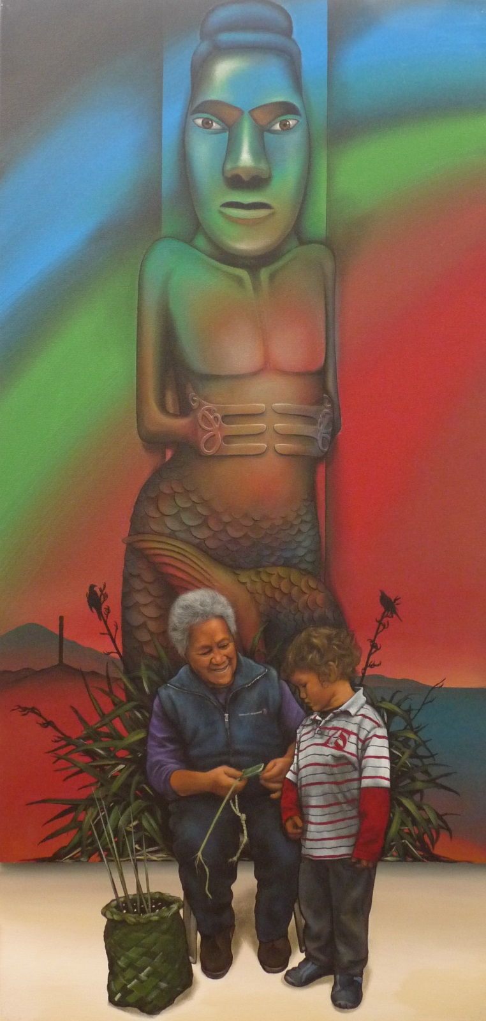

Slide 35
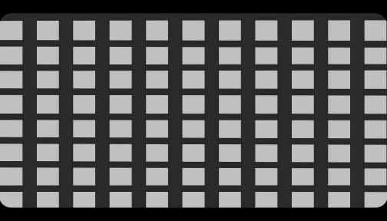
Mauri – o – meter
Notes:
Acknowledge all of the people who have completed our surveys and helped to distribute them
Maree, Tania, Heather, Eden and the rest of the team at Te Whariki
Denise Messiter who we miss greatly

