Slide 1



a mātauranga Māori approach to the community mobilisation model of violence prevention in Hauraki
key findings from an 18-month research project

Slide 2
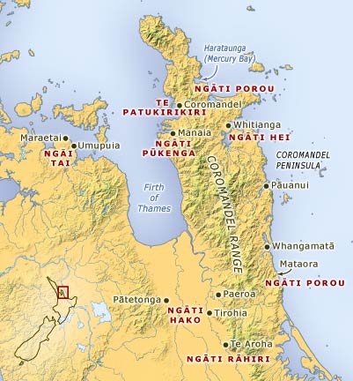
Hauraki
Matakana ki te Matakana
coastal, isolated, high value terrain
5 community boards, 18 settlement areas
30 tūrangawaewae
51% holiday homes
Te Poipoia Tūkino o Hauraki (Te Poipoia)
a local collective of indigenous NGOs
a 10 year strategic plan
the name of this research project
Te Whāriki Manawāhine o Hauraki
a member of Te Poipoia
violence prevention & support services
host organisation for the research
Tūmana Research
Kāinga based
Māori health & development
lead reseacher
Notes:
Mahurangi Peninsula in Matakana, just north of Warkworth
to Ngā Kurī-a-Whārei, near Katikati
includes the Tāmaki, Piako, Ōhinemuri, Wairoa districts, the Coromandel Peninsula and Whangamatā.
TDCD population projections = 51% of dwellings will be holiday homes by 2045, marginalisation by non-resident population

Slide 3
2012: identifying the need for research
formative evaluation of kaupapa Māori violence prevention services in Hauraki
leadership, collaboration and capacity building
evidence-based decisions
new directions/innovation
build on wisdom, knowledge & theoretical paradigms of tangata whenua and other indigenous peoples
alignment with Mauri Ora Framework for violence prevention (2nd Māori Taskforce, 2004)
DISPEL THE
ILLUSION
REMOVE OPPORTUNITIES
TRANSFORMATIVE PRACTICE

Slide 4
2013: scoping the research theme
HRC development grant
investigate possible themes
literature review
consultation (clients/stakeholders)
peer-review of design, methods, objectives
write up proposal
apply for project grant

Slide 5
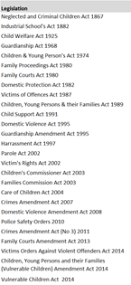
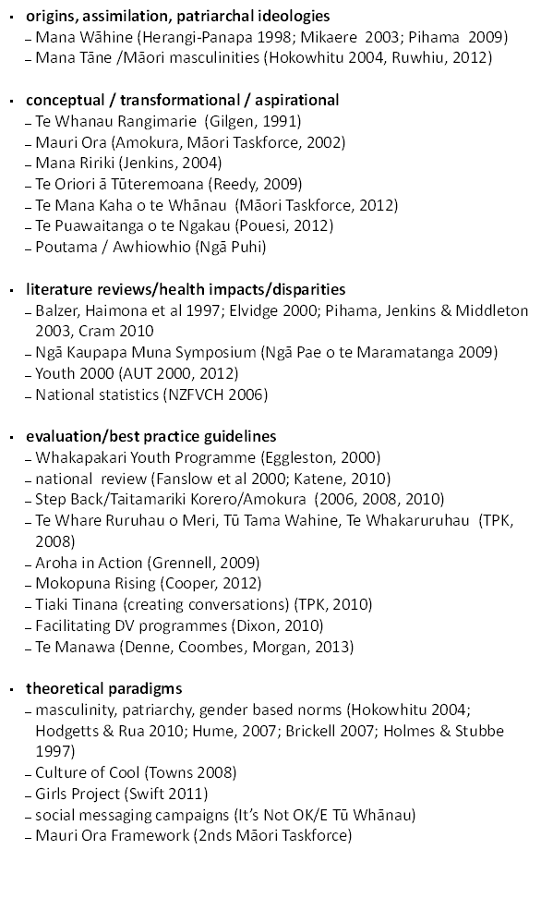
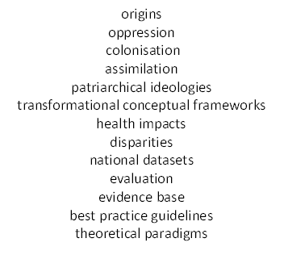
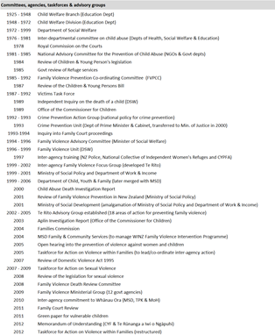
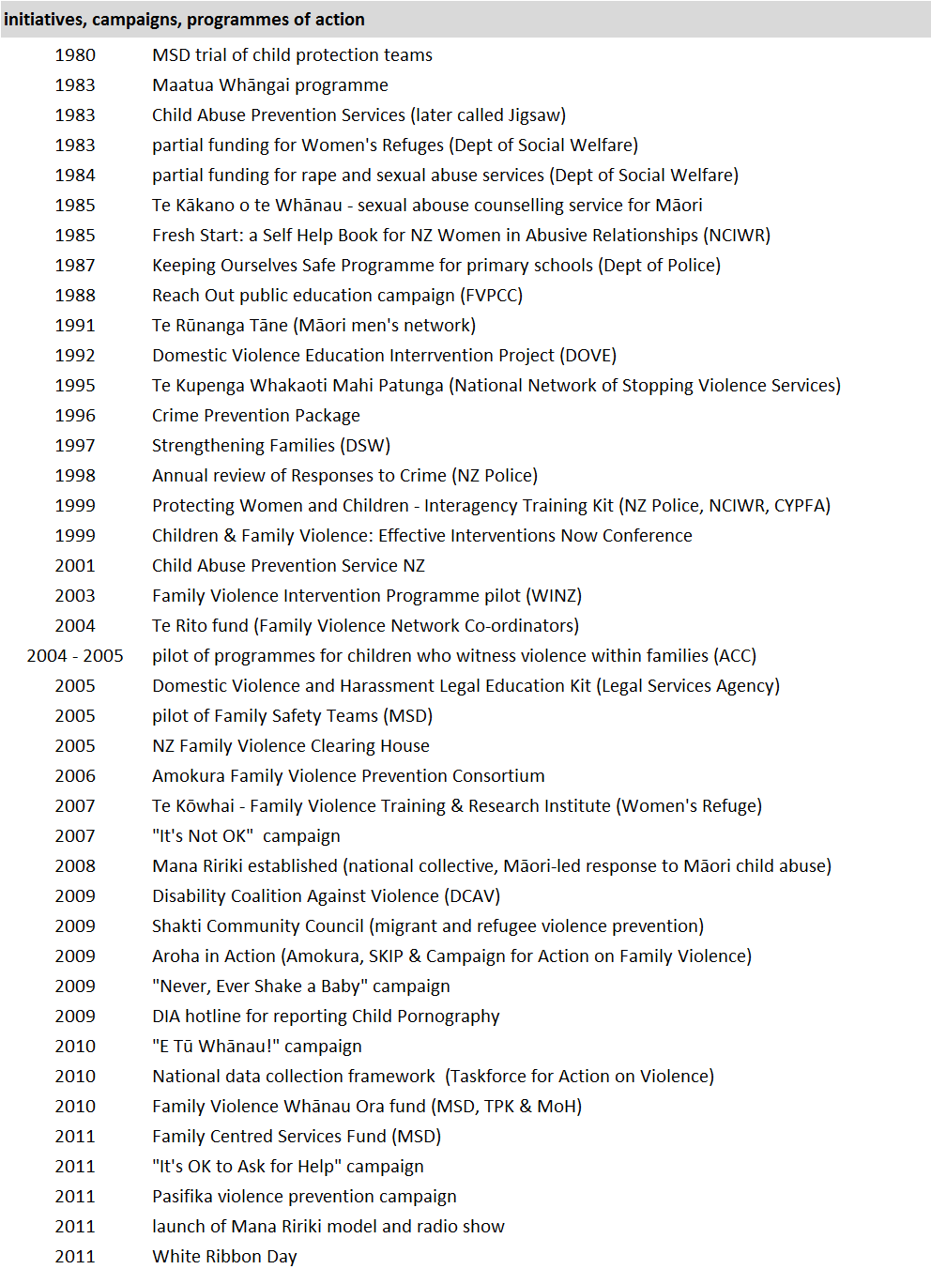
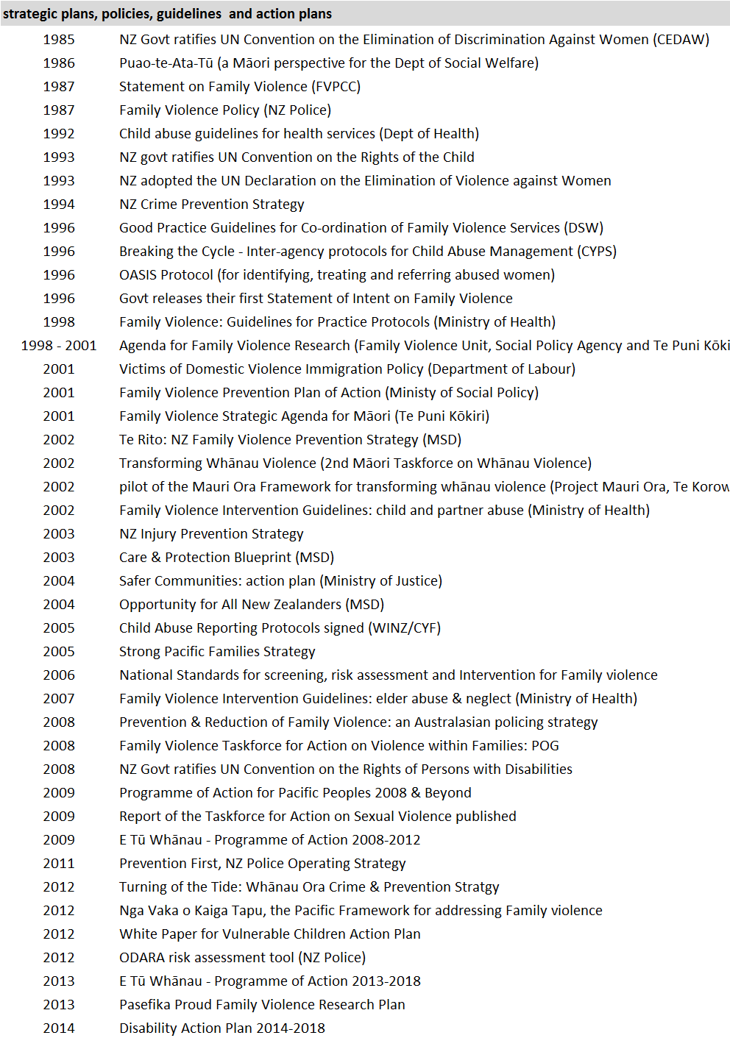
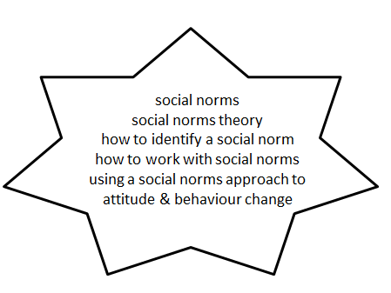
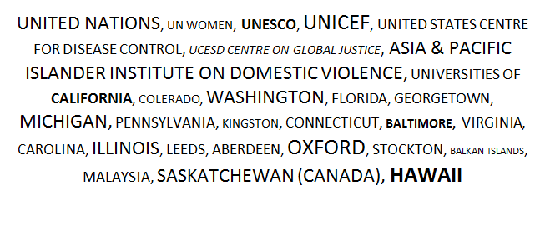
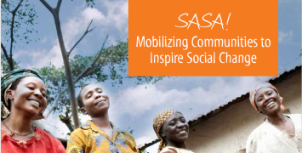
literature review
wisdom, knowledge & theoretical paradigms from tangata whenua and other indigenous peoples
alignment with Mauri Ora Framework
background
tangata whenua
indigenous peoples
www.raisingvoices.com

Slide 6
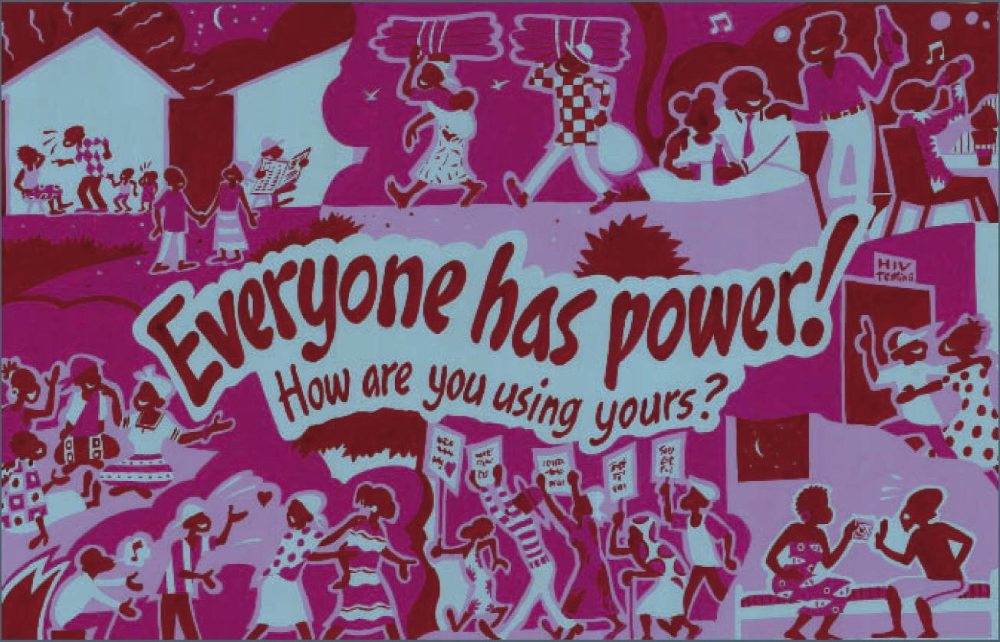
principle 1: violence is about POWER
SASA! design logic
violence is caused by an imbalance of power
strategies for the prevention of violence must address this underlying cause

Slide 7
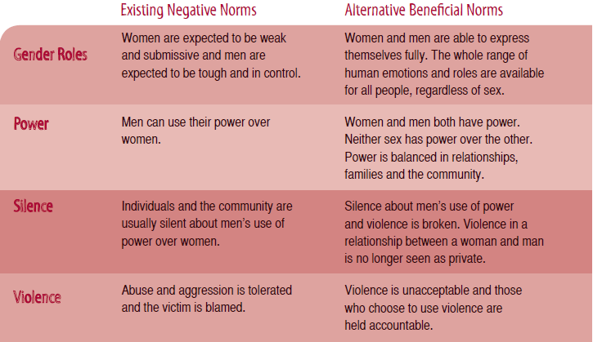
principle 2: power is a social construct
a social norm is a personal belief about the things that other people do and think
descriptive norm (I do it because other people do it)
injunctive norm (I do it because other people think I should do it)
social norms are held in place by the expectations of people in our reference group (whānau, community, friends, workmates, society)
Bicchieri, C. & Mercier, H. (2014). Norms and Beliefs: How Change Occurs. The Jerusalem Philosophical Quarterly, 63 (January): 60-82.
SASA! design logic
violence is upheld by normalised beliefs about power
violence is upheld by social norms
violence prevention strategies have to target harmful social norms

Slide 8
principle 3: social norms can change
establish team
create resources
gather baseline data
complete surveys
distribute resources
participate in discussion
engage with community
participate in discussion
participate in discussion
participate in discussion
participate in discussion

Slide 9
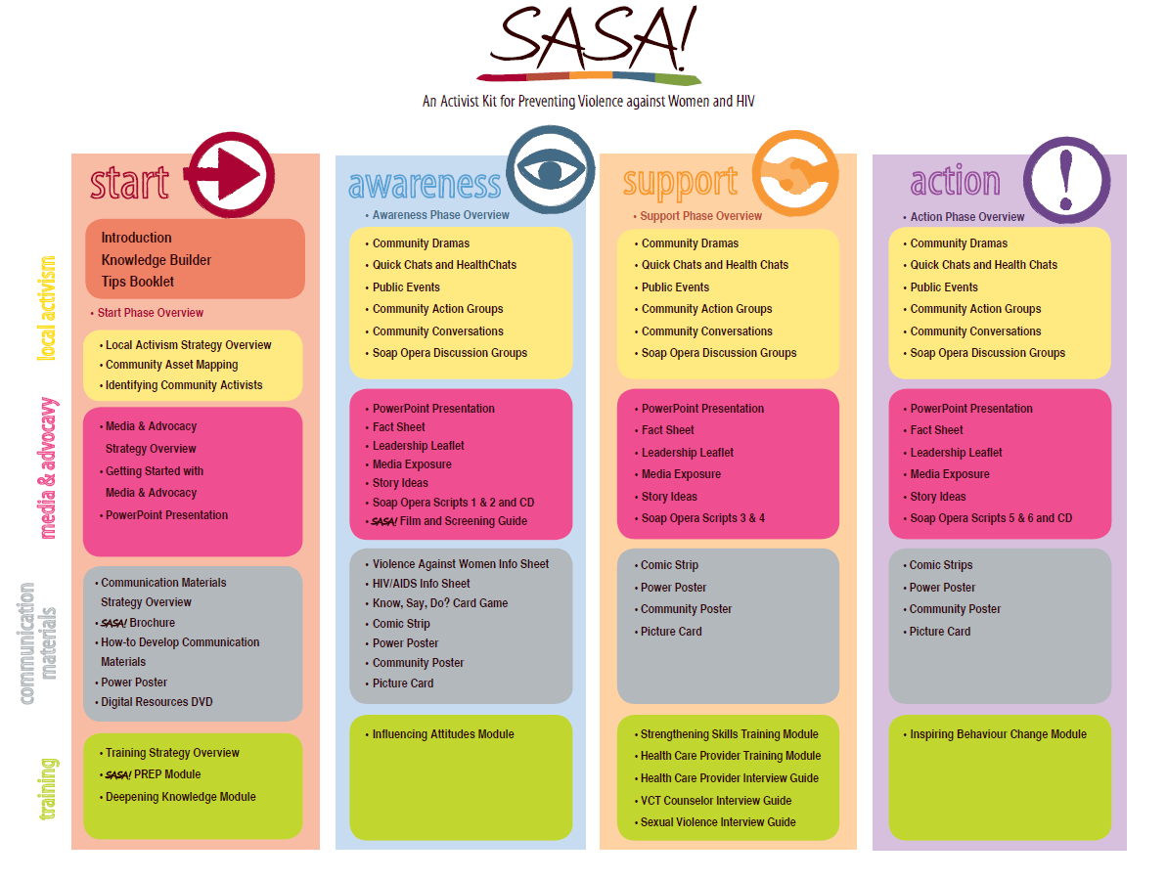

Slide 10
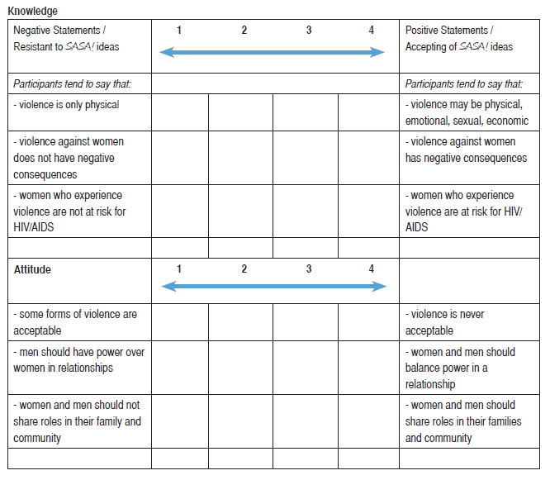
SASA! Outcome Tracking Tool (completed by the Activist/facilitator/team member/observations)

Slide 11
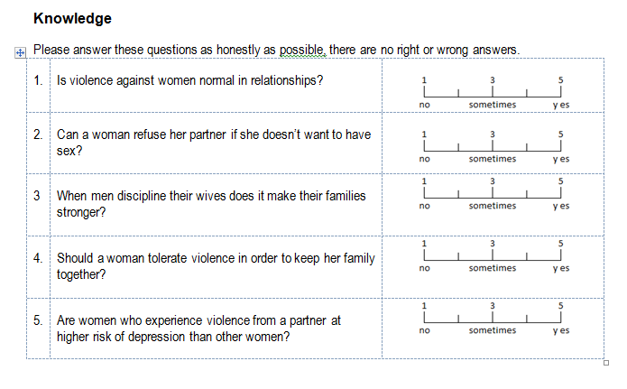
SASA! Outcome Tracking Tool (completed by whānau/community/programme participants)

Slide 12
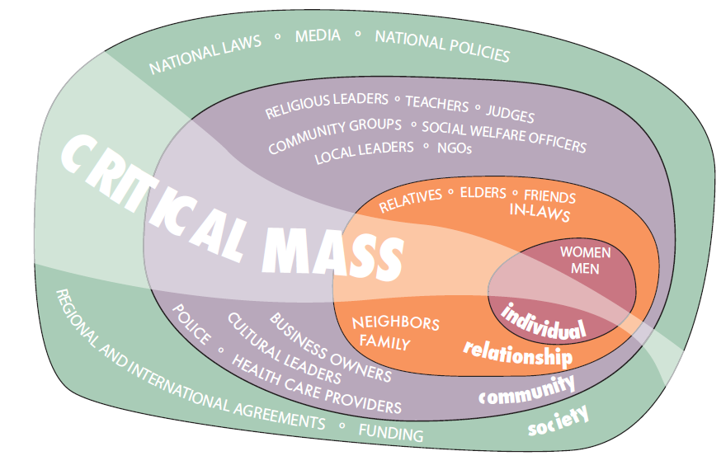
principle 4: critical mass
Systems Theory (Bronfenbrenner, 1979)
the simultaneous use of diverse strategies, within and across our Circles of Influence, will eventually generate a critical mass that can change social norms and sustain long-term behaviour change

Slide 13
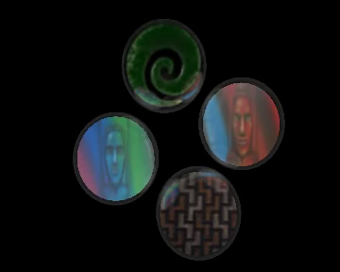

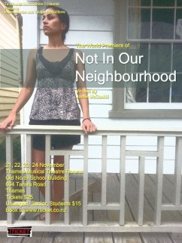



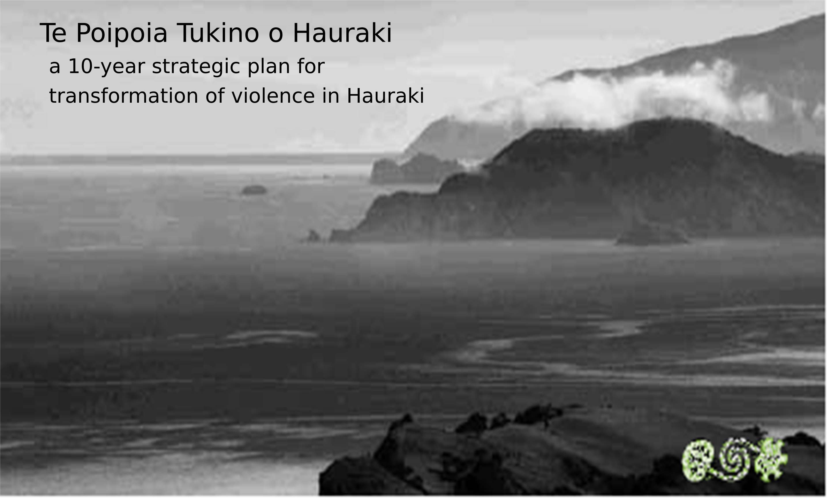

POUTAMA MAURI ORA MAURI TU:
a programme for healing and recovery from violence
Notes:
Hearing about SASA! immediately struck a chord with Te Whariki because it gives value and meaning to the diverse strategies that we have been using for the prevention of violence within our community for decades

Slide 14
2014: the research questions
will a social norms approach work in Hauraki?
produce evidence that social norms are operating and associated with family violence (demonstrate feasibility)
how will we know a community mobilisation model of violence prevention is working?
collect baseline prevalence data so changes can be monitored over time
can the social norms approach be applied to Māori cultural imperatives?
develop/deliver a programme that teaches Māori cultural imperatives
pre/post test acceptance/change
Notes:
Our Start Phase has involved three data collection methodologies, two of which I am going to quickly describe.
I am going to show you some evidence which suggests a social norms approach to the prevention of family violence is going to be successful in Hauraki
And I am going to show you some data which suggests that a Maori cultural imperative has the capacity to become a social norm that generates critical mass

Slide 15
will a social norms approach work?
how to identify a social norm
what I do?
what I think other people do?
what do other people think it is appropriate to do?
ask whānau whether they think violence is common in their whānau/family/community?
masculinity theory
masculinities are a social norm
masculinities are associated with power asymmetries that underpin intimate partner violence (Connell, 2010; UN Women, 2013)
NZ literature on the socialisation of masculinities (Hokowhitu 2004, Hodgetts & Rua 2010; Towns 2008; Swift, 2011)
could use a simple word quiz to investigate whether gender-based power asymmetries are operating in Hauraki?
Notes:
Need to know how to identify a social norm because we are looking for evidence which shows that social norms are operating and associated with family violence in Hauraki
one way of getting this evidence is to ask whānau whether they think violence is common
another way is to look for evidence of masculinities
a social norm (a personal belief about the way men should be/held in place by the expectations of others)
Associated with power asymmetries that underpin IPV
NZ literature on the socialisation of masculinities – how we talk to each other, culture of cool, girl’s project

Slide 16
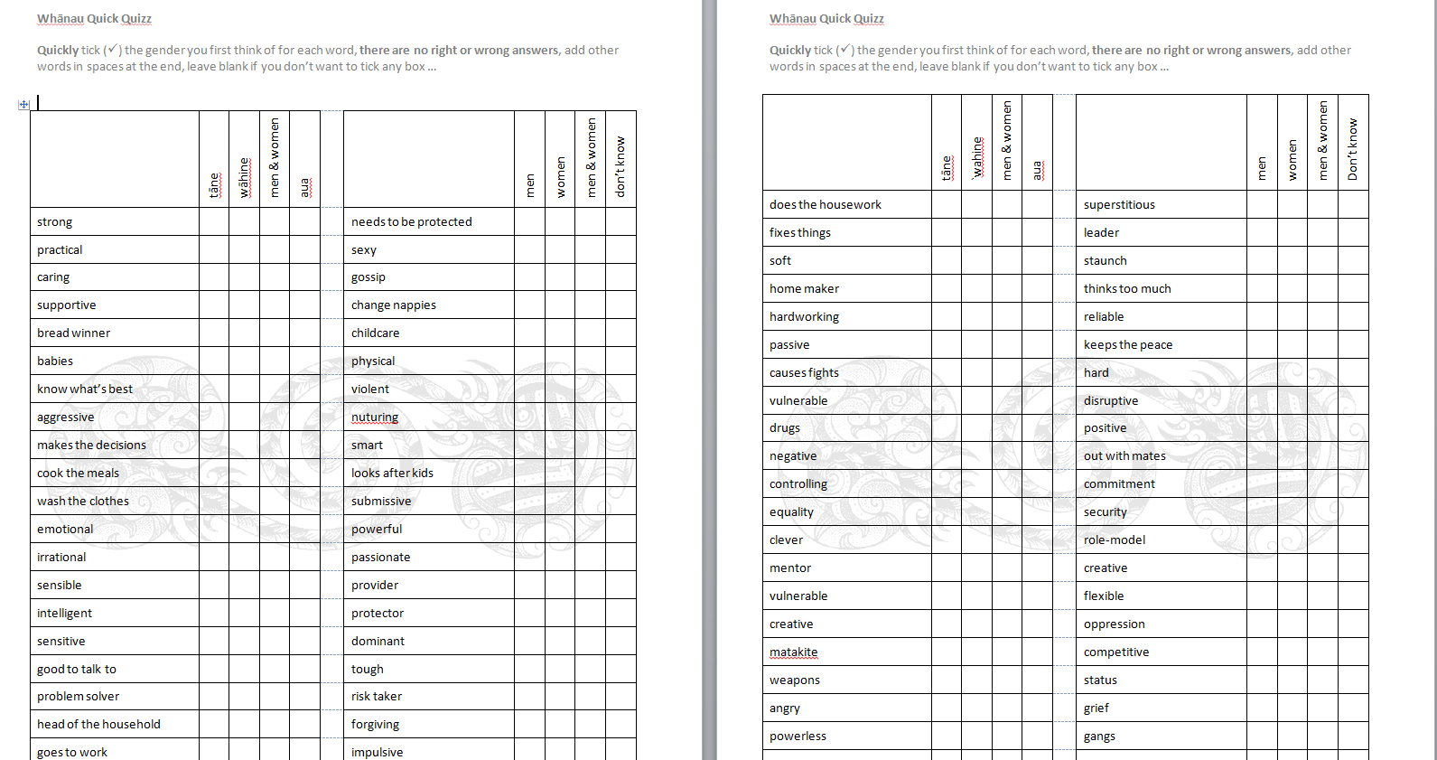
a simple word quiz

Slide 17
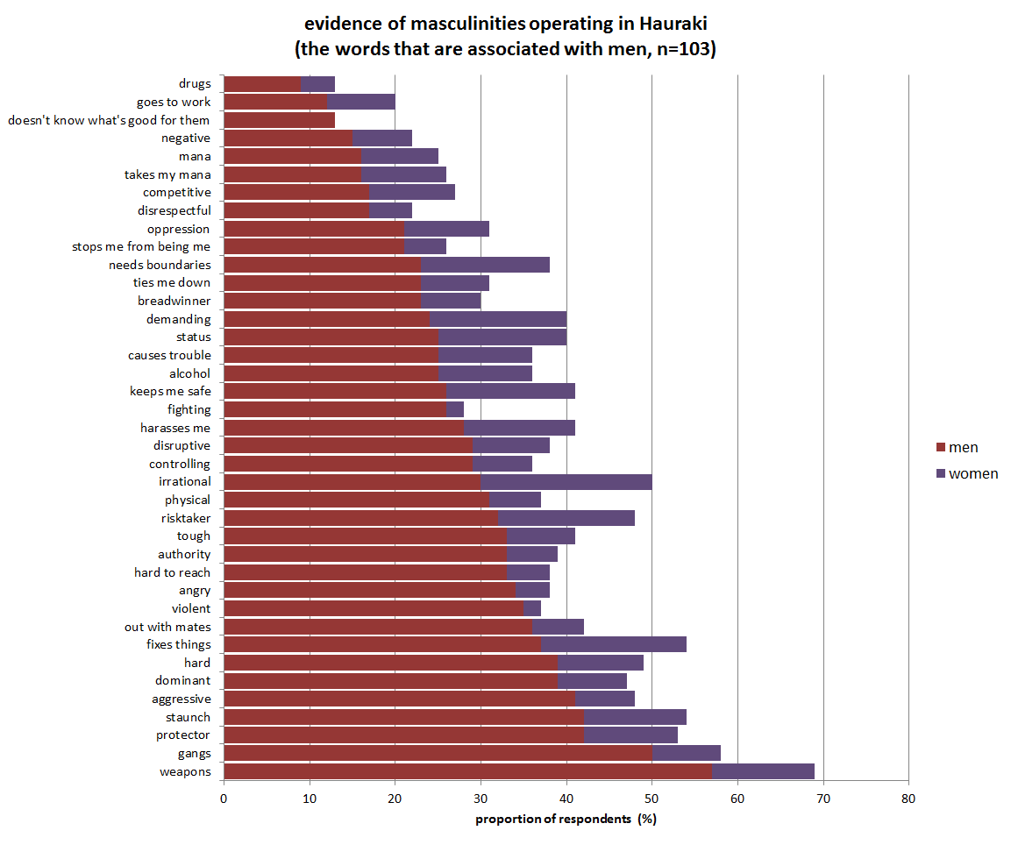
Notes:
In general, 39 of the 150 items more likely associated with men, notably
1 in 2 people associate weapons and gangs with men
1 in 3 expect men to be a protector, staunch, aggressive, dominant, hard, fixthings, out with mates, violent, angry and hard to reach with men

Slide 18
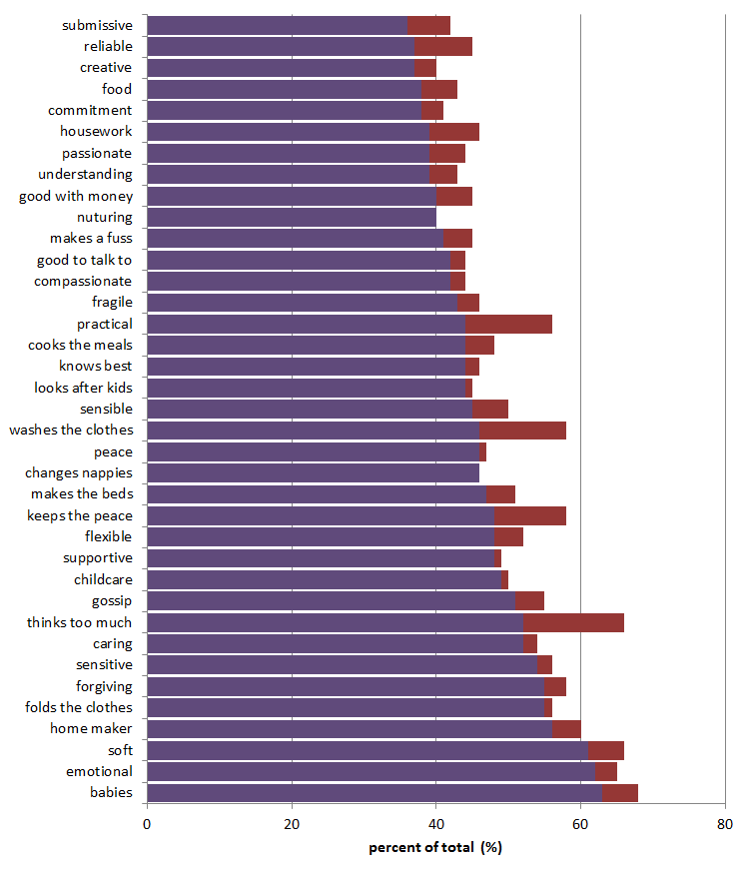
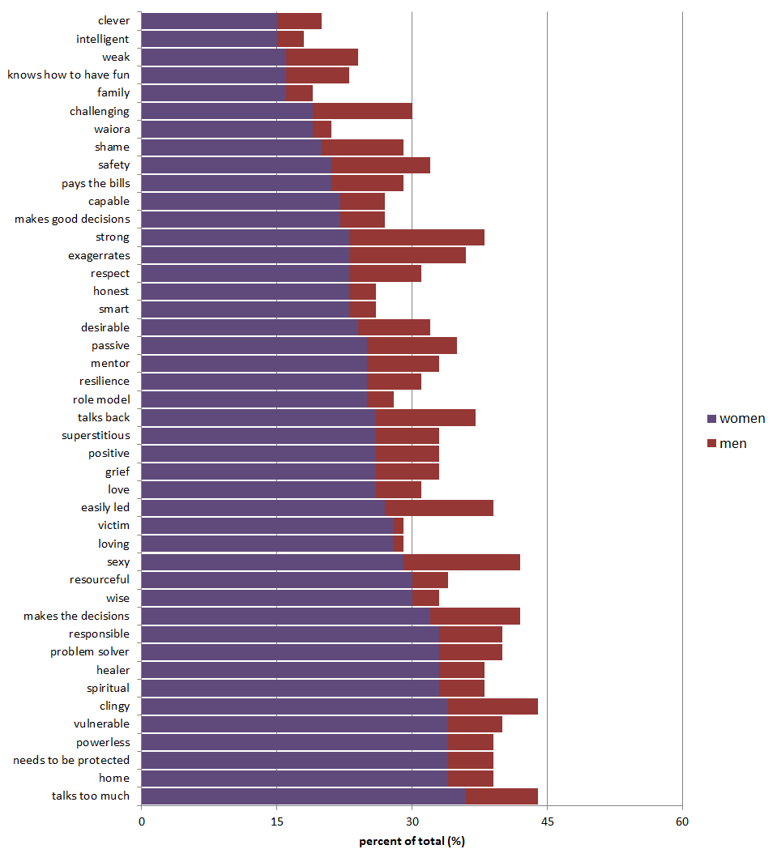
evidence of feminities operating in Hauraki (words that are associated with women, n=103)
Notes:
Most people expect women to babies, emotional and soft
1 in 2 people expect people to be a homemaker, fold the clothes, forgiving, sensitive, caring, thinks too much, gossip, childcare, supportive, flexible, keeps the peace
Around 40% of the sample expect women to be passionate, understanding, good with money, compassionate, cook the meals, look after the kids
1 in 3 say that women need to be protected, talk too much, are powerless, vulnerable, superstitious ….

Slide 19
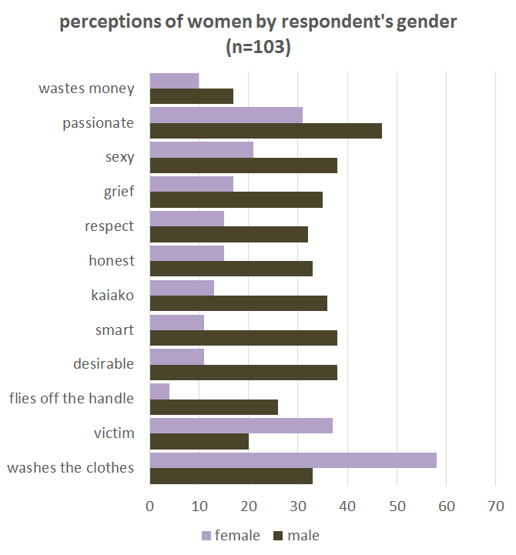

Slide 20
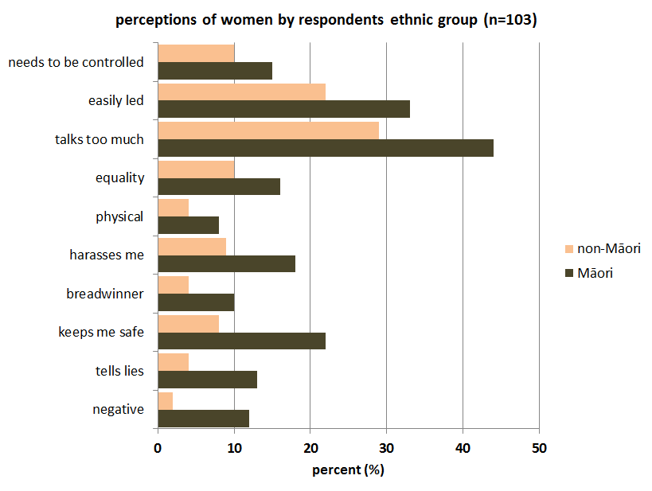
Notes:
More than enough evidence to show that masculinities are operating and a social norms approach will be worthwhile as a primary prevention strategy

Slide 21
designing the prevalence survey
objectives
Is whānau violence a social norm?
do we think violence is common in our whānau/family/community?
how will we know the community mobilisation model is working in Hauraki?
collect prevalence data (benchmark baseline)
capacity to track change over time

Slide 22
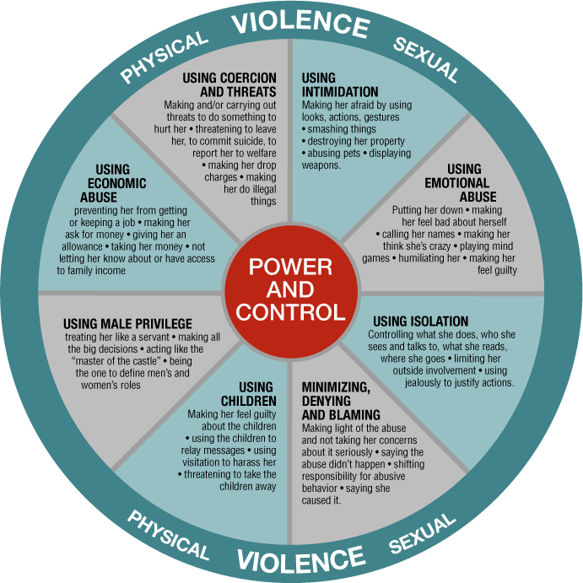
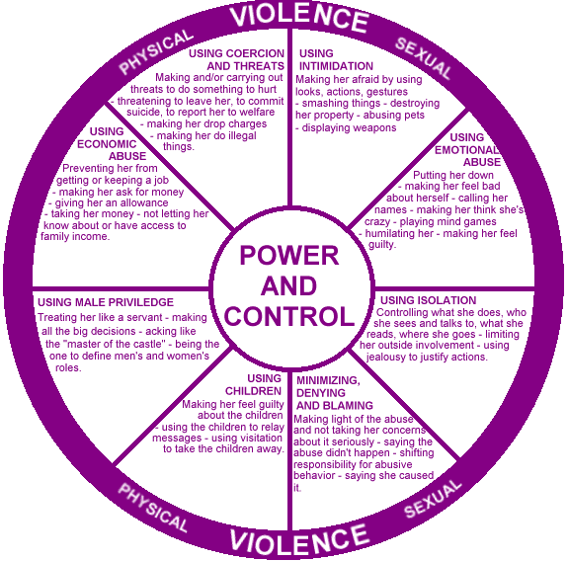
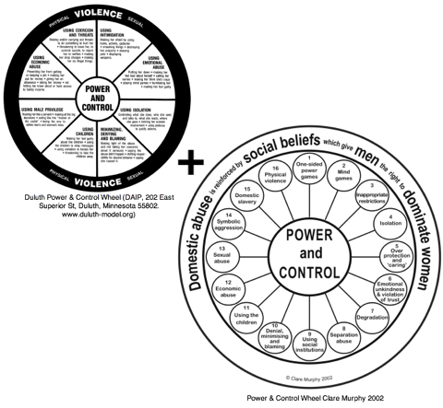
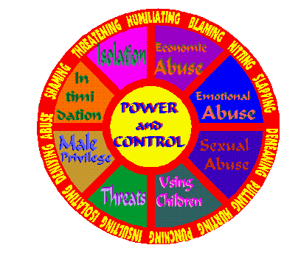
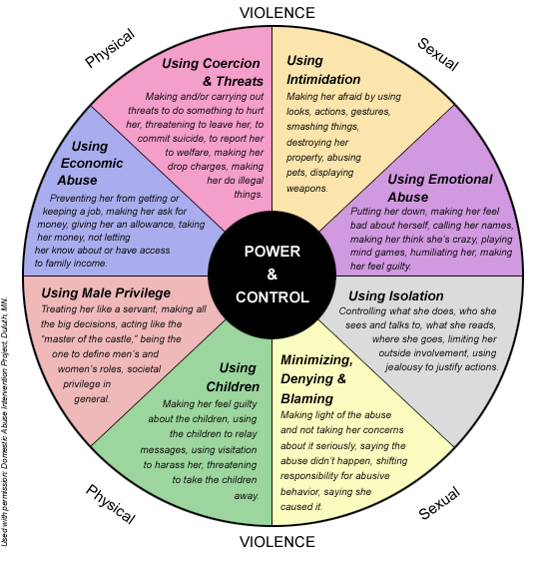
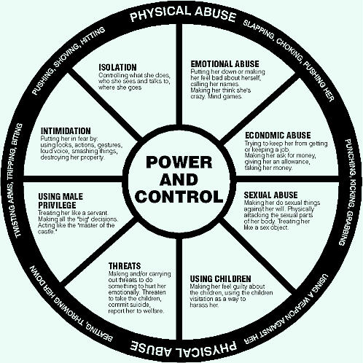
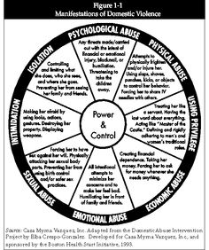
Designing the the prevalence survey

Slide 23
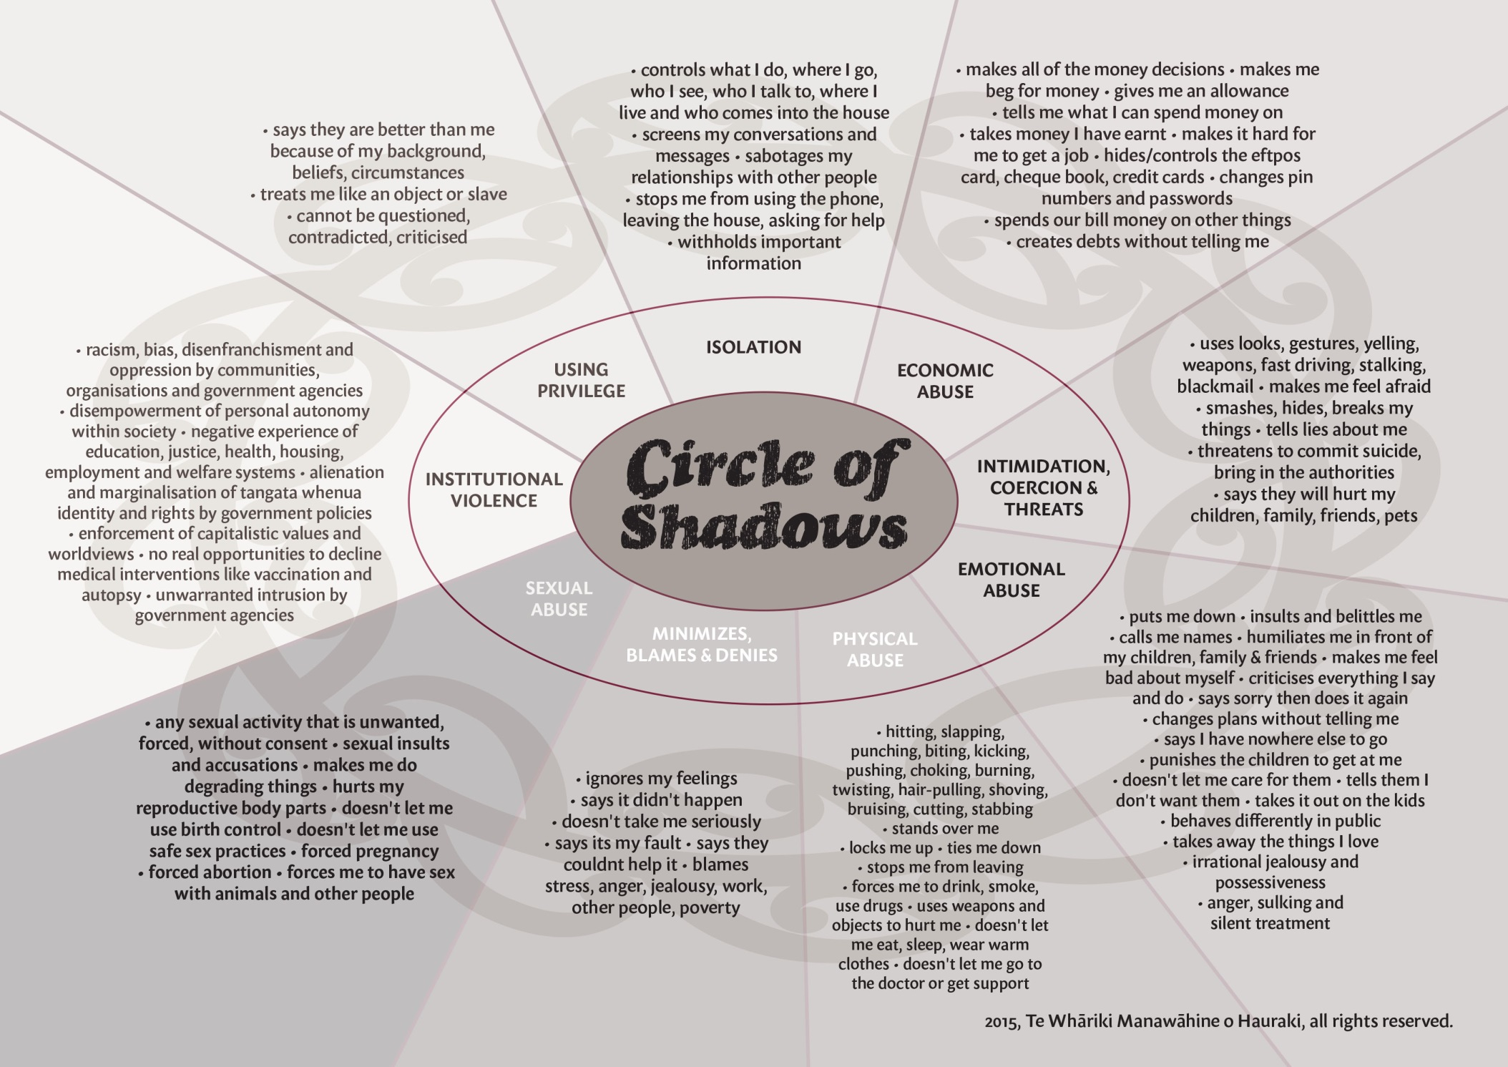

Slide 25
Notes:
Everybody had experienced at least one form of violence identified in the Circle of Shadows
14% had experienced 5 or 6 types of violence
Vast majority (74%) had experienced 7-9 types of violence described in the Circle of Shadows

Slide 26
Notes:
92 males, 208 females

Slide 27
Notes:
roughly equal representation, 146 Māori, 154 non-Māori

Slide 29
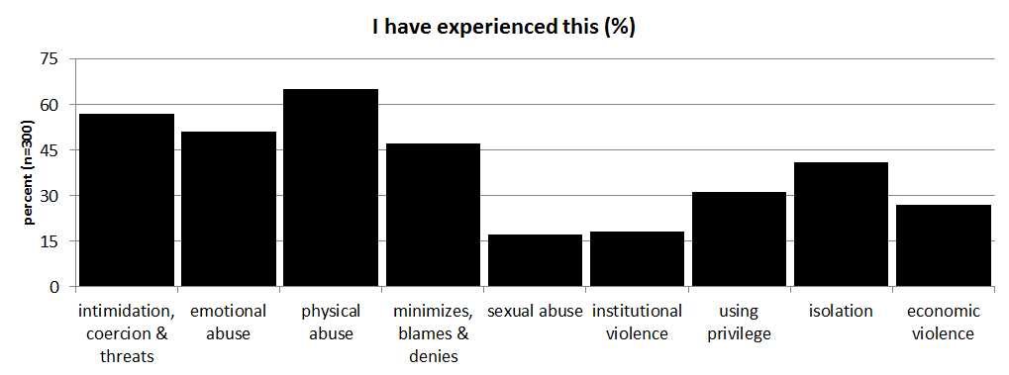
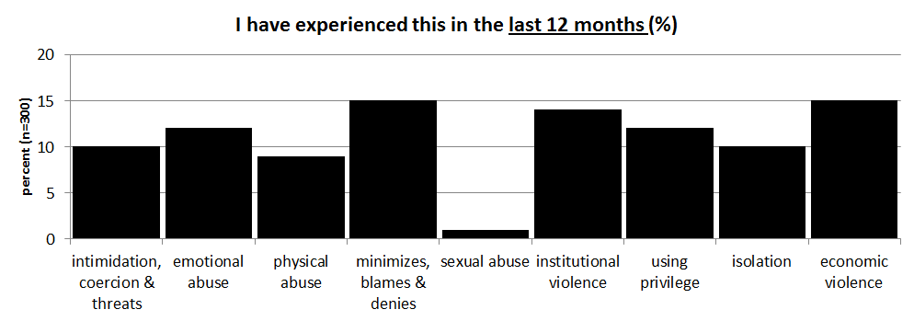

Slide 30
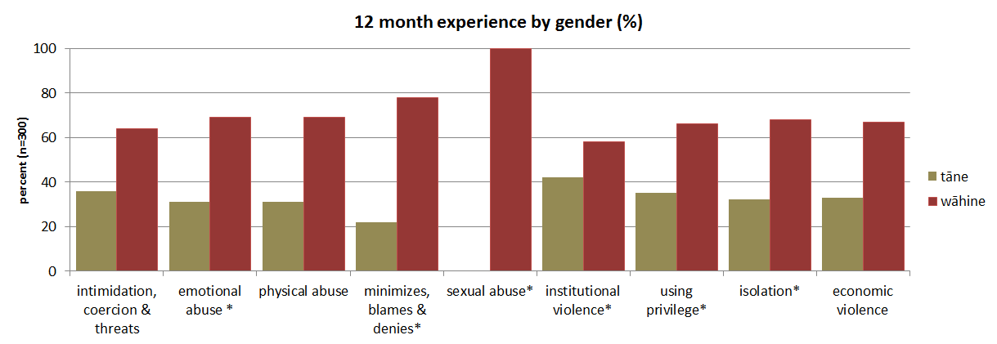
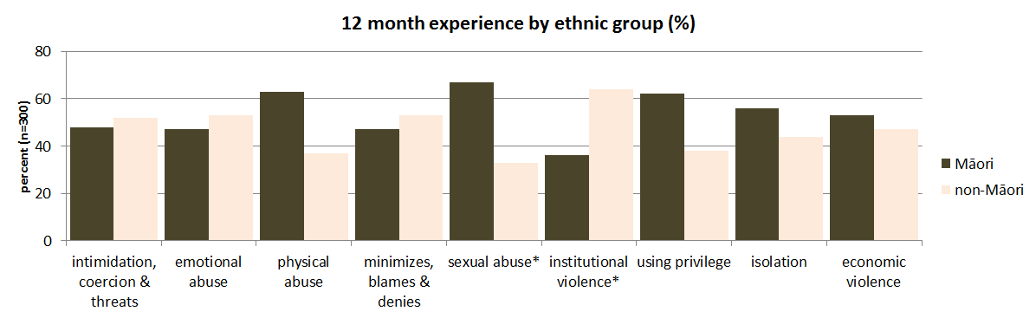
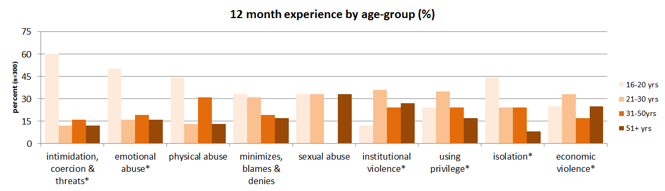

Slide 31
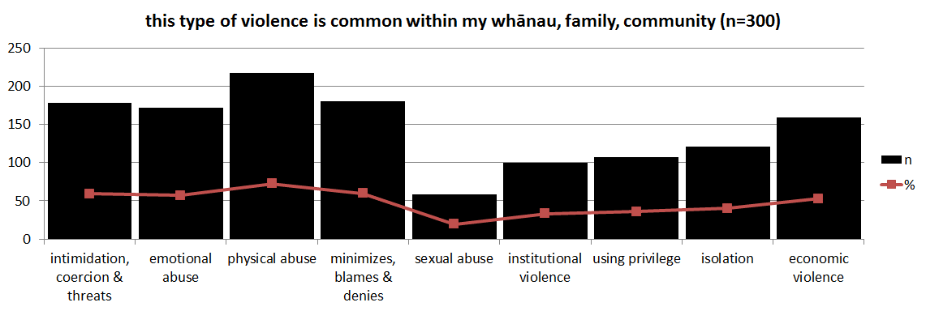
Is violence a social norm?
what I do?
what I think other people do?
what do other people think it is appropriate to do?

Slide 32
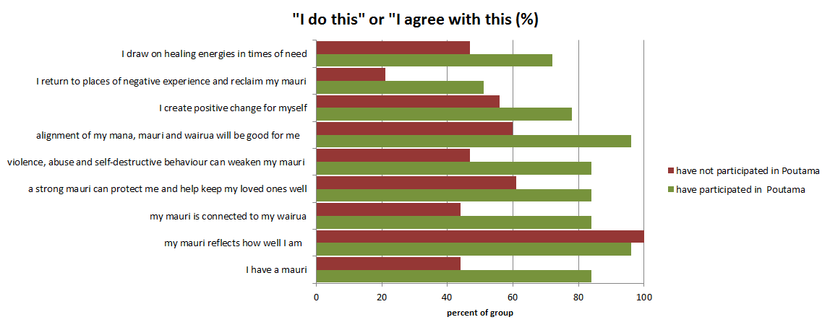
can a Maori cultural imperative be a social norm?
36 questions/items
self-rated scale … “do you do agree/think/do….”
before/after participation in noho (pre/post test)
likelihood of agreement with statements
Poutama Mauri Tu, Mauri Ora – a programme for healing and recovery from whanau violence (Denise Messiter, 1995)
Notes:
Using the theory on how to identify a social norm, we wrapped a pre/post survey around the Poutama programme – and the findings showed that participation increased the likelihood of agreement with mauri statements and willingness to take personal actions that are good for our mauri …. this is an empirical finding that has informed our next research hypothesis ….

Slide 33
the logic for a Mauri-Ora Revolution
life principle, the sneeze of life, unifying element, healing energy, sacred and divine origins, taonga tuku iho
dynamic, resilient, flexible, can wax and wane, feeds on collective energy, interacts with mana and tapu, reflects vitality/state of being – mauri tu, mauri ora, mauri noho, mauri mate
impacted by violence and abuse
1 of 6 cultural imperatives in the Mauri Ora Framework for violence prevention
mauri is a Māori cultural imperative that is responsive to intervention/transformation
mauri could be normalised through resources, programmes, activities, SNA strategies/ create critical mass
mauri is measureable
the mauri-ora continuum could be aligned with the TTL model of behaviour change – mauri mate, mauri noho, mauri tū, mauri ora
a mauri-ora revolution is a primary prevention strategy for violence in Hauraki

Slide 34

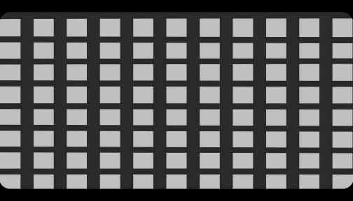
a mauri-ora revolution is the mātauranga Māori community mobilisation model for displacing the negative social norms that underpin family violence in Hauraki

Slide 35
What have we gained?
evidence of social norms operating in Hauraki
masculinities/gender based role perceptions
violence is normal in my family/community
the feasibility of a social norms approach to violence prevention
a dataset that enables implementation of the SNA methodology
target masculinity perceptions (promote gender equality)
target violence perceptions (violence is not normal in my whānau/family/community)
evidence that a Māori cultural imperative (mauri) is a social norm that could form the basis for a mātauranga Māori community mobilisation model of violence prevention in Hauraki

Slide 36
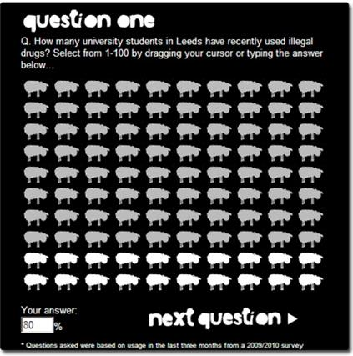
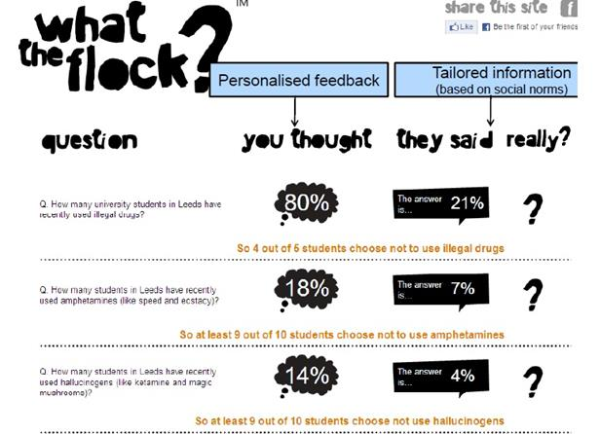
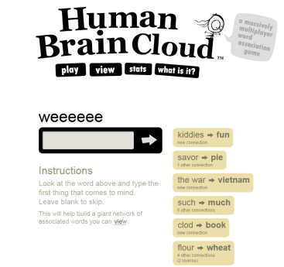
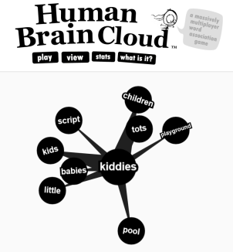
2016: SNA strategies for our CM toolkit

Slide 37
Lead Researcher: Stephanie Palmer stephanie@tumana.maori.nz 07 8668 579 0274846 875 Te Whāriki Manawāhine: Maree Tukukino mareeh@hauraki.refuge.co.nz 07 8688475 0272621844 Poutama Mauri Tū Mauri Ora: Denise Messiter denisemessiter@gmail.com 0224317718

