Slide 1
Te Poipoia Tūkino o Hauraki
transforming & healing whānau violence in Hauraki
Ngā Kānohi Kitea Development Grant
Health Research Council of NZ

Slide 2
Orientation Training
Te Whāriki Manawāhine Research Team
underlying model & rationale
project design
key research questions
research team tasks & roles
timeline
what happens next?

Slide 3
1. underlying model & rationale
Te Whāriki has been delivering violence prevention programmes & initiatives in Hauraki for 20 years
How is this making a difference within the community?
Raising Voices (Uganda) have a model for gathering evidence
  aligns with Poutama Mauri Ora, Mauri Tū
Is their model of use for Te Whāriki?
  must build on existing strategies & strengths
  needs mātauranga Māori content and aspirations
develop & pilot test a mātauranga Māori version of the Raising Voices model

Slide 4
Raising Voices
prevention of violence against women & AIDS
  trans-theoretical model of behaviour change
  social norms
  community mobilisation
    systems theory
    circles of influence
    critical mass
SASA!
www.raisingvoices.org

Slide 5
Aligning models of behaviour change

Slide 6
Social Norms
what people in some groups believe to be normal in the group
  descriptive norm (doing what others do)
  injunctive norm (doing what others think we should do)
held in place by the expectations of people within the group (the reference network)

Slide 7
Different types of norms
personal norm
  do it for my own reasons
moral norm
  do it because I believe it is morally wrong
legal norm
  do it because it is enforced by the state
social norm
  do it because others do it
  do it because others think I should do it

Slide 8
Systems theory
    the simultaneous use of diverse strategies, within and across the Circles of Influence, will engage the critical mass that is needed to sustain long term behaviour change

Slide 9
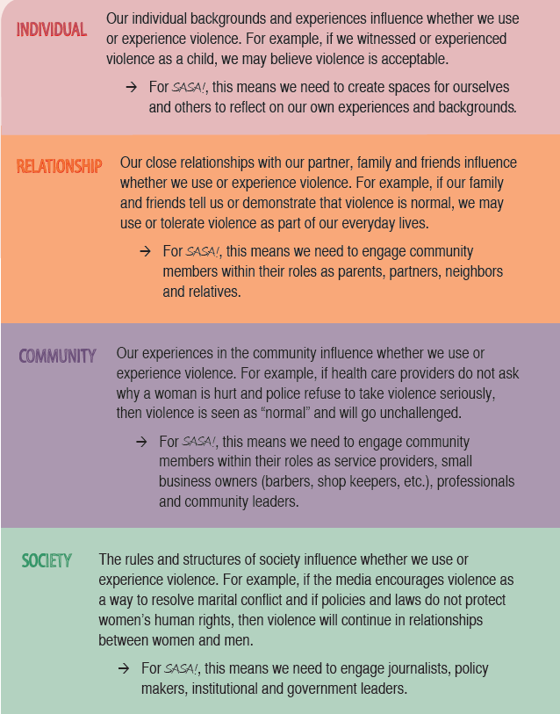
Circles of Influence (Ecological Model)

Slide 10
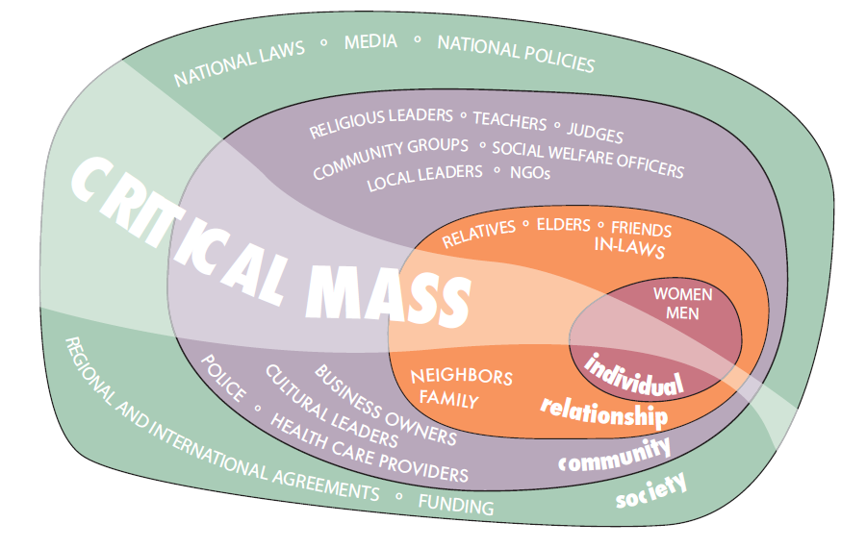
Community Mobilisation

Slide 11
SASA!
primary prevention model
  stop violence before it starts
  systematic process for reducing the prevalence of violence
strengthen skillsets of SASA! team to
  Start!, Awareness!, Action!, Support!
  Tohunga! Matakite! Toa! Kaiako!
engagement in community activism
  programmes/strategies/activities
  replace negative social norms with beneficial norms
  produce outcomes (knowledge, attitudes, skills, behaviours)
track outcomes/gather evidence of change

Slide 12
2. Project design
Te Whāriki
  alignment of SASA! with Poutama Mauri Ora Mauri Tu!
  discuss/identify content, themes, strategies, social norms (what do we know? what works?)
  develop mātauranga Māori resources & tools
  deliver four (4) community mobilisation programmes, events, activities
  pilot mātauranga Māori versions of the outcome tracking tool
Whānau & Community
  participate in programmes, events, activities, discussions
  complete assessment tools

Slide 13
SASA! process
Phase 1: Start/Tohunga
  identify intended outcomes
  plan the strategies
  monitor progress
  implement activities
  assessment dialogues
  track outcomes
  reporting
Phase 2: Awareness/Matakite
  identify intended outcomes
  plan the strategies
  monitor progress
  implement activities
  assessment dialogues
  track outcomes
  reporting
Phase 3: Support/Toa
  identify intended outcomes
  plan the strategies
  monitor progress
  implement activities
  assessment dialogues
  track outcomes
  reporting
Phase 4: Action/Kaiako
  identify intended outcomes
  plan the strategies
  monitor progress
  implement activities
  assessment dialogues
  track outcomes
  reporting

Slide 14
Assessment Dialogues
key messages
dialogue guides for each phase of model
similar to focus group discussion themes
reflected/reinforced in activities for each phase
informs the survey for tracking outcomes
SASA! Phase 1 example
  What types of violence do women/children experience in our community?
  Would you consider violence against women/children an injustice?
  What does it mean for men and women to balance power in their relationship?
  How do people in our community react to a woman experiencing violence?

Slide 15
Community Mobilisation Strategies/Activities
public events
  drama/story telling/soap opera
  short films/documentaries
  music/festival
  march/parade/hikoi
media & advocacy
  radio/talk shows
  newspaper/magazine articles
  brochures/leaflets
  posters/banners
  power point presentations
  fact/ sheets
  mailbox drop
  door knocking
workshops/wānanga
  facilitated programmes
  skillsets & training
  sharing information
  consciousness raising
discussion groups
  assessment dialogues
  community/agency based
games
  card games
  board games
other
  cartoons/comics
  picture cards
  creative arts

Slide 16
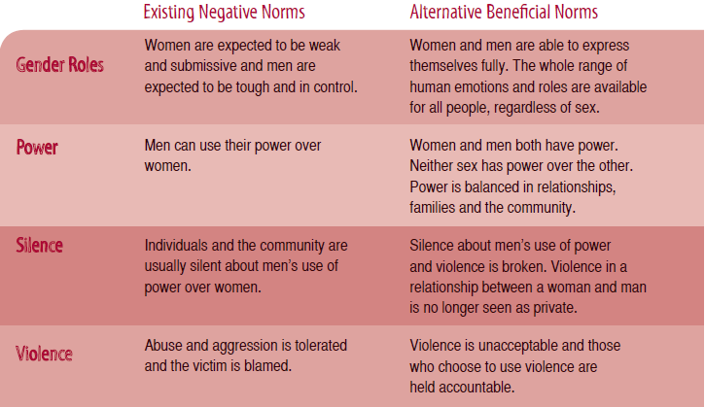
aiming to change social norms

Slide 17
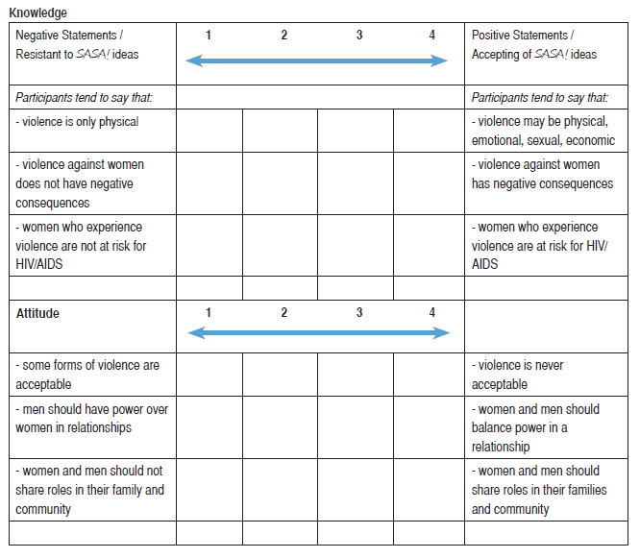
SASA! Outcome Tracking Tool
(completed by the Activist/facilitator/Te Whāriki staff member)

Slide 18
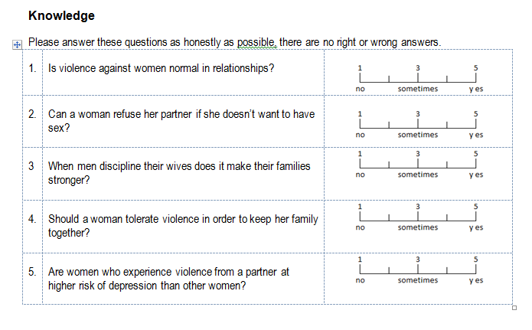
SASA! Outcome Tracking Tool
(completed by whānau/community/programme participants)

Slide 19
3. Key research questions
Is the outcome tracking tool useable? acceptable? valid? reliable? robust?
does it capture meaningful data about the social norms that are associated with whānau violence in Hauraki ?
Is there any evidence of gender/ethnicity differences between the responses?
Do Te Whāriki’s community mobilisation programmes and activities have a beneficial effect on social norms?
Is one activity/strategy more effective than another?
Is there any evidence of critical mass?
Would a larger study would be of value?

Slide 20
4. Research team tasks & roles
governance
budget
finances
project management
administration
logistics
participating in focus group discussions
organising focus group discussions
identifying mātauranga Māori content, themes, social norms
creating resources, eg posters, handouts
creating data collection tools
design & delivery of community activities/events
liaison, promotion, networking & recruitment (getting people to come)
facilitating discussion/assessment dialogues with audience/whanau/programme participants
data entry
analysis of results
literature review
progress reports
getting outcome tracking tools completed by staff, whānau/audience members etc
identifying intended outcomes, strategies, activities for each phase
participating in focus group discussions about mātauranga Māori themes, social norms
participating in focus group discussions about mātauranga Māori content of activities, assessment dialogues, outcome tracking tools etc
completing activity reports
planning programmes & strategies
writing the report
dissemination of report
site visit to Uganda
writing application for project grant

Slide 21
5. Timelines

Slide 22
what happens next?
have a look at SASA! model/resources
  paper copies?
  CD?
  available at www.raisingvoices.org
research team to have a series of focus group discussions
  develop matauranga Maori resources, tools
  discuss/identify social norms, strategies, assessment dialogues
  one phase at a time
  starting with Tohunga
  time & date?
aiming for development & delivery of activity 1 in July?

