Slide 1
developing a Community Mobilisation model of violence prevention that works for the Hauraki nation
research objectives, outcomes & future directions
presentation to the Board
Te Whāriki Manawāhine o Hauraki
12 October 2015

Slide 2
Phase one: identifying the need for research
formative evaluation of kaupapa Māori violence prevention services in Hauraki ($20,000)
      leadership, collaboration and capacity building
      evidence-based decisions
      new directions/innovation
      build on wisdom, knowledge & theoretical paradigms of tangata whenua and other indigenous peoples
      alignment with Mauri Ora Framework
DISPEL THE
ILLUSION
REMOVE OPPORTUNITIES
TRANSFORMATIVE PRACTICE

Slide 3


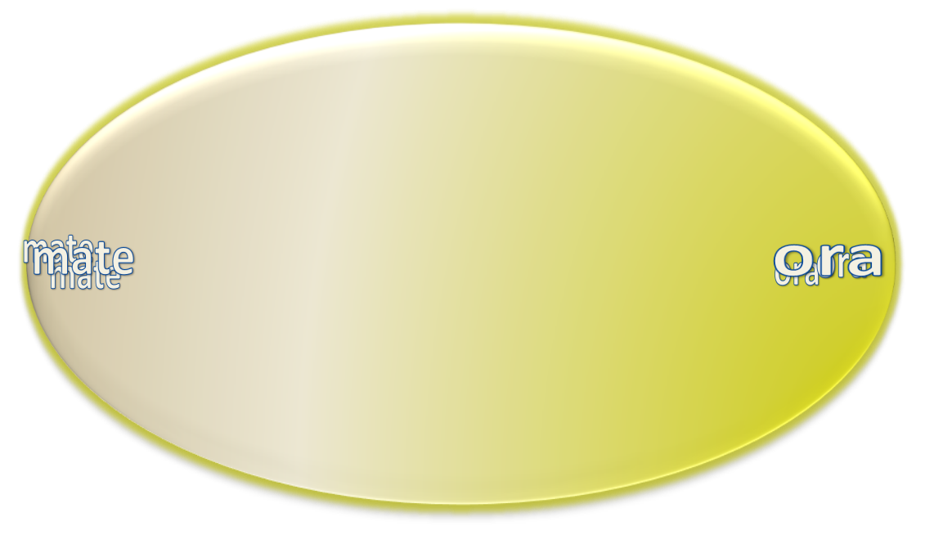
Māori cultural imperatives
Kruger, T., Pitman, M., Grennell, D. et al (2004). Transforming Whānau Violence – a conceptual framework. Second Māori Taskforce on Whānau Violence. Wellington, Te Puni Kōkiri.
Dobbs, T. & M. Eruera ( 2014). Kaupapa Māori wellbeing framework: the basis for whānau violence prevention and intervention. NZ Family Violence Clearinghouse

Slide 4
Phase 2: exploring the research theme
NKK development grant ($10,000)
      for iwi, hapū, community groups
      opportunity to investigate a well-defined area of Māori health need
      funding to write a proposal
        literature review
        consultation (clients/local stakeholders)
        peer-review of design, methods, objectives
        submit application within 3 months

Slide 5
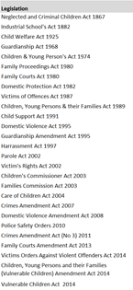
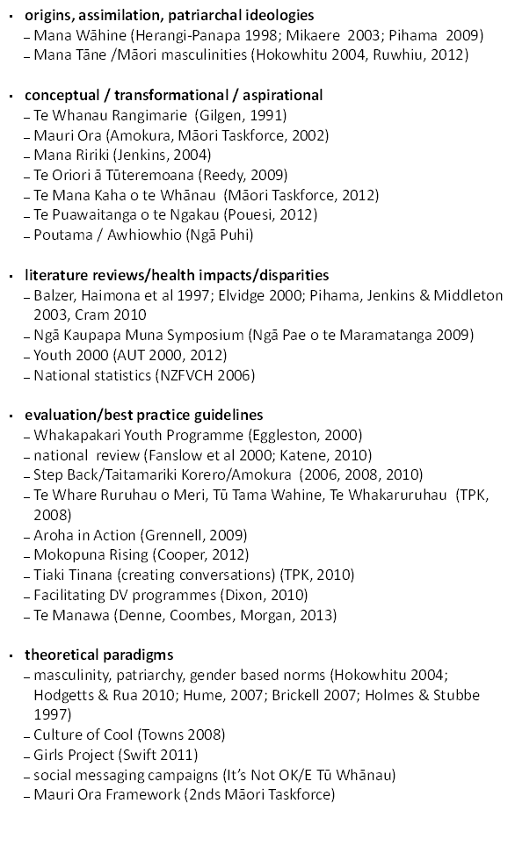
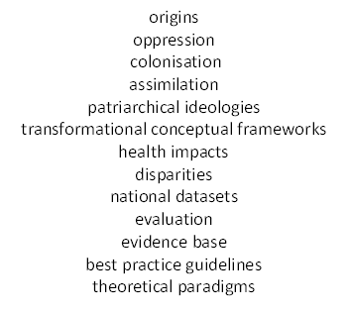
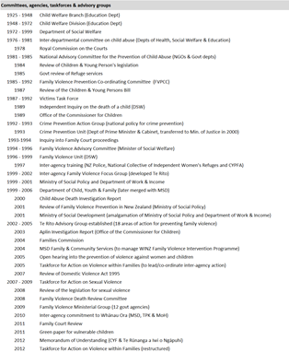
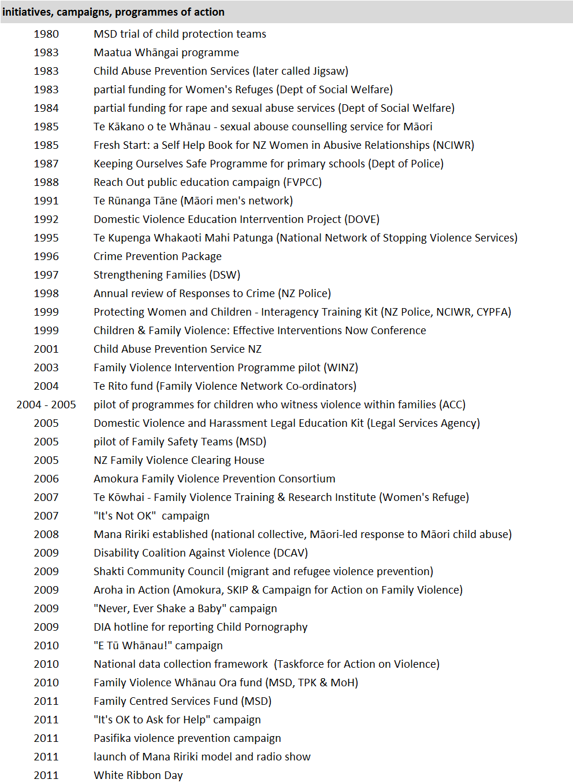
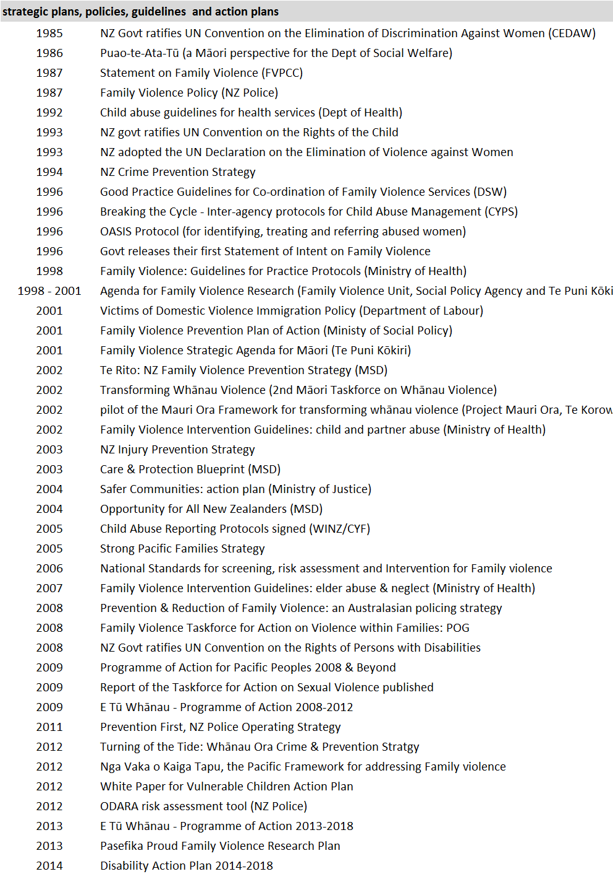
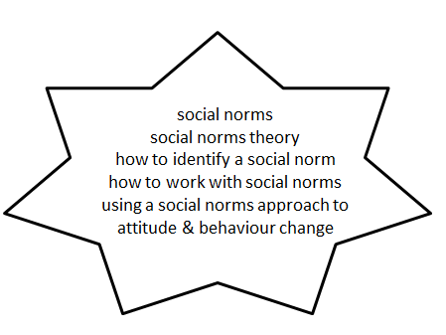
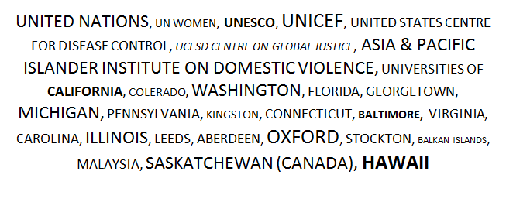
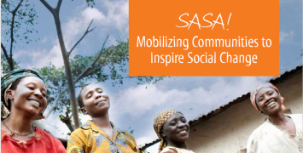
literature review
      wisdom, knowledge & theoretical paradigms from tangata whenua and other indigenous peoples
      alignment with Mauri Ora Framework
background
tangata whenua
indigenous peoples
  www.raisingvoices.com

Slide 6
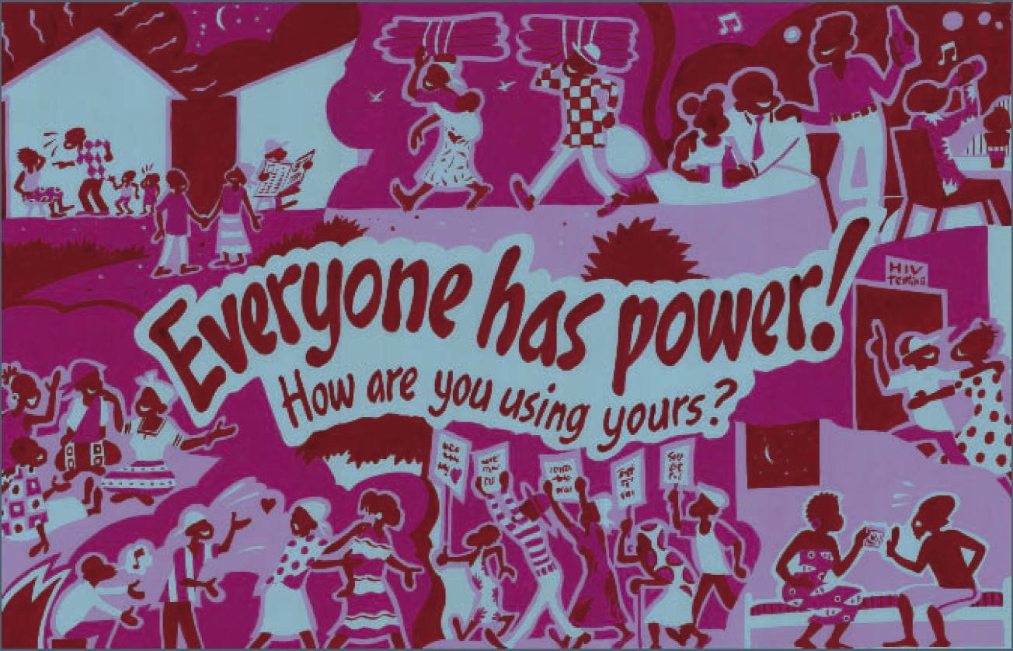
principle 1: violence is about POWER
SASA! design logic
violence is caused by an imbalance of power
strategies for the prevention of violence must address this underlying cause

Slide 7
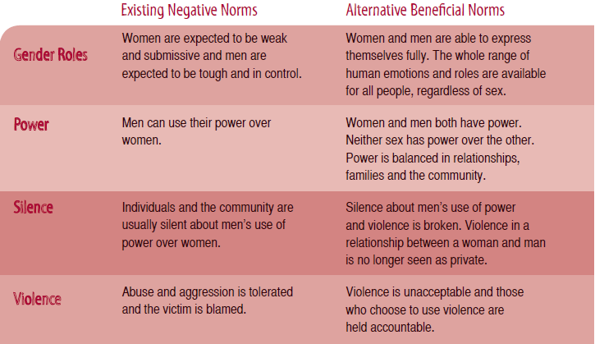
principle 2: power is a social construct
a social norm is a personal belief about the things that other people do and think
  descriptive norm (I do it because other people do it)
  injunctive norm (I do it because other people think I should do it)
social norms are held in place by the expectations of people in our reference group (whānau, community, friends, workmates, society)
Bicchieri, C. & Mercier, H. (2014). Norms and Beliefs: How Change Occurs. The Jerusalem Philosophical Quarterly, 63 (January): 60-82.
SASA! design logic
violence is upheld by normalised beliefs about power
violence is upheld by social norms
violence prevention strategies have to target harmful social norms

Slide 8
principle 3: social norms can change
establish team
create resources
gather baseline data
complete surveys
distribute resources
participate in discussion
engage with community
participate in discussion
participate in discussion
participate in discussion
participate in discussion

Slide 9
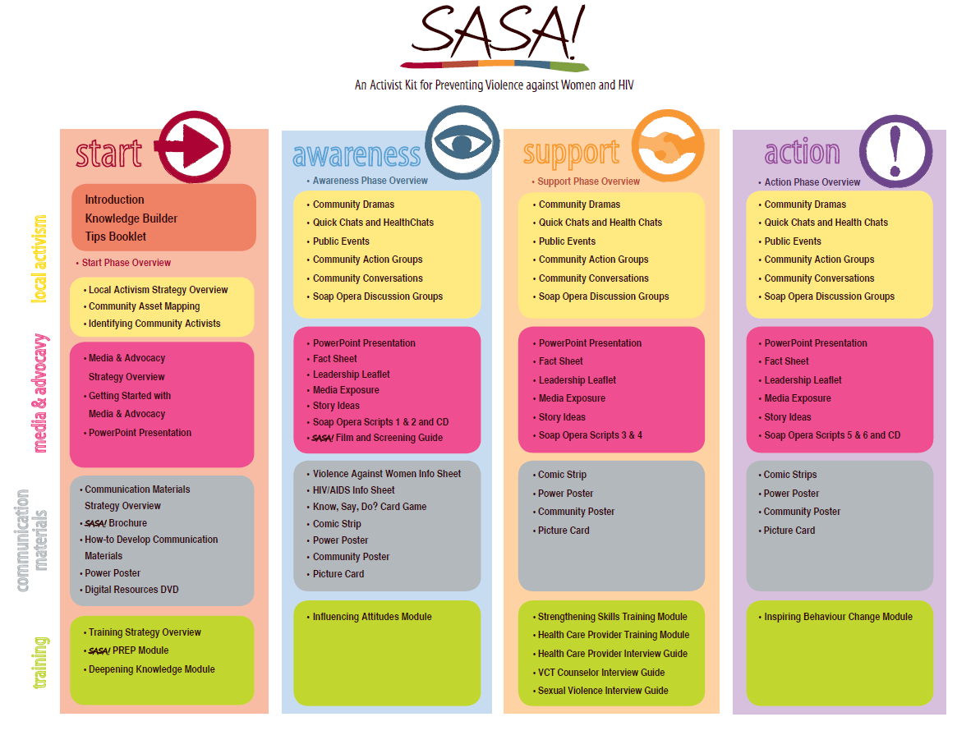

Slide 10
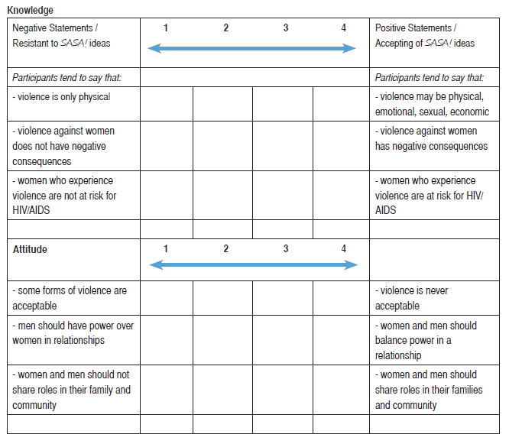
SASA! Outcome Tracking Tool
(completed by the Activist/facilitator/Te Whāriki staff member)

Slide 11
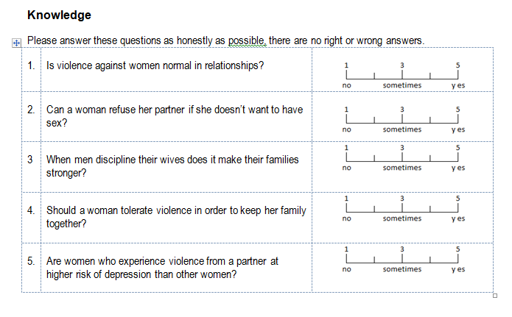
SASA! Outcome Tracking Tool
(completed by whānau/community/programme participants)

Slide 12
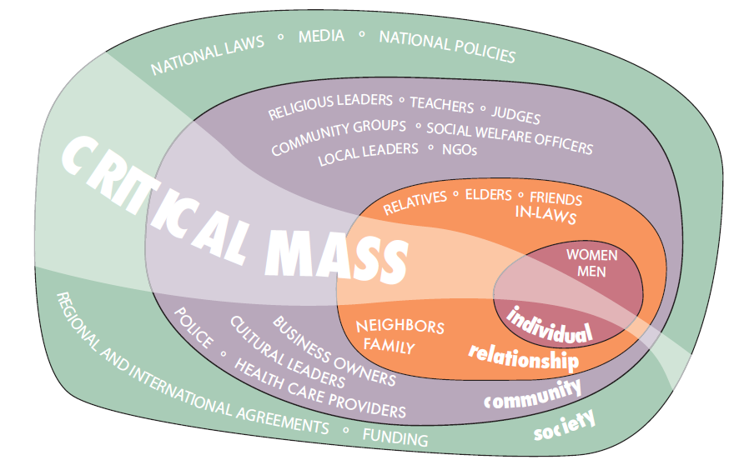
principle 4: critical mass
    Systems Theory (Bronfenbrenner, 1979)
    the simultaneous use of diverse strategies, within and across our Circles of Influence, will eventually generate a critical mass that can change social norms and sustain long-term behaviour change

Slide 13
Rationale for NKK project grant
Te Whāriki has been delivering a violence prevention programme & community mobilisation initiatives in Hauraki for 20 years
  is this making a difference in Hauraki?
Raising Voices have a model for gathering evidence that aligns with our flagship programme (Poutama Mauri Ora, Mauri Tū)
  could their framework be of use to Te Whāriki?
    would it build on existing strategies & strengths?
    needs mātauranga Māori content and aspirations
develop & pilot test a mātauranga Māori version of the Raising Voices model for delivery of primary prevention strategies and gathering evidence

Slide 16
Project design
Te Whāriki
  alignment of SASA! framework/model with Poutama Mauri Ora Mauri Tu!
  identify Poutama messages/social norms (because we know it works)
  develop mātauranga Māori resources & tools (based on Poutama messages/social norms)
  train Poutama team to deliver community mobilisation programmes/events/activities
  deliver four (4) community mobilisation programmes, events, activities (to promote Poutama social norms/messages)
  pilot Poutama version of the outcome tracking tool (pre/post test)
Whānau & Community
  participate in programmes, events, activities, discussions
  complete surveys/data collection/assessment tools

Slide 17
the vision: a Poutama toolkit
Phase 1: Start/Tohunga
  identify intended outcomes
  plan the strategies
  monitor progress
  implement activities
  assessment dialogues
  track outcomes
  reporting
Phase 2: Awareness/Matakite
  identify intended outcomes
  plan the strategies
  monitor progress
  implement activities
  assessment dialogues
  track outcomes
  reporting
Phase 3: Support/Toa
  identify intended outcomes
  plan the strategies
  monitor progress
  implement activities
  assessment dialogues
  track outcomes
  reporting
Phase 4: Action/Kaiako
  identify intended outcomes
  plan the strategies
  monitor progress
  implement activities
  assessment dialogues
  track outcomes
  reporting

Slide 18
Poutama messages/events/activities
public events
  drama/story telling/soap opera
  short films/documentaries
  music/festival
  march/parade/hikoi
media & advocacy
  radio/talk shows
  newspaper/magazine articles
  brochures/leaflets
  posters/banners
  power point presentations
  fact/ sheets
  mailbox drop
  door knocking
workshops/wānanga
  facilitated programmes
  skillsets & training
  sharing information
  consciousness raising
discussion groups
  assessment dialogues
  community/agency based
games
  card games
  board games
other
  cartoons/comics
  picture cards
  creative arts

Slide 19
the timeframe

Slide 20
Phase 3: NKK Project Grant ($187,000)
  Project team:
  Denise Messiter (1st named investigator/project manager)
  Stephanie Palmer (lead researcher)
  Carolyn Hopa (research assistant)
  Irene Kereama-Royal (project advisor)
  Jamie McCaskill/Kali Kopae (programme facilitators)
  Heather Wiseman (administrator)
Milestones
identify social norms that have relevance for Māori (from Poutama)
develop & pilot a tool for the measurement of social norms (that have relevance for Māori)
train kaimahi in the delivery of primary prevention techniques (Poutama/Te Whāriki activities)
deliver primary prevention strategies test and post-test pilot tool
analyse, report on and disseminate findings

Slide 21
identifying Poutama social norms/messages
2 wānanga/Train the Trainers (April, October 2014)
draft list of possible themes (March 2015)
pre/post test (May-April 2015)
  3rd wānanga, Tirohia Marae
  supplemented with any other participant & recruitment at mall
  n=56 (25/31)
no clear findings/didn’t make sense
  little or no difference between people who had/had not participated (how can that be??)
  people who had never been to a Poutama were agreeing with Poutama specific concepts (shouldn’t be)
  vehement objections to some Poutama messages, eg I DON’T HAVE A TOHUNGA!! (not generalisable)
  mauri items of most use

Slide 22
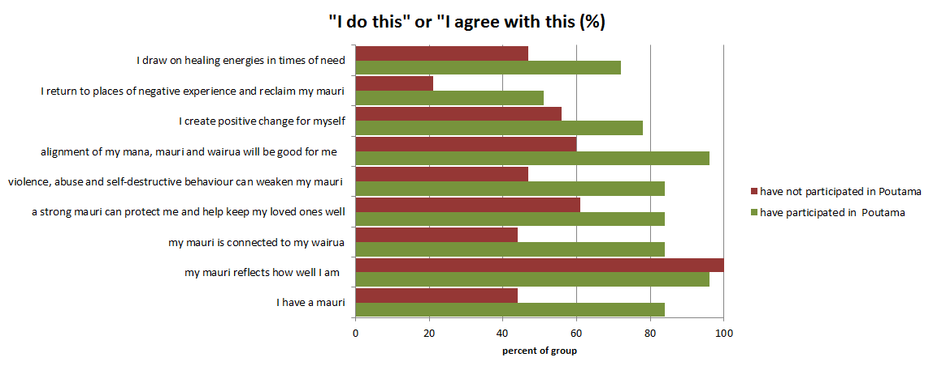

Slide 23
another way to Start
how do we know a social norms approach will work in Hauraki?
  produce evidence that social norms are operating and associated with family violence (demonstrate feasibility)
how will we know the community mobilisation model is working in Hauraki?
  collect baseline prevalence data
  capacity to track change over time

Slide 24
will a social norms approach work?
how to identify a social norm
        what I do?
        what I think other people do?
        what do other people think it is appropriate to do?
        do people think violence is common in our whānau/family/ community?
masculinity theory
  there is a NZ/tangata whenua literature on this (Hokowhitu 2004, Hodgetts & Rua 2010; Towns 2008; Swift, 2011)
  gender perceptions (masculinities) are associated with power asymmetries that underpin intimate partner violence
  could use a simple word quiz to explore gender-based power asymmetries in Hauraki

Slide 25
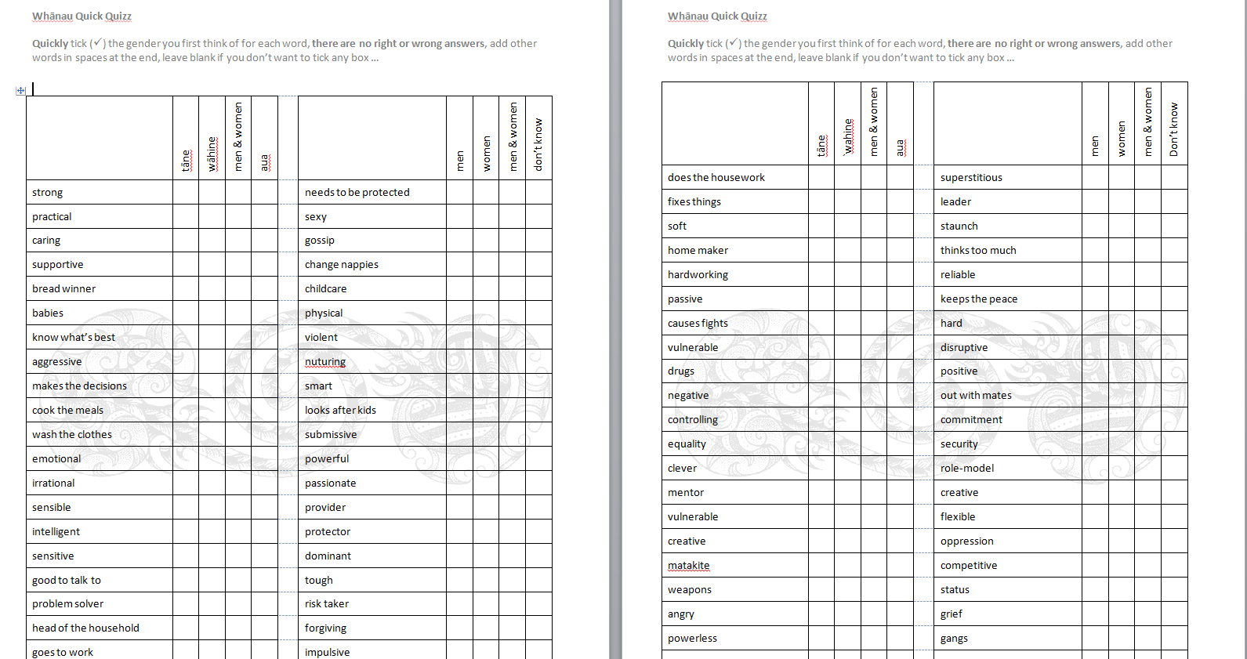
Evidence that social norms are operating in Hauraki

Slide 26
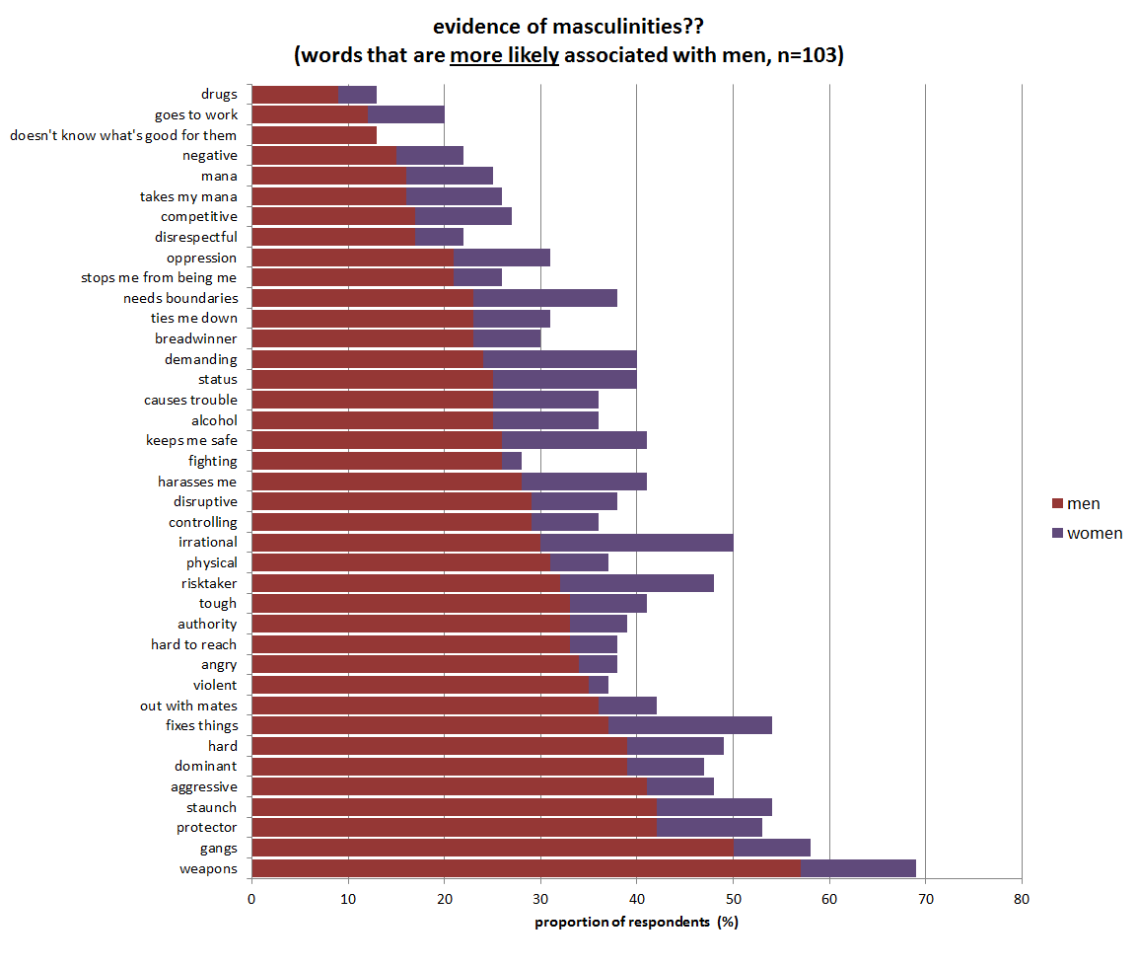

Slide 27
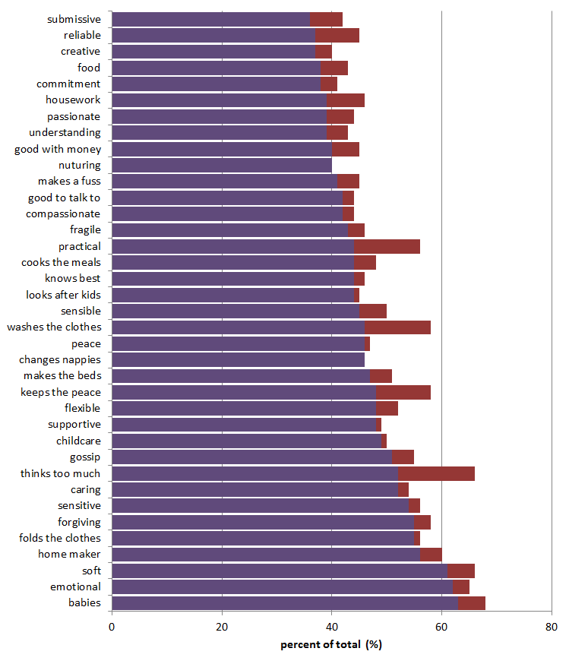
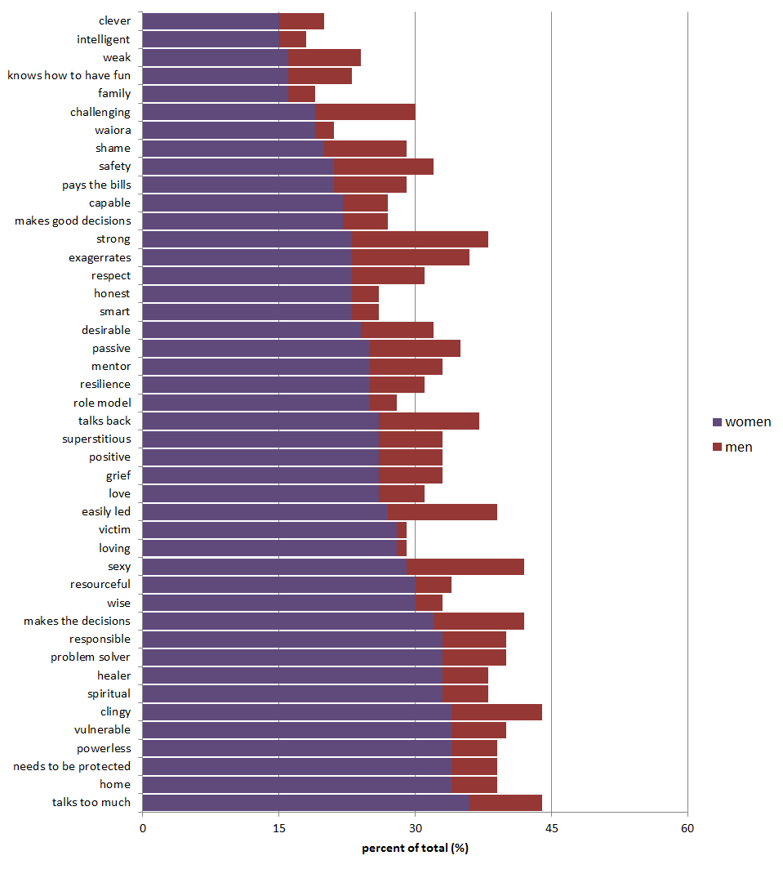
evidence of feminities
(words that are more likely associated with women, n=103)

Slide 28
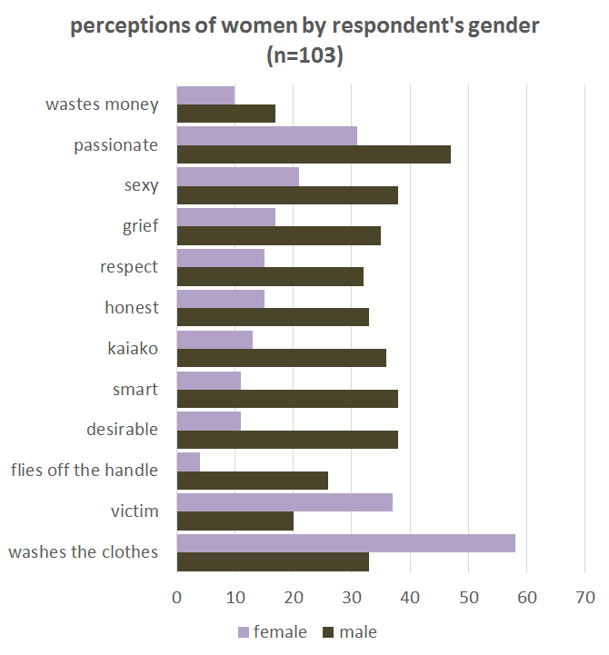

Slide 29
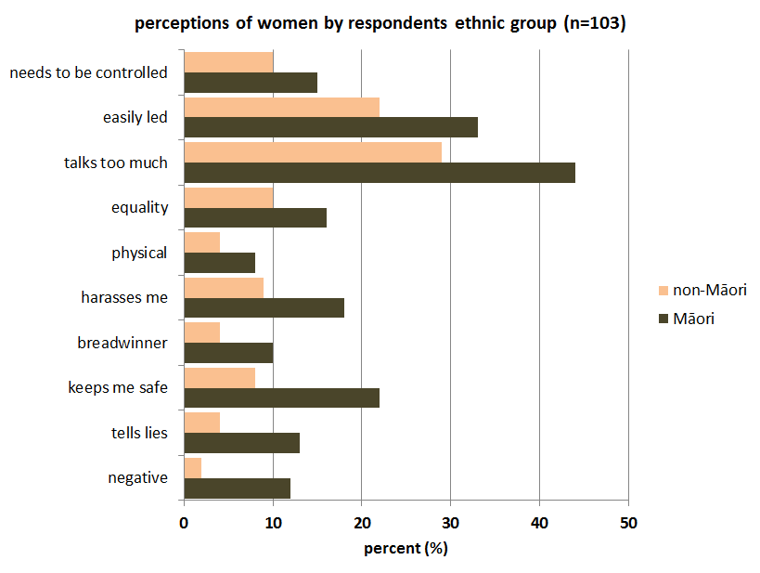

Slide 30
designing the prevalence survey
        objectives
          Is whānau violence a social norm?
            do we think violence is common in our whānau/family/community?
  how will we know the community mobilisation model is working in Hauraki?
    collect prevalence data (benchmark baseline)
    capacity to track change over time

Slide 31
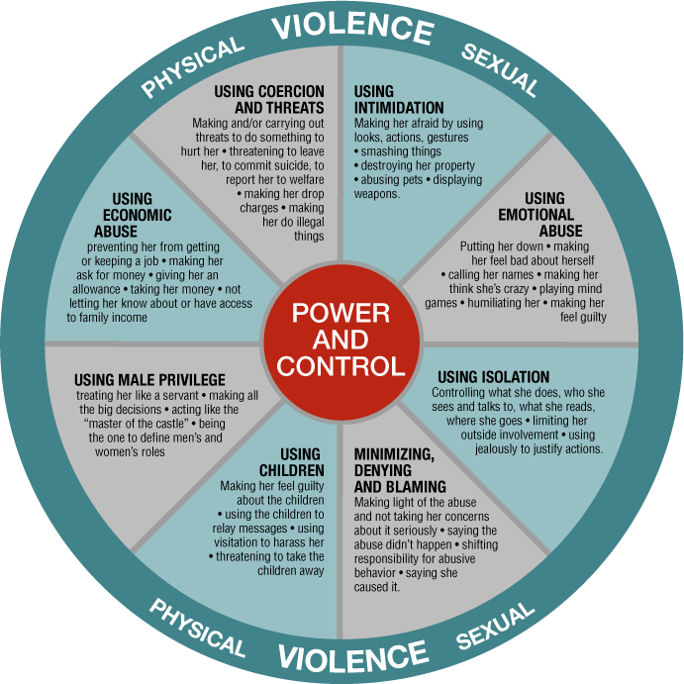
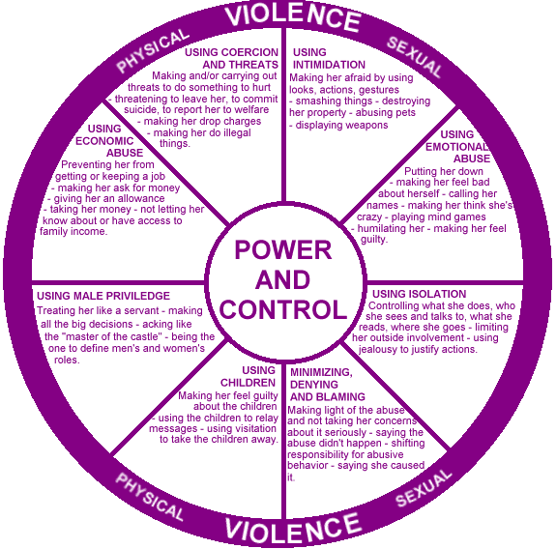
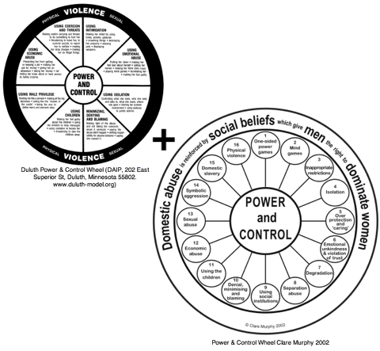
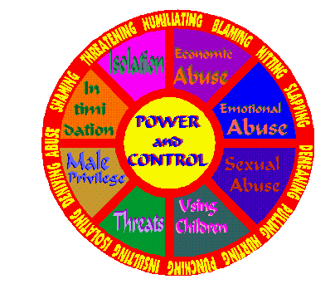
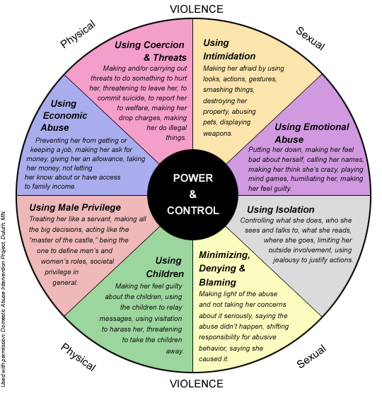
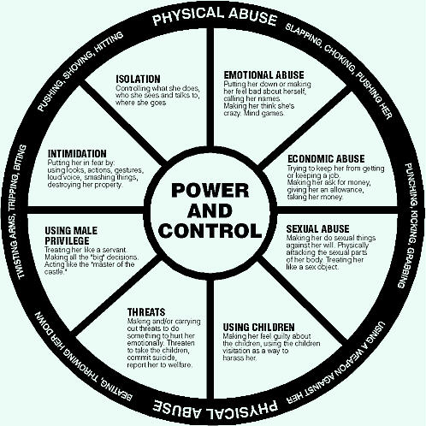
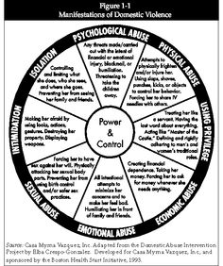
Designing the the prevalence survey

Slide 32
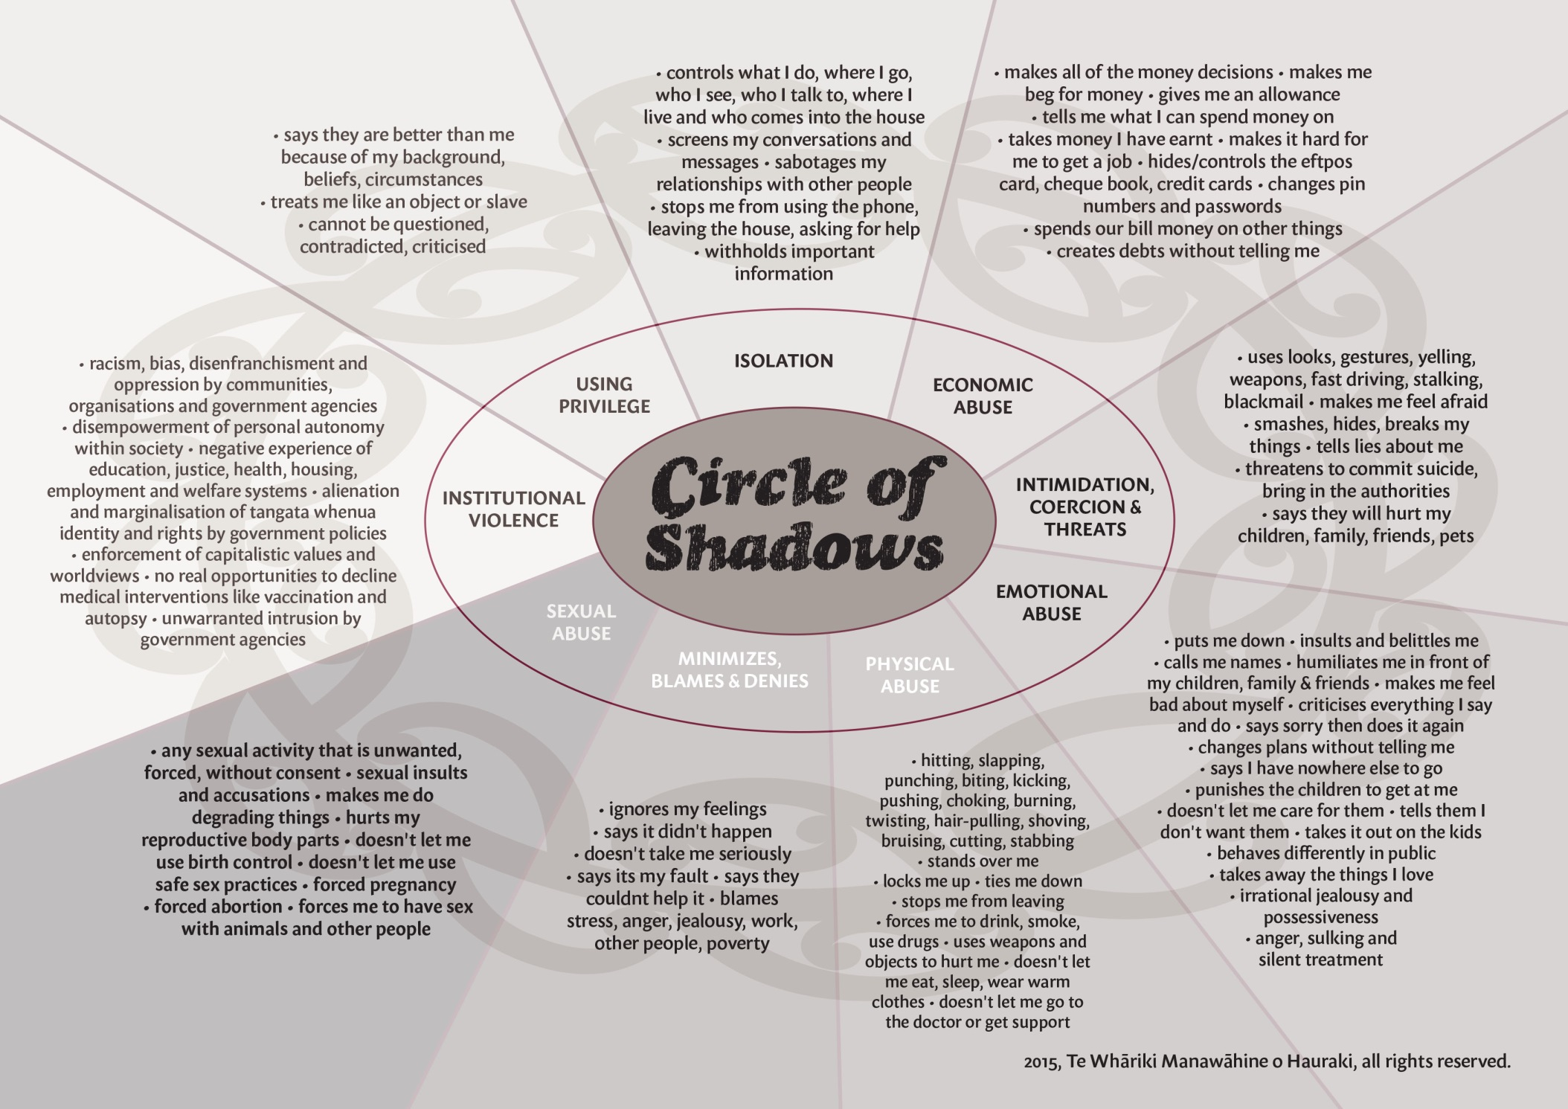

Slide 34
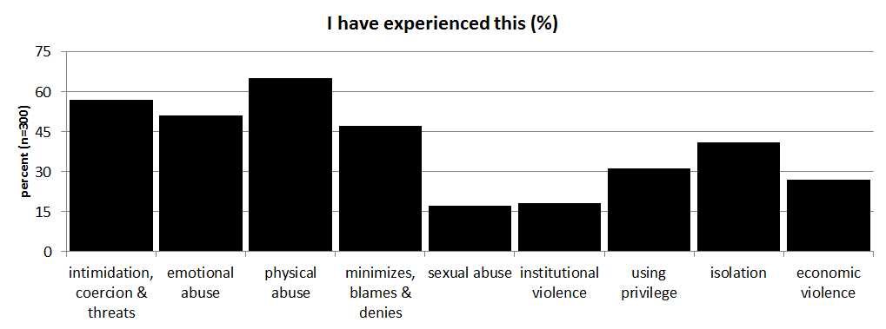
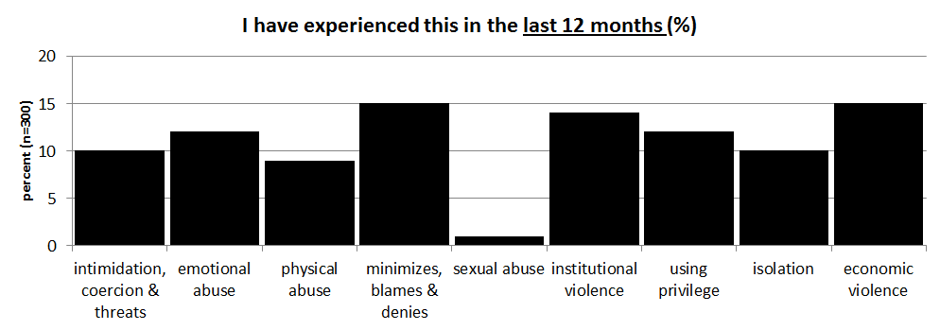

Slide 35
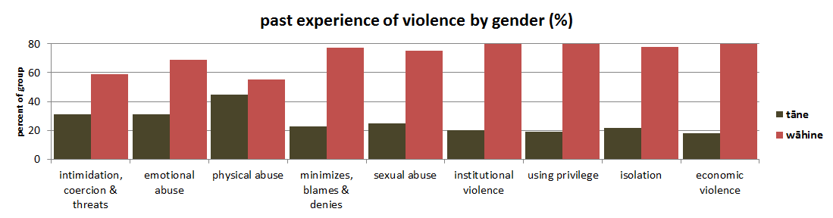
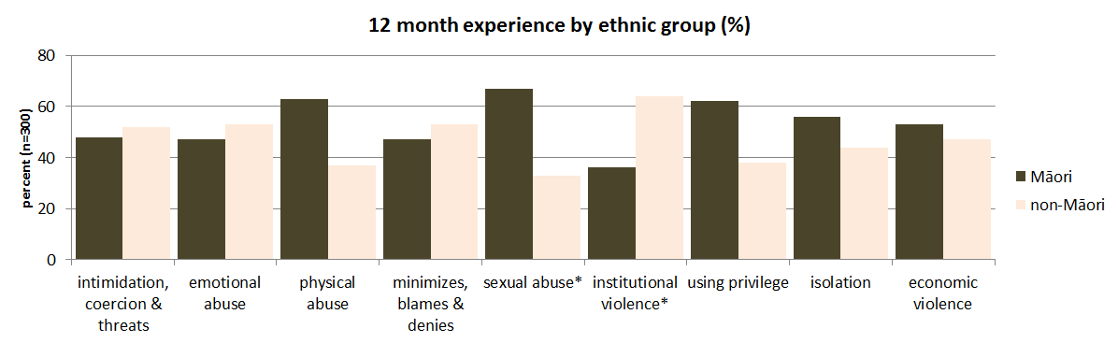
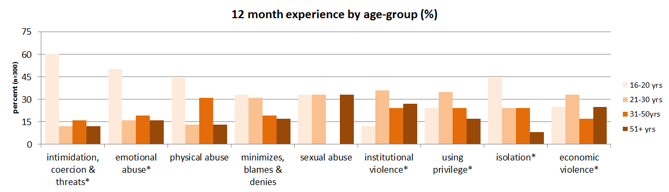

Slide 36
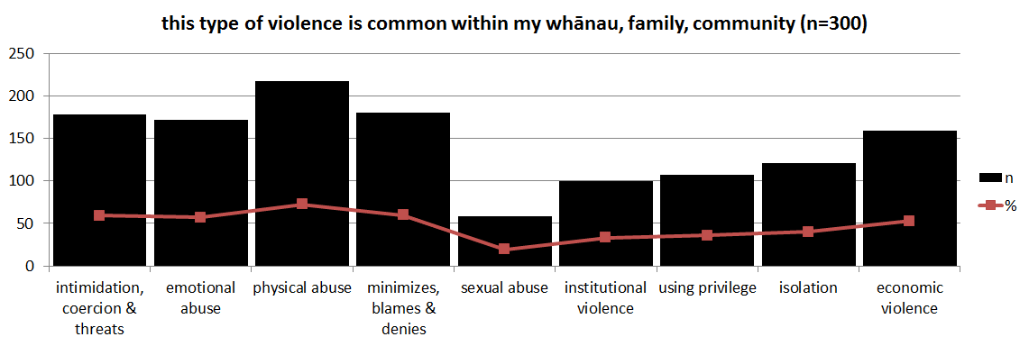
Is violence a social norm?
    what I do?
    what I think other people do?
    what do other people think it is appropriate to do?

Slide 37
What have we gained?
evidence of social norms operating in Hauraki
  masculinities/gender based role perceptions
  violence is normal in my family/community
the feasibility of a social norms approach to violence prevention
a dataset that enables implementation of the SNA methodology
  personalised feedback strategy
    target masculinity perceptions (to promote equalities)
    target violence perceptions (is not normal in my family)
  rationale for MBIE funding to develop some digital strategies
  evidence that a Māori cultural imperative (mauri) is a social norm that could form the basis for a mātauranga Māori community mobilisation model of violence prevention in Hauraki

Slide 38
the logic for a Mauri-Ora Revolution
  life principle, the sneeze of life, unifying element, healing energy, sacred and divine origins, taonga tuku iho
  dynamic, resilient, flexible, can wax and wane, feeds on collective energy, interacts with mana and tapu, reflects vitality/state of being – mauri tu, mauri ora, mauri noho, mauri mate
  impacted by violence and abuse
  1 of 6 cultural imperatives in the Mauri Ora Framework for violence prevention
  mauri is a Māori cultural imperative that is responsive to intervention/transformation/critical mass
  could be normalised through resources, programmes, activities, SNA strategies
  mauri is measureable
  the mauri-ora continuum could be aligned with the TTL model of behaviour change – mauri mate, mauri noho, mauri tū, mauri ora
  a mauri-ora revolution is a primary prevention strategy for violence in Hauraki

Slide 39

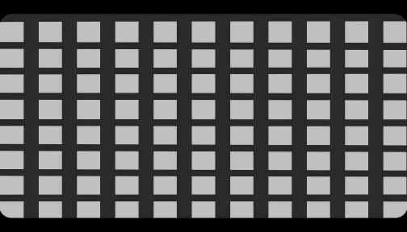
a mauri-ora revolution is a mātauranga Māori community mobilisation model for displacing the negative social norms that underpin family violence in Hauraki

Slide 40
Phase 4: where to from here?
MBIE grant to develop some digital strategies ($25K - $120K)
Trust Waikato contribution to salaries/operations for one year pilot of digital strategies as a community mobilisation resource ($26K)
Lotteries Community Sector Research contribution to digital strategies project ($90K)
EoI for HRC Project Grant to continue community mobilisation research
other possible funders to continue community mobilisation research
  HRC NKK grant
  Te Punanga Haumaru Fund
  Medibank Research Grant
  Skycity Community Trust
  Jetstar Flying Start
  Lottery Charities

