Slide 1

Te Poipoia Tūkino o Hauraki transforming & healing whānau in Hauraki
Te Whāriki Manawāhine
Denise Messiter, Maree Tukukino, Tania Weidenbohm,
Tania Wihongi, Heather Wiseman, Stephanie Palmer, Lucy Hamon

Slide 2
What is Te Poipoia Tukino o Hauraki?
Te Poipoia Tūkino o Hauraki – forum of indigenous providers from Hauraki . HMTB, TKHOH,TWMWOH, TAK, TKONH
Te Poipoia 2006 – 2008 developed strategy to address domestic violence in our tribal communities
Gov strategies not working for our people
In 2007, 6 Hauraki children died from domestic violence
Violence in Hauraki hidden by national picture
That picture transposed onto Hauraki
Means we miss what is important and necessary for us
Key directives from our communities are to:
Affirm Te Ao Maori as valid construct for transforming and healing family and domestic violence in Hauraki
Need to understand the relationship between colonisation and violence in Hauraki
Adopt transformative practices and approaches at family, community and tribal levels
So what has Gov been doing for the past 160 years that has made a difference for Hauraki?

Slide 3
laws & legal mechanisms, 1867-2014
Notes:
Our govt has invested billions of $s in the prevention and elimination of Domestic Violence in NZ
At least 27 laws enacted since 1867,
18 of which are still in place
generally aim to protect the victims and ensure perpetrator prosecution
Increasingly characterised by
monitoring/screening
Draconian definitions of protection
inter-agency information sharing
Mandatory reporting of suspected abuse, and
removal of children

Slide 4
govt agencies, ministerial committees, investigations & advisory groups, 1985-2013
Notes:
roughly 45 govt depts, committees & advisory groups have been involved in the establishment of NZs FV sector
Māori representation in decision-making has been evident since the mid-80s
responsibility currently spread across 12 govt agencies including the Ministries for Māori Development, Women’s Affairs, Pacific Island Affairs & Disability
In recent years, the Govt has started to sign MoUs with Maori tribes themselves

Slide 5
strategies, conventions, policies, pilots & action plans, 1985-2014
Notes:
Over the last few decades, more than 40 conventions, protocols, strategic plans and programmes of action have created the platform for family violence policy implementation

Slide 6
campaigns, interventions, quality assurance & funding opportunities, 1980-2014
Notes:
Since 1980 the govt has created numerous opportunities for NGO involvement in resource development, crises support, intervention and rehabilitation services
Hundreds of programmes and campaigns have been developed, rolled out and delivered by Mainstream, Maori, Pasifika and other minority groups at the national and community level
acceptance of govt funding often has a sting in the tail for voluntary, community-based organisations, who’s core business is about imbalances in power and control
one one hand, govt funding gives employment, structure and certainty
on the other hand it reduces autonomy and introduces burdensome compliance demands

Slide 7
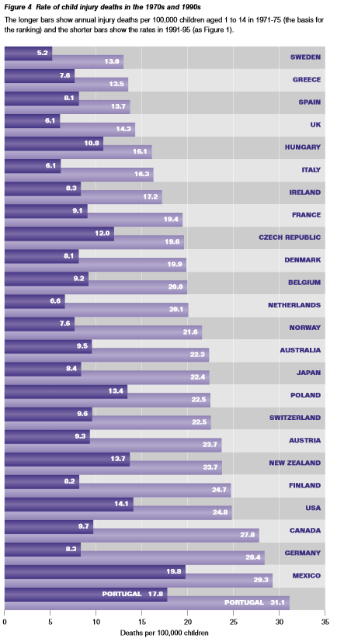
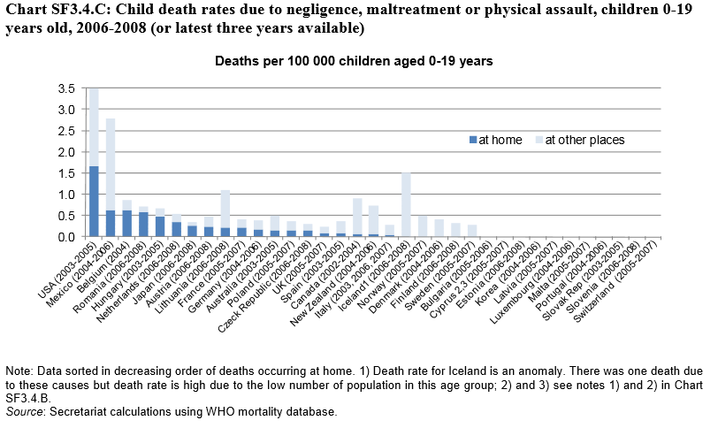
Is it working? – international comparisons
Notes:
So … is the govts enormous investment of time and money working? Is it helping to stem the tide of FV that seems to be so particularly characteristic of indigenous communities
If we look at other countries in the OECD, it is evident
NZ had the 7th highest rate of child deaths from intentional and unintentional injuries in the 1970s
by 1990 we had the 5th highest rate
and 20 years later little had changed
In 2008, we still had the 5th highest rate of child deaths from negligence, maltreatment or physical assault in the OECD

Slide 8
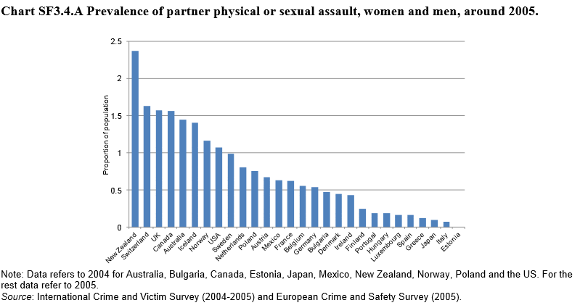
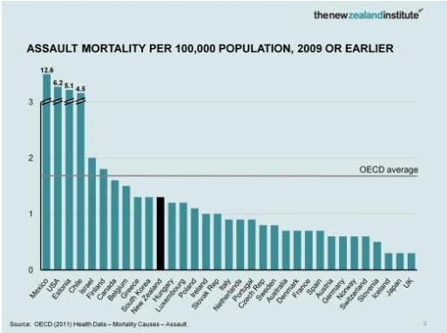
Notes:
Our statistics on IPV are just as grim …
In 2005, NZ had the highest prevalence of intimate partner physical and sexual assault in the OECD, outranking all other nations by 40 to 90%
in 2009, we still had the 9th highest rate of assault mortality – equivalent to Sth Korea and Greece but quadruple experience in the UIK and Japan

Slide 9
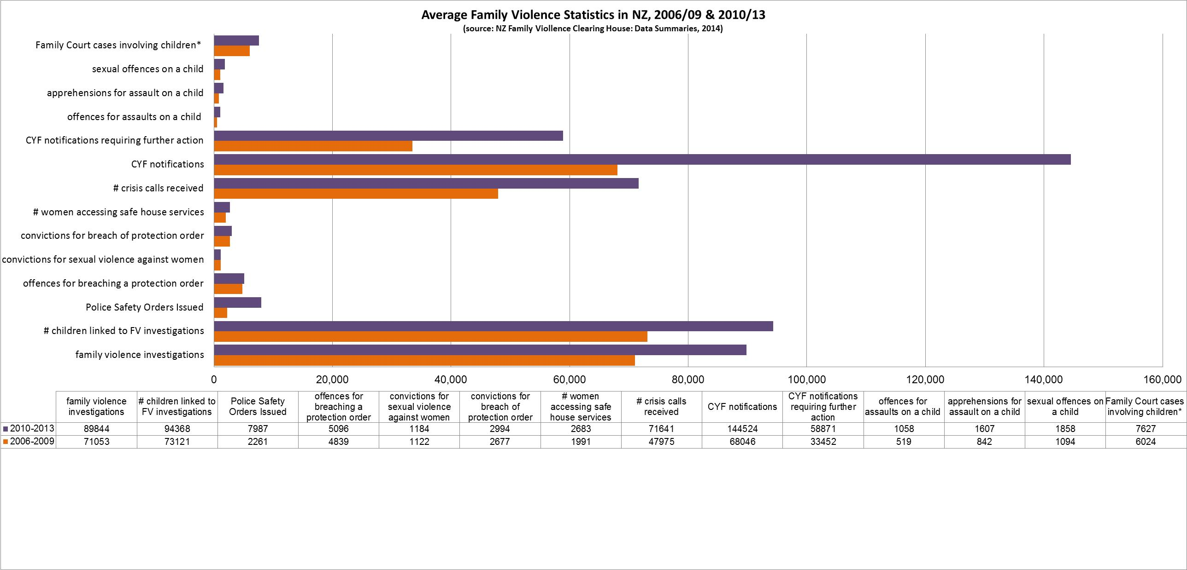
Is it working? – national trends
Notes:
This graph has been compiled from national case summaries published by the NZ Police, CYF and refuge services
To give a more reliable picture, the data has been averaged over 3 year periods
since 2006 there has been
100-200 fold increase in the number of
Police Safety Orders
CYF notifications, and
offences for assault on a child
70-90% increase in the number of
CYF notifications requiring further action
sexual offences on a child, and
apprehensions for assault on a child
20-30% increase in the number of
FV investigations
women accessing safe house services
children involved in FV investigations and
Family Court hearings initiated by either the Domestic Violence Act or Children, Young Persons & their Families Act

Slide 10
the problem with national datasets
family violence is grossly under-reported
deficit-based
mask positive change at the local evel
not responsive to mātauranga Māori indicators
do not acknowledge indigenous success in primary prevention strategies
Notes:
Despite billions and billions of fiscal dollars, the national datasets suggest little progress towards the elimination of family violence over the last 30 years
Its hard to know whether this is really the case, or the data is just reflecting a more punitive legal system
Either way, from an indigenous perspective, the national datasets have always had problems, this is just another reason not to trust their information, for example
women and communities know that children are taken away if CYF or the Police are informed or involved in FV events, so there is this silence and, as a result, family violence is grossly under reported in national datasets
national datasets are also derived from negative statistics like perpetrator apprehensions and prosecutions, child placements and use of FV services – the system is deficit based, it has been designed to measure deficiencies
And can, therefore, mask or not recognise important indicators of positive changes that may be occurring within the local community, such as an attitude or behaviour change
The national datasets are not responsive to mātauranga Māori indicators of progress
which means they do not measure, acknowledge or recognise indigenous indicators of success such as the transformative outcomes of awareness raising, small group work and programme delivery

Slide 11
In other words …
Indigenous providers of community-based violence prevention programmes and services need to create an evidence base that demonstrates their success!!
Notes:
NZs much heralded Glenn Inquiry endorses this position

Slide 12
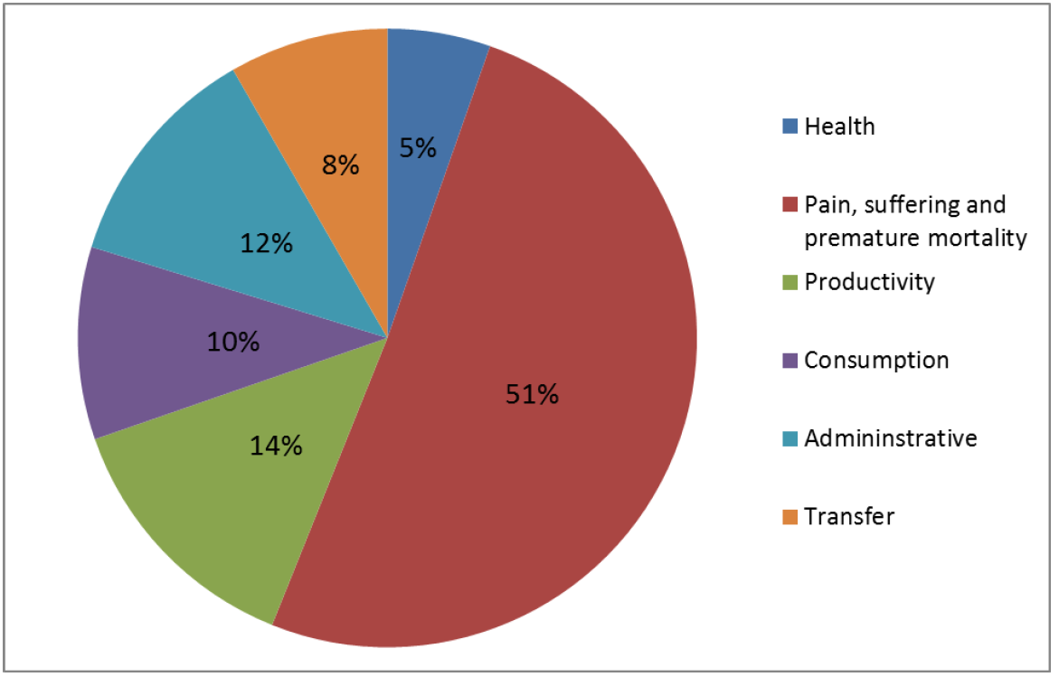
The $$ cost of Family Violence in NZ
$1bn a year (KPMG, 1994)
$2bn a year (Ng, 2012)
$4.1 to $7bn or $1,509 per capita (Glenn Inquiry, 2014)
the equivalent per capita cost for Australia is NZ$675 (KPMG, 2009)
projected increase to $10bn by 2018
“despite apparent increases in government spending … the majority of this spending has been on responding to symptoms with only small increased in investment in those providers who are able to effectively address the solutions” (pg 1, The Glenn Inquiry – Economic Costs, 2014)
Notes:
In 2012 Owen Glenn pledged $60m to end child abuse and FV in NZ
the so-called Glenn Inquiry has commissioned a number of projects including one that aimed to measure the true economic cost of domestic violence in our society
Previously this cost was thought to be around NZ$1 to $2 billion a year
The Glen Inquiry produced conservative, moderate and high end scenarios which estimate family violence will cost $4.1 to $7bn,or NZ$1,509 per capita, in 2014
these estimates calibrate prevalence rates against the likely lifetime impact of FV for victims, perpetrators and employers
For example, health care costs (5%), productivity issues (14%), administration matters like income support and engagement with Police and court systems (12%) and transfer costs like victim/survivor compensation and lost taxes (8%).
As we all know, the biggest impact of family violence, which accounts for 51% of all costs, is the psychological, emotional and spiritual suffering that it causes, along with the associated likelihood of premature mortality
If the govt contines to deliver services the way they currently do, it is projected the annual costs of FV will climb to $10bn plus by 2018, this is because … the majority of the govts spending is directed towards responding to symptoms, like an ambulance at the bottom of the cliff, very little is channelled towards the service providers with effective solutions
Denise is going to tell you about our solution

Slide 13
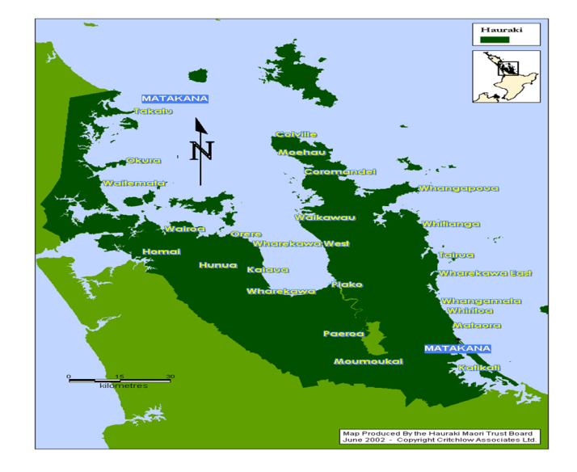

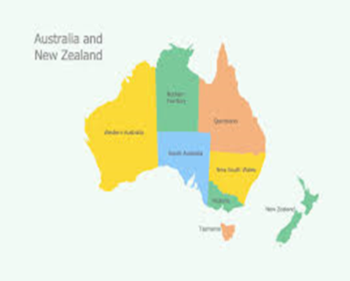
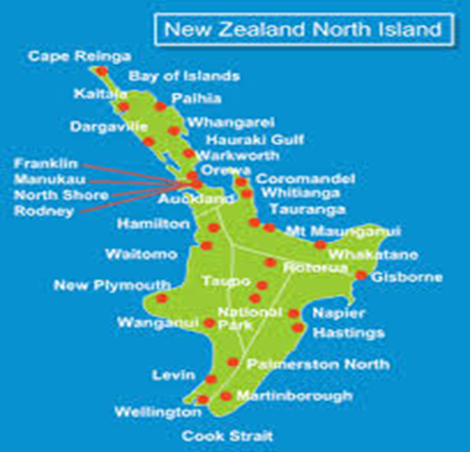
Where in the World is Hauraki?

Slide 14
Who is Te Whariki?
Te Whariki has been delivering healing violence services for 30 years
Vision “Safer Hauraki”
Mission “Transforming and healing whanau in Hauraki
Values statement “Honouring connectedness, valuing integrity, sharing knowledge, wisdom and healing and advocating justice for all”
Outcome We Work Toward “ Strong, connected Hauraki whanau and Hauraki communities”
Notes:
Changed terminology and vision – instead of saying violence free focus is on healing and recovery

Slide 15


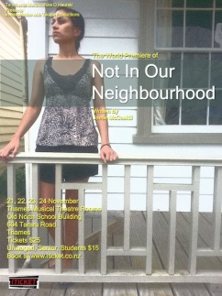


What Te Whariki Does?
Provide support and advocacy including legal, counselling and social services, 24/7 free crisis support line,
Social marketing to raise awareness about healing and transforming family and domestic violence in Hauraki from a Hauraki perspective (www.haurakiwomensrefuge.co.nz) and Facebook
Therapeutic intervention programme – Poutama Mauri Ora, Mauri Tu – The Art of Reclaiming Sacred Space

Slide 16
A bit about our Model Poutama Mauri Ora, Mauri Tū
Therapeutic model of recovery and healing premised on traditional Maori knowledge and truths
Designed to support Maori world view that we live in four concurrent/intersecting worlds
Te Taha Tinana (Physical), Te Taha Wairua (Spiritual), Te Taha Hinengaro (Intellectual), Te Taha Whanau (Social)
Four traditional archetypes/traditional spaces/ways of being
4 dimensions of Mauri (Mauri Ora, Mauri Tu, Mauri Noho, Mauri Mate)
Shadows, Light, Positive, Negative, explored in a traditional learning setting
Use traditional tools (dance, karanga, storytelling, games, 3 baskets of knowledge, 4 winds) to stimulate and rejuvenate Mauri and Mana
Reframe lives using the light and shadow qualities of 4 traditional archetypes
Increase awareness of Mauri and Mana and inspire willingness to take action to change the life negating impact of violence
Notes:
Model is about normalising healing not violence
Want to know what motivates people to recover from violence and maintain their recovery within a society that’s full of violence

Slide 17
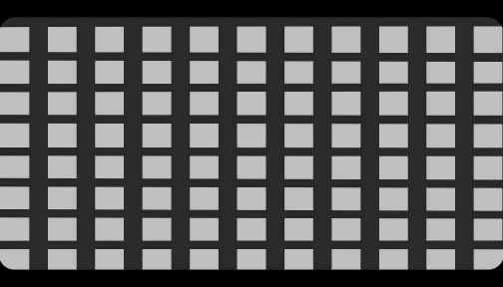
Mauri in Action

Slide 18
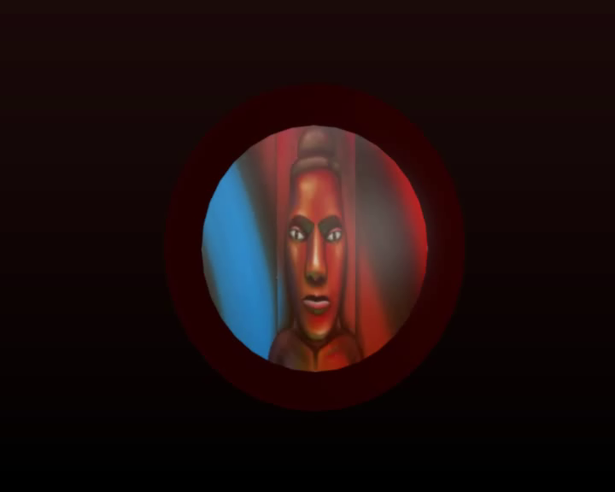
Tohunga Healer – Assessor – Mauri – Papatuanuku – Shadow and Light of Emotional Wellbeing - South

Slide 19

Toa Leader – Wairua – Dance – Karanga – Respect – Boundaries - Shadow and Light Spiritual Wellbeing - North

Slide 20

Matakite Visionary – Insights, Childlike, Spontaneous, Storytelling, Games, Shadow and Light of Emotional & Spiritual Wellbeing – East Hine Titama

Slide 21
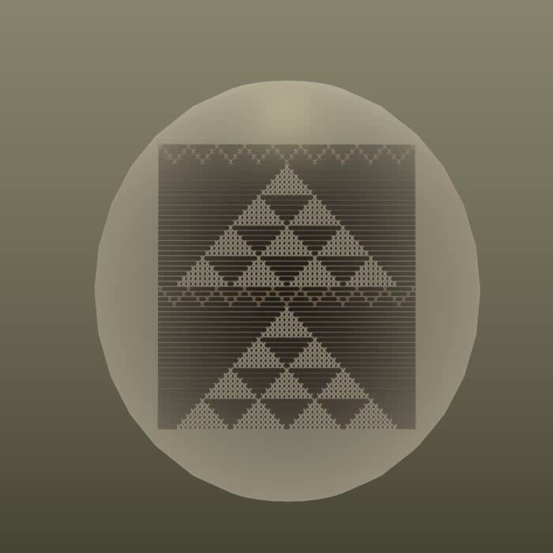
Kaiako Teacher – Mentor – Uncertainty – Trust – Life – Death – Change
Shadow & Light, Emotional & Spiritual Wellbeing – West – Hine Nui te Po

Slide 22
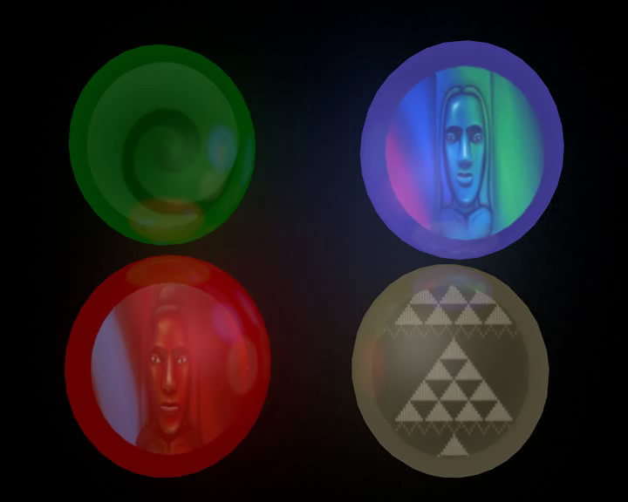
Poutama Mauri Ora Mauri Tu
Integration – Collision of 4 Worlds – 4 Archetypes – Traditional – Contemporary - Unknown

Slide 23
Research aims
to develop and pilot a tool for measuring the social norms that are associated with whānau violence in Hauraki
statistical evidence of validity
mātauranga Māori content and aspirations
useable & meaningful for Māori whānau in Hauraki
aligns with Poutama Mauri Ora, Mauri Tū
builds on existing strengths & strategies
Notes:
Earlier this year Te Whariki received an Health Research Council research grant that has given us the opportunity to establish our own evidence base.
The research aims to provide
statistical evidence of validity
ensure matauranga Maori content and aspirations
and produce a tool that is
meaningful for whanau
aligns with Poutama and
builds on existing strengths and strategies

Slide 24
why social norms?
inspired by the community mobilisation model of violence prevention (Michau, 2012)
primary prevention
diverse programmes and strategies
systematic approach to behaviour change
capacity to reduce prevalence
robust process for tracking outcomes
captures the nature of Te Whariki’s engagement with Hauraki
establishment of a quantitative evidence base
consistent with the Mauri Ora Framework of Violence Prevention (2nd Māori Taskforce on Whānau Violence, 2004)
dispell the illusion
remove opportunities for whanau violence
teach transformative practice
Notes:
Our decision to explore social norms has been
Inspired by the community mobilisation model of violence prevention that has largely been developed by Raising Voices in Uganda.
Community mobilisation is a …
The notion of community mobilisation appealed to us because it captures the nature of Te Whariki’s engagement with Hauraki
Our work is about mobilising communities to recover from violence
The community mobilisation model enables that investment to measured, monitored and turned into a quantitative evidence base
A social norms approach is also consistent with …
dispel the illusion that whānau violence is normal and acceptable
remove opportunities for whānau violence to be perpetuated
teach transformative practices based on Māori cultural imperatives

Slide 25
what is a social norm?
the things that people believe to be normal in their group
descriptive norm (do what others do)
injunctive norm (do what other people think we should do)
held in place by the expectations of people within the group (the reference network)
Notes:
Social norms are like a perception about ….
There are different types of social norms, for example …
In general, it is important to know social norms are ….

Slide 26
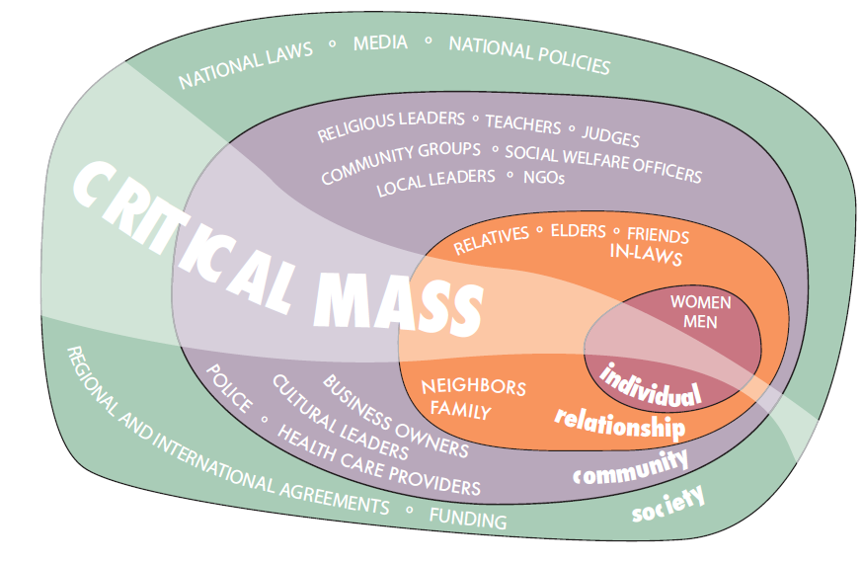
Theoretical base for a social norms approach
Systems Theory (Bronfenbrenner, 1979)
the simultaneous use of diverse strategies, within and across the Circles of Influence, will engage the critical mass that is needed to sustain long term behaviour change
Notes:
Community mobilisation is underpinned by 2 main theoretical paradigms:
Firstly, Public health’s trans-theoretical framework of behaviour change which talks about people moving through 5 main stages (pre-contemplation, contemplation, preparation for action, action, maintenance)
Raising Voices have aligned the objectives of their model with the trans-theoretical framework and Poutama can do the same
Secondly, community mobilisation is firmly underpinned by Systems Theory or the ecological model of behaviour change (Bronfenbrenner, 1979), which Raising Voices have called Circles of Influence
the notion of ripple effects in which small initial inputs, like one person attending a workshop about violence prevention, can trigger much larger beneficial effects throughout the community (Beutement & Broenner, 2010)

Slide 27
Research design
Data Collection
demonstrate the existence social norms
baseline prevalence data
pre/post test of pilot tool
Primary prevention strategies
deliver Poutama Mauri Ora, Mauri Tū!
train facilitators
initiate community mobilisation events, activities
Notes:
We are just entering a data collection phase but, in essence, our methodologies are aiming to
Demonstrate the existence of social norms
gather some baseline prevalence data that we can use to monitor progress or change in Hauraki (currently only have national datasets and deficiency based measures)
re/post pilot of our tool for the measurement of social norms

Slide 28
evidence of social norms: a simple word quiz

Slide 31
designing the prevalence survey

Slide 32
what do we need to know?
Have you experienced this (in the last 12 months)
Have you ever experienced this? (in your lifetime)
Is this experience common in your whanau/community?

Slide 33
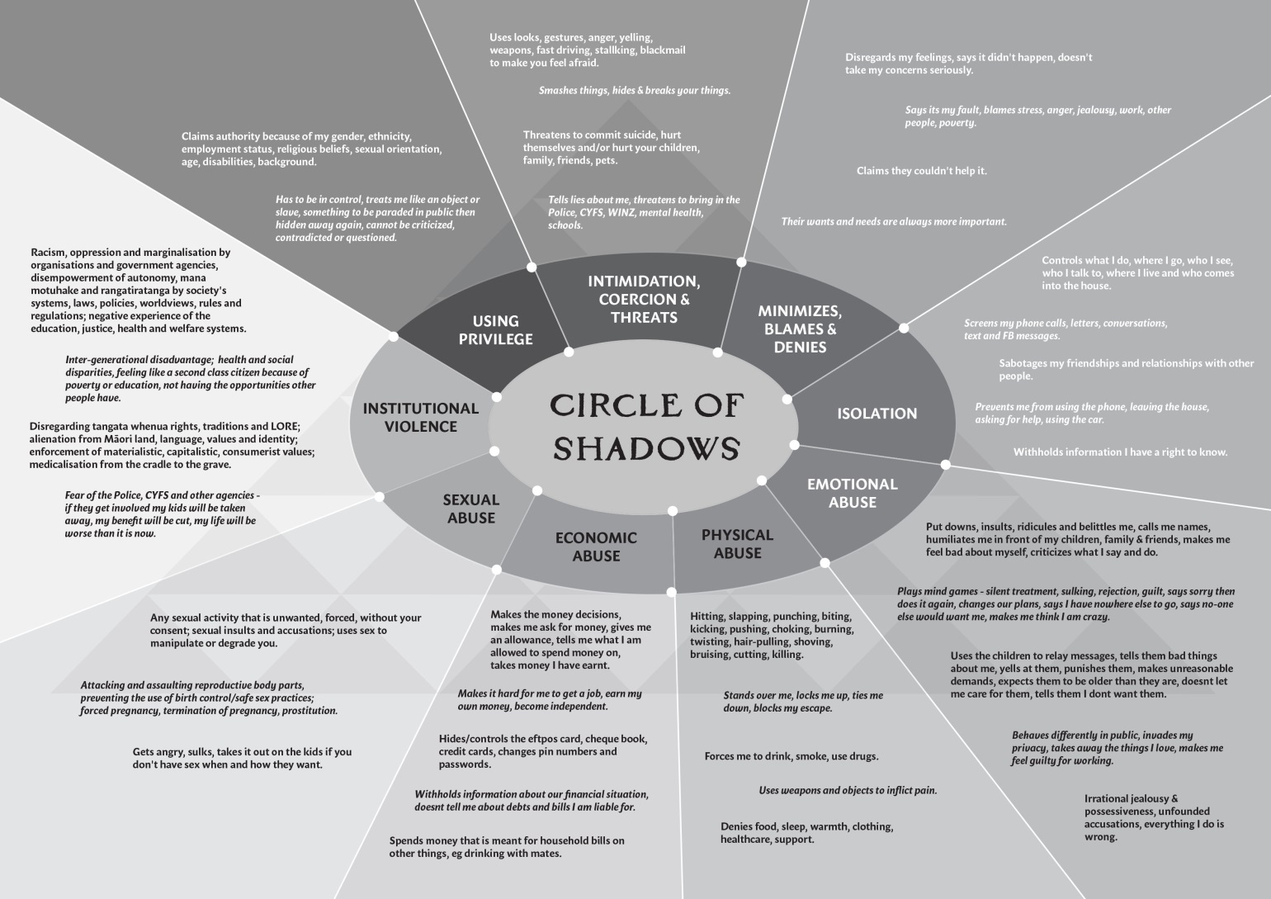
Circle of Shadows

Slide 34
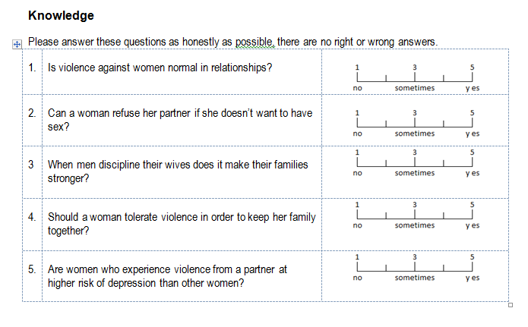
Raising Voices – social norms

Slide 35
Poutama – social norms

Slide 37
Our evidence base ….
Is the tool useable? acceptable? valid? reliable? robust?
does it capture meaningful data about the social norms that are associated with whānau violence in Hauraki ?
Is there evidence of gender/ethnicity differences in the responses?
Does participation in Te Whāriki’s community mobilisation programmes and activities have a positive effect on social norms?
Is one activity/strategy more effective than another?
Is there evidence of critical mass?
Would a larger study would be of value?

Slide 38




Acknowledgements
Tikapa Productions
Jamie McCaskill
Kali Kopae
Health Research Council NZ
Te Whariki Manawahine o Hauraki (staff, clients & whanau)
La Casa Lodge
Mana Retreat
Raising Voices, Uganda
2nd Maori Taskforce on Whanau Violence (Mauri Ora Framework on Violence Prevention)
Dotconz Animations
Tumana Research
Hauraki mokopuna, whanau katoa

Slide 39
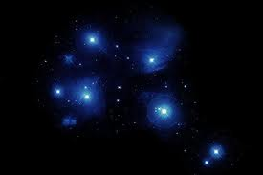

Kua Wheturangitia – Kai Ako
Margy Crook
Paraire Huata
Myra Ngapo
Ngahina Weidenbohm
Taimoana Turoa

Slide 40
for more information, contact
Maree Tukukino, Te Whariki Manawahine o Hauraki (mareet@hauraki.refuge.co.nz)
Stephanie Palmer (tepoipoia@xtra.co.nz)
Denise Messiter (denisemessiter@gmail.com)
animations (hamish@tumana.maori.nz)

